Slide 1
Online Testing System Assessment Viewing Application (AVA)
Training Module
2023-2024
Copyright © 2020 Cambium Assessment, Inc. All rights reserved.
Notes:
Welcome to the Assessment Viewing Application (AVA) training module.
AVA is a component of the online testing system that allows authorized users to view interim assessments for administrative or instructional purposes.
This training module is designed to help you navigate AVA; however, you should consult the Assessment Viewing Application User Guide located on the DE portal for features implemented.

Slide 2
Objectives
After viewing this presentation, you should understand how to
Log in to AVA;
Access the assessments; and
Navigate through the test.
Notes:
After viewing this presentation, you should understand how to
log in to AVA;
access the assessments; and
navigate through the test.

Slide 3
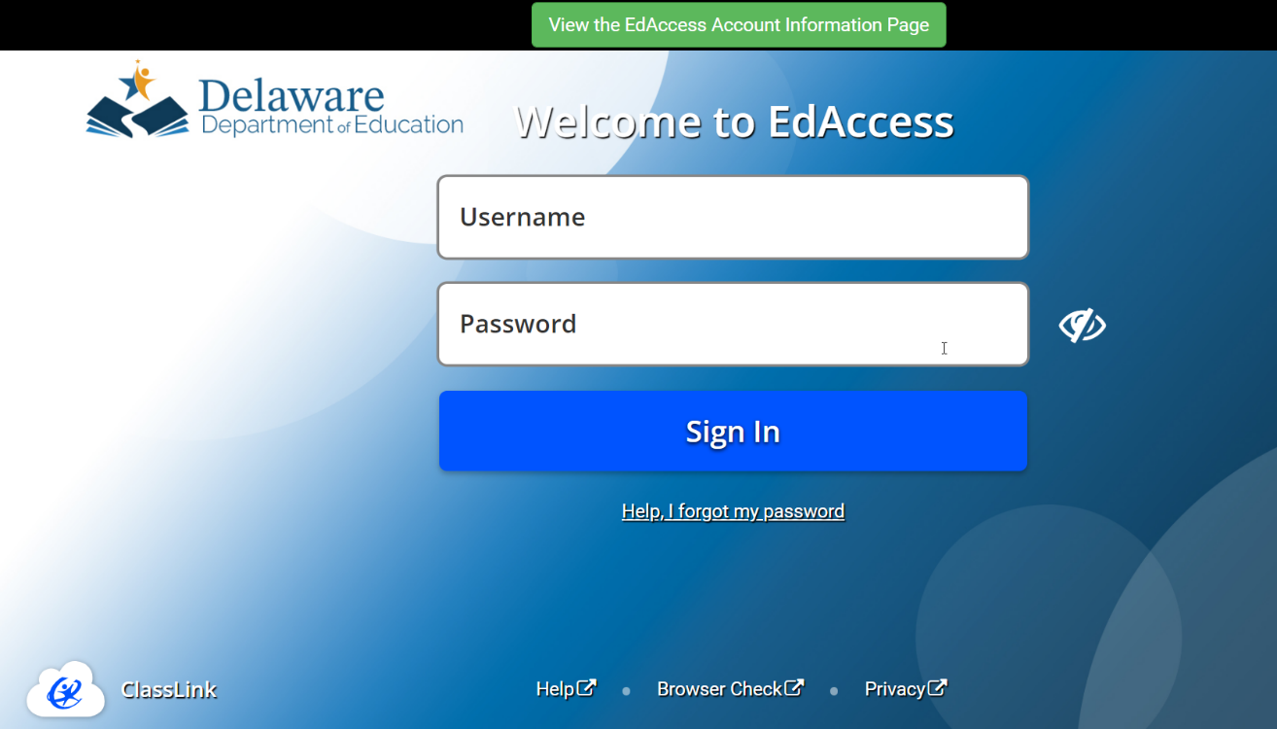
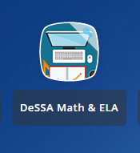
Logging into AVA
AVA is accessed through the Delaware Department of Education’s (DDOE’s) EdAccess or LEA Classlink application.
1. Access the DDOE EdAccess or LEA Classlink application Single Sign-On login page at https://launchpad.classlink.com/ddoe. Use your regular EdAccess ID and password to log in.
2. After you have successfully logged, you will see a list of authorized applications, including DeSSA Math & ELA.
Click the [DeSSA Math & ELA] button from your menu. You will be directed to the DeSSA portal.
Notes:
AVA is accessed through the Delaware Department of Education’s (DDOE’s) EdAccess or LEA Classlink application.
Access the DDOE EdAccess login page at launchpad.classlink.com/ddoe. Use your regular EdAccess ID and password to log in.
After you have successfully logged in, you will see a list of authorized applications, including DeSSA Math & ELA.
Click the [DeSSA Math & ELA] button from your menu. You will be directed to the DeSSA portal.

Slide 4
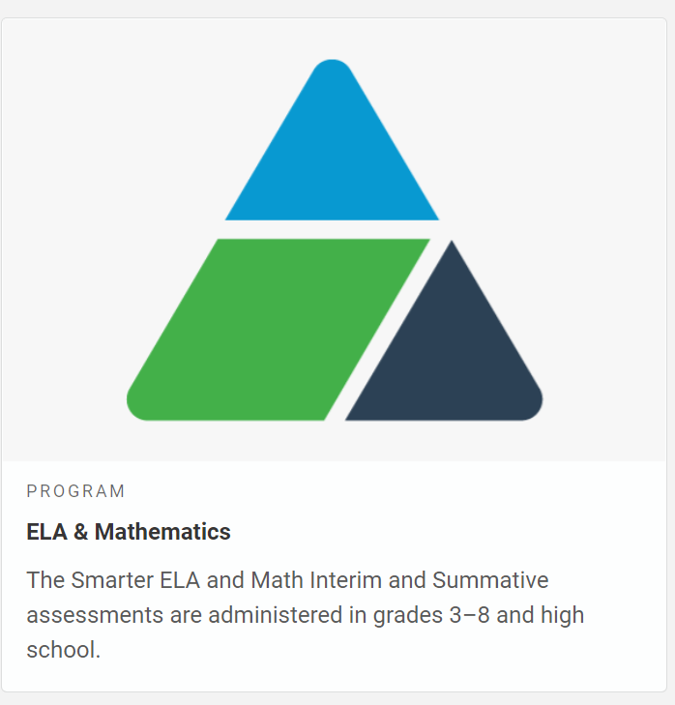
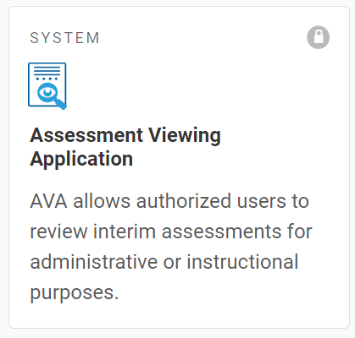
Logging in to the AVA (continued)
AVA is accessed through the Delaware Department of Education’s (DDOE’s) EdAccess or LEA Classlink application.
3. Click the [ELA & Mathematics] user card to access DeSSA applications.
4. Click the [Assessment Viewing Application] card. If you are authorized to access this application, you will be automatically directed to AVA. You will not have to log in again.
Notes:
Access the DDOE EdAccess or LEA Classlink application login page at launchpad.classlink.com/ddoe. Use your regular EdAccess ID or LEA Classlink ID and password to log in.
After you have successfully logged in to EdAccess or LEA Classlink, you will see a list of authorized applications, including DeSSA Math & ELA.
Click the [DeSSA Math & ELA] button from your menu. You will be directed to the DeSSA portal.
Click the [ELA & Mathematics] user card to access DeSSA applications.
Click the [Assessment Viewing Application] button. If you are authorized to access this application, you will be automatically directed to the AVA site.

Slide 5
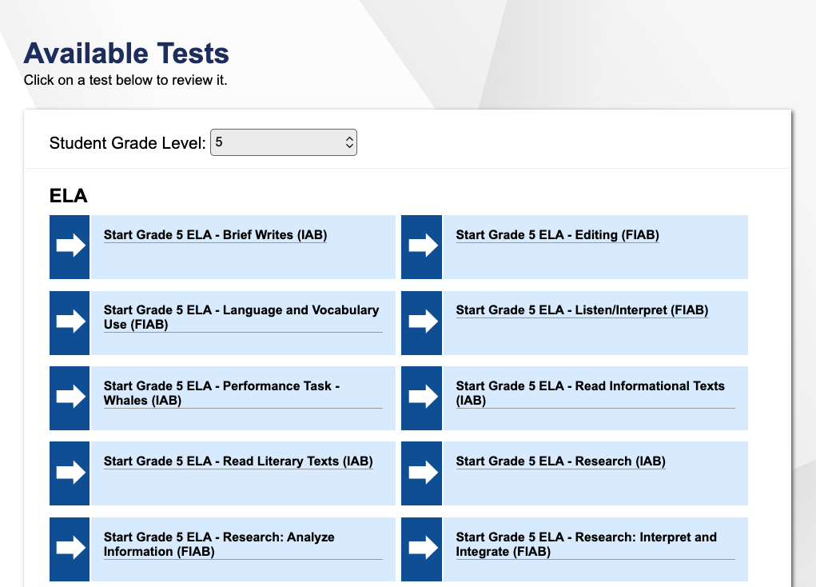
Choosing a Test and Grade
Notes:
After logging in, the Available Tests page will appear.
From the Grade drop-down list, select the desired grade level to view the available tests for the selected grade. Next, click the test name you want to view.

Slide 6
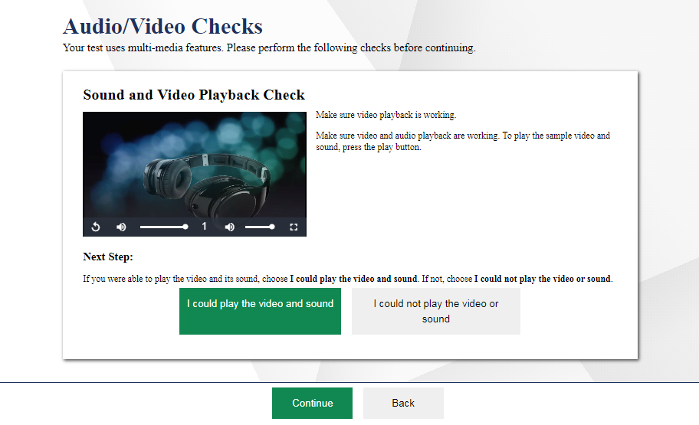
Sound and Video Playback Check
Notes:
On tests that contain video, you will see a Sound and Video Playback Check panel.
To perform the Sound and Video Playback Check:
Click the play button to play the video and audio.
If you can see the video and hear the audio, click the I could play the video and sound button to proceed.
If you cannot see the video and/or hear the audio, click the I could not play the video or sound button and consult your technology coordinator for assistance.

Slide 7
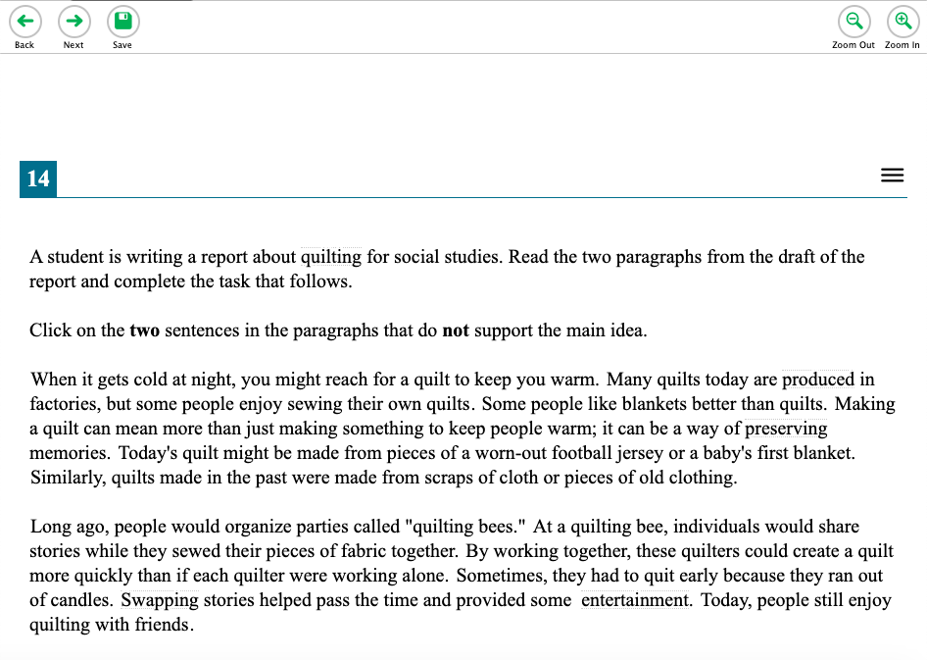
Understanding the Test Page
Global Menu
Zoom In/Out
Context Menu
Notes:
This slide displays a sample test page.
AVA includes several on-screen tools, including global tools and context menu tools.
Global tools are available on every page in the banner. These include the Back, Next, Save, and Zoom buttons.
The context menu displays the tools available for that test item.
For a detailed list of tools, consult your Assessment Viewing Application User Guide.

Slide 8
Responding to Items
Notes:
Next, we will discuss how to navigate a test, pause a test, and complete a test review.
Pages may have only a single item, or they may contain multiple items. Responses you enter will not be scored when you complete the test review. When viewing a test, you can practice responding to each test item. You can also click Next to move through the assessment without responding to an item. This feature is only applicable to Teachers who want to preview the items prior to making decisions about the content and purpose of these interims.

Slide 9
Pausing Tests
Please note that pausing the test will automatically log you out of AVA.
Notes:
You may pause the test at any time. Pausing the test automatically logs you out of AVA. To return to the test, you must log in and select the appropriate test again.
To pause the test, click Pause in the banner. A “log out” message will appear. Click Yes to confirm that you want to pause the test. Please note that pausing the test will automatically log you out of AVA.
As a security measure, you are automatically logged out and your test is paused after 20 minutes of inactivity.

Slide 10
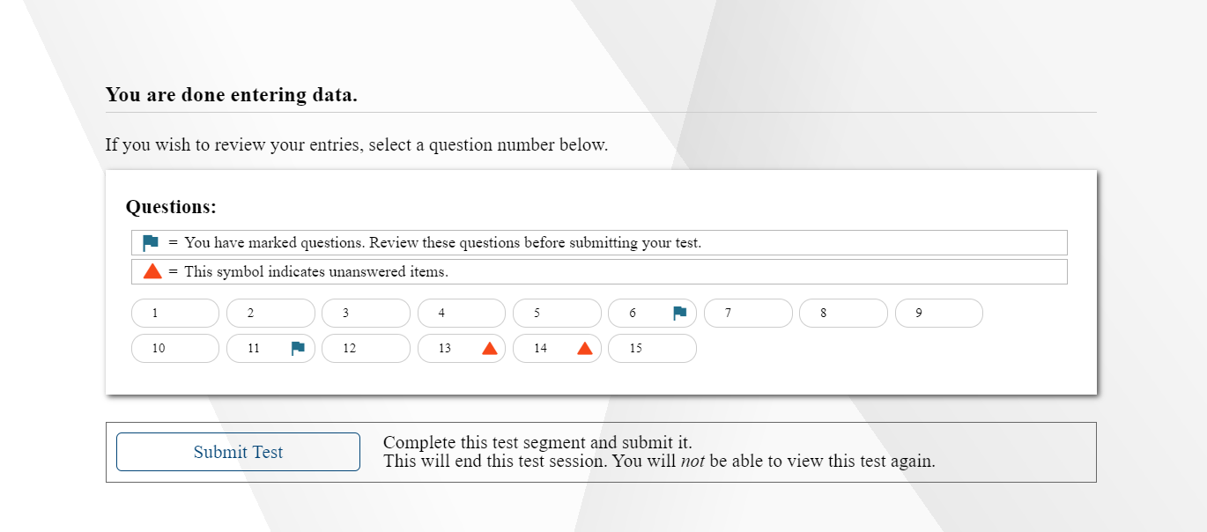
Reviewing Marked Items
Notes:
To finish reviewing the test, click Next on the last page. A review page will appear. Select an item number to return to and review that item. You can navigate through the test as before. You can return to the review page by selecting Review from the Items drop-down in the top-left corner.
When you are finished reviewing, select Submit Test.

Slide 11
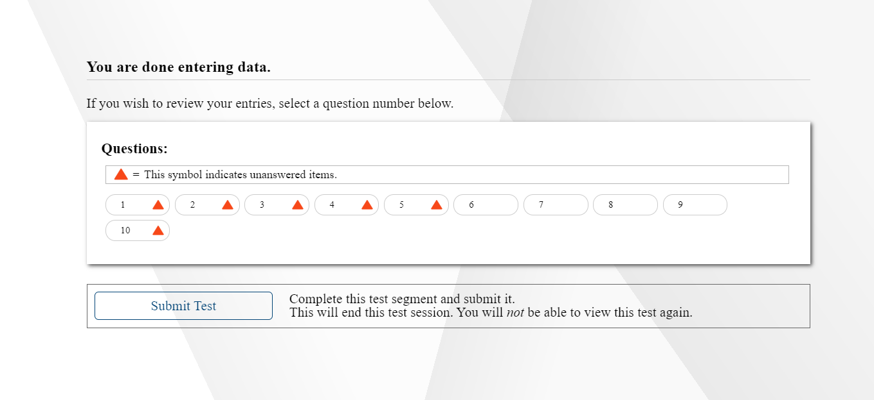
Completing the Review
Notes:
You will be asked one more time to confirm that you are done viewing the test. Select No to return to the review page, or select Yes to complete the test.

Slide 12
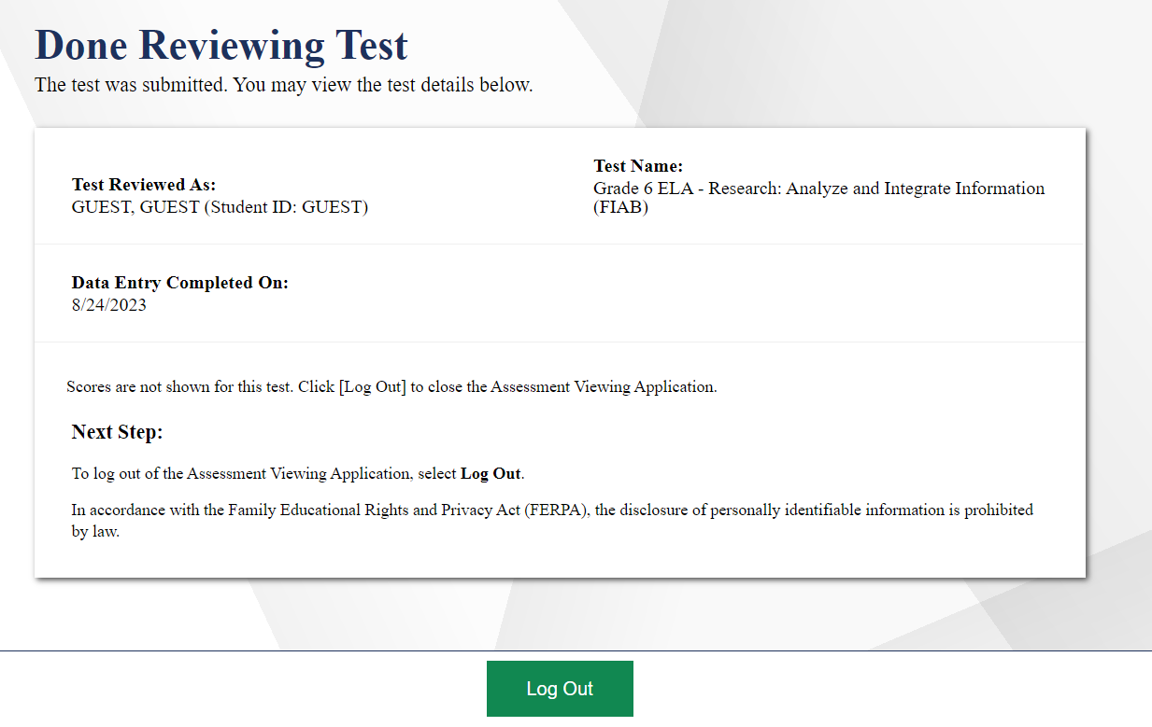
Logging Out
Notes:
The Done Reviewing Test page displays a confirmation that the test review is over. Click Log Out.

Slide 13
Thank You!
Further Information
https://de.portal.cambiumast.com/
DeSSA Help Desk:
E-mail Support: DeSSAHelpDesk@cambiumassessment.com
Support Toll-Free Number: 877.560.8331
Hours: 6:30 a.m. to 6:30 p.m. ET- Mondays–Fridays (except holidays)
DOE Contact:
Phone number: (302) 857-3391
https://helpdesk.doe.k12.de.us/
Notes:
Thank you for taking the time to view this training module. For additional information, refer to the Assessment Viewing Application User Guide located on the portal or contact the Delaware Help Desk.

