Slide 1
The reporting system
For Summative & Interim Assessments
—The Basics
Training Module
2022–2023
Copyright © 2022 Cambium Assessment, Inc. All rights reserved.
Notes:
Welcome to the training module on the Centralized Reporting System for Summative and Interim Assessments.
This training module is based on the Centralized Reporting System User Guide for Summative and Interim Assessments, 2023–2024, which is available on the DeSSA portal.

Slide 2
Topics in Order of Presentation
The Basics
Log in to Reporting & Understand User Roles
Dashboard Generator Page & the Dashboard
Performance on Tests Report
District, School, Teacher, and Student Reports
Print and Export Data
Generate Individual Student Reports (ISRs) & Student Data Files
Use the Longitudinal Report and the Demographic Breakdown Report
Notes:
This module consists of two parts. NOTE: The features and functionality operate the same for both interim and summative tests, except for the reporting categories as noted. The first part, The Basics, slides 3–50, covers general tasks like logging in and navigating from the dashboard generator through the subsequent reports for district and school users and teachers. Topics then include printing and exporting data and generating ISRs and student data files. The section finishes with two unique reports, the Longitudinal Report and the Demographic Breakdown Report.

Slide 3
CRS: Interim vs Summative Tests
IAB/ICA
Summative
Item Level Data: (individual student responses and scores plus item rubric and resources).
Teacher Handscoring (required for performance task mathematics items that cannot be scored automatically).
Student Level Claim and Target Data (ICA)
Cross-Sectional Reporting
Student Level Claim and Target Data (2018-2019 and prior; starting again in 2023-2024).
Notes:
Most features and functionality available in the Centralized Reporting System apply to both the interim and summative tests. There are a few features that are unique to each category of tests.
Item level data outside of the ELA essay data is only available for the IAB and ICA tests.
Teacher handscoring is only conducted on the interim tests. For 2023-2024, teacher handscoring will only be required for designated items on the mathematics performance task tests.
Student level claim and target data has only been available for the interim tests since 2020-2021 due to the transition to the shorter summative blueprint. However, student level claim and target level data will once again be available with the 2023-2024 summative assessment.
New for 2023-2024 is the ability to compare data across school years using the cross-sectional reporting feature. This feature is covered in the Centralized Reporting User Guide and the Comprehensive Centralized Reporting Training Module, both of which are located on the DeSSA portal.

Slide 4
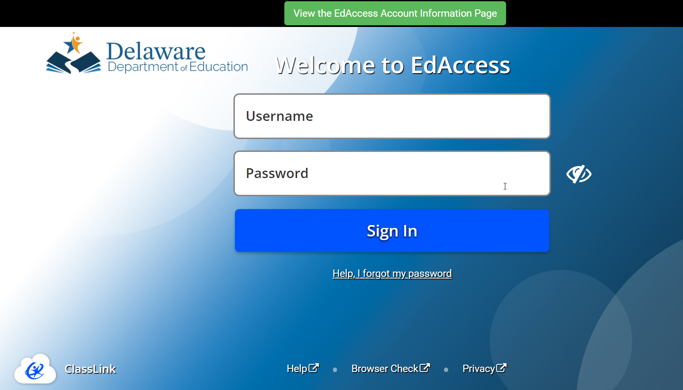
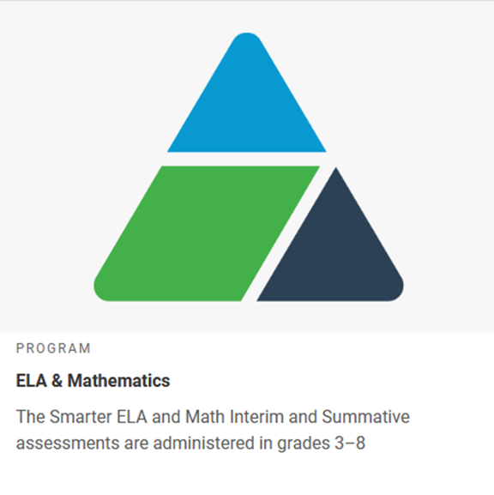
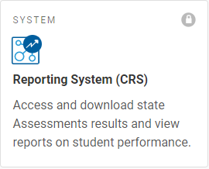
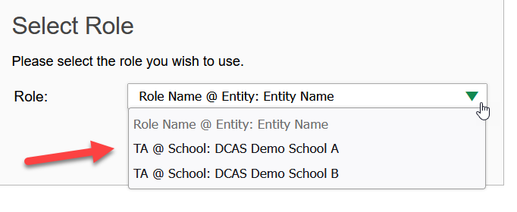
Log In to Reporting
Notes:
To access the Centralized Reporting System, log into ClassLink and then select DeSSA ELA and Math.
From the DeSSA portal homepage, select the ELA & Mathematics portal card and then select the Reporting System card.
You will automatically be connected to the Dashboard Generator page unless you are TA associated with multiple schools. In that case, you are prompted to select a role from the drop-down menu. Select the role associated with the school you want to view and then click Continue to display the Dashboard Generator.

Slide 5
Understand Different User Roles
User | Which Students Appear in Your Reports | Filter Options | Aggregate Comparisons Available
Teacher | All students in your classes who have completed assessments | By class roster | Your students School District State (if available)
School | All students in your school who have completed assessments | Select a teacher, then by roster | Your school District State (if available)
District | All students in your district who have completed assessments | By school | Your district State (if available)
Notes:
Teachers, school-level users, and district-level users have access to different features and data in the Centralized Reporting System. This chart summarizes which students will appear in your reports, the filter options, and the aggregate comparisons available for each of the three roles.
NOTE: These features are available for both summative and interim assessments and operate the same for both.

Slide 6
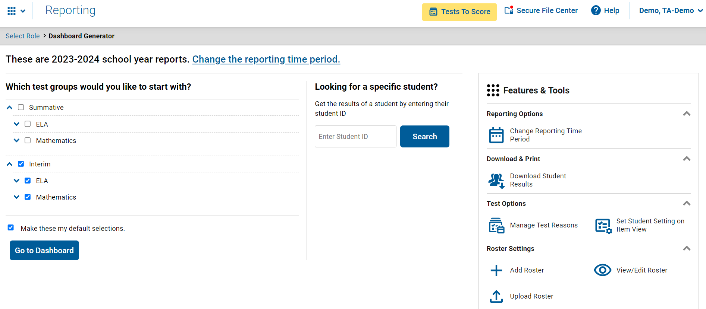
Dashboard Generator
1
3
2
Notes:
The Dashboard Generator page displays after you log in to Reporting. This page is queued to display BEFORE the appearance of the dashboard so you can easily customize your results in advance, so you only see the results that are most helpful to you.
The banner displays your username, the Help button, and the Secure File Center button. If there are interim tests with unscored items, a yellow alert displays in the banner.
There are three prominent sections on the page. In section 1, you will find the test group section where you can check only the tests that apply to your needs and make those your default selections. In section 2, you can access an individual Student Portfolio report by entering a student ID number in the search box. In section 3, you see the Features & Tools menu where you can take some actions prior to viewing data on the dashboard.
To save your selections, mark the checkbox Make these my default selections. These selections will be set in the Dashboard Generator whenever you log in. You can change the defaults at any time.
Click Go to Dashboard.

Slide 7
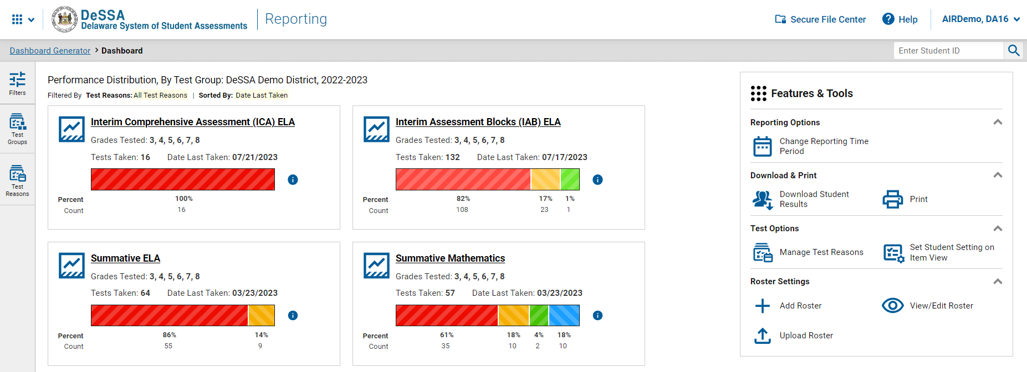
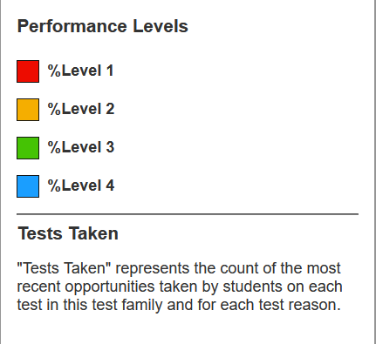
Dashboard—Test Group Cards
Notes:
The Dashboard appears after you select test groups. Test information and results are displayed for the students who are assigned to you based on your role. Teachers see all the tests their students have taken. School-level users see tests taken by all the students in the school. District-level users see the tests taken by all the students in the district.
A test group card displays for each test, by subject, along with the grades tested and the total tests taken. The cards are sorted from left to right, then top to bottom based on the date last taken. The performance distribution results display as a color-coded bar with the percent proficient and student count listed under each colored level. Click the green information button to display the performance levels. For example, 57 students took the Summative Mathematics test. 61% of them achieved a Level 1 performance level while 18% of them achieved a Level 2, 4% achieved a Level 3, and 18% achieved Level 4. The data on the dashboard gives teachers, administrators, and principals a way to quickly compare how their students performed across different test groups.

Slide 8
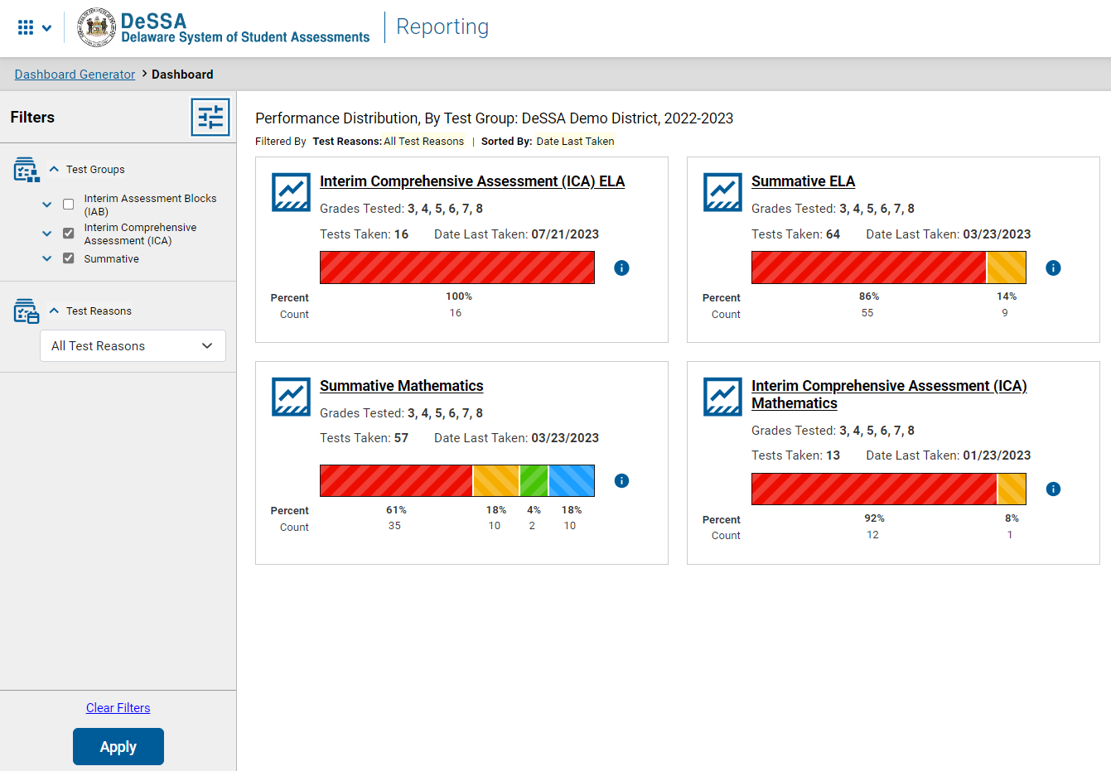
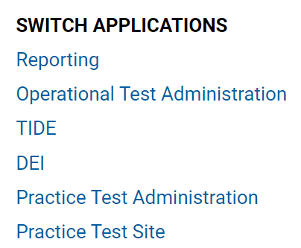
Dashboard—Filters Panel
2
1
Notes:
If you want to change the data you see,
1. Use the Filters panel to further customize your Dashboard. Make selections from the Test Groups options and/or the Test Reasons options. Test Reasons typically represent test administration seasons or opportunities. Selecting a test reason filters out results you do not need to see.
Click the Apply button and your dashboard customizes according to your selections. Filter selections are highlighted in yellow in the table of results header. To clear the filters at any time, click the Clear Filters button and click Apply again.
2. In the upper-left corner of each page in Centralized Reporting is the “System Switcher.” You can move from the Reporting system directly into the Test Administrator (TA) Interface, the Data Entry Interface (DEI), TIDE, and other systems when you need to perform tasks in those systems. You do not have to log out and log back in.
To access data on either Interim or Summative assessments, click the underlined name of a test group card to advance to the Performance on Tests report.

Slide 9
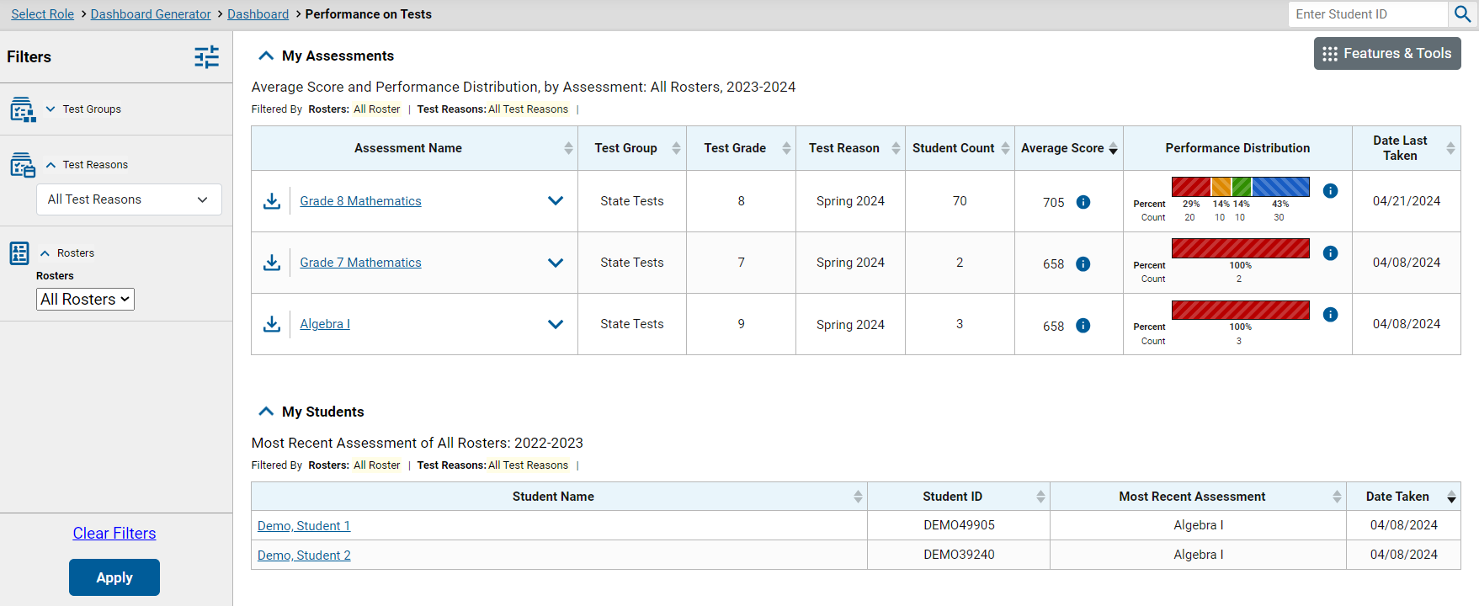
Performance on Tests Report for a Teacher—Two Tables
Notes:
All users move to the Performance on Tests report from the Dashboard. Here is the Performance on Tests report for a teacher who clicked a mathematics test group card. The My Assessments table lists all the tests that the teacher’s students have taken, in order of date last taken.
The My Students table is a fast pass to the individual Student Portfolio report. This report is useful for teachers as they prepare for parent-teacher conferences where student performance across all tests is needed.
Teachers have a Rosters option in the Filters panel. They can select one of their rosters, click Apply, and the Performance on Tests report customizes to show results for only students on the selected roster.

Slide 10
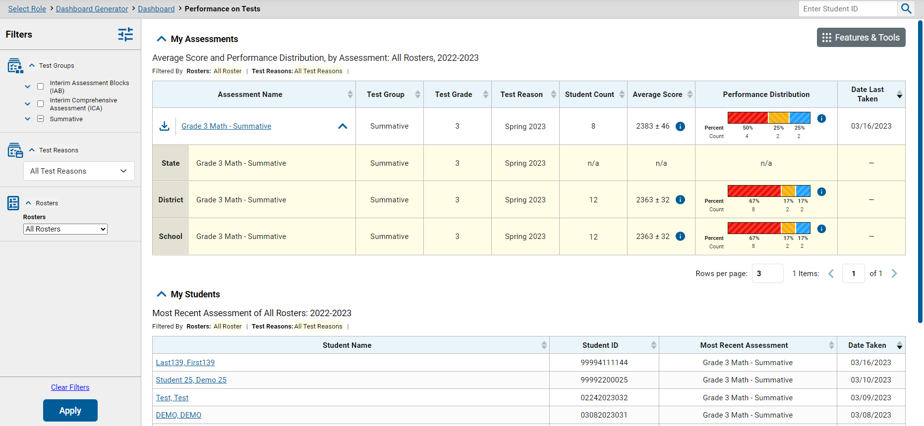
Performance on Tests Report for a Teacher—Aggregate Comparison Rows
Notes:
You can compare your results to aggregate state, district, and school data directly from the Performance on Tests report, depending on your user role. Simply click the expansion arrow to the right of the assessment name to display them. Shown here are the comparison rows a teacher will see. The aggregates are highlighted in yellow below the Assessment Name. Notice that an export button is included for each test in the table. Use it to generate a PDF, Microsoft Excel, or CSV file of the results for that test.
Notice the path in the navigation trail at the top of the report page. Since this teacher has a single role, the Select Role breadcrumb does not display. The teacher has navigated from the Dashboard Generator to the Dashboard to the Performance on Tests report. You can use this trail to return to any previous page in Centralized Reporting.
Click the underlined name of the report to drill down further into test data.

Slide 11
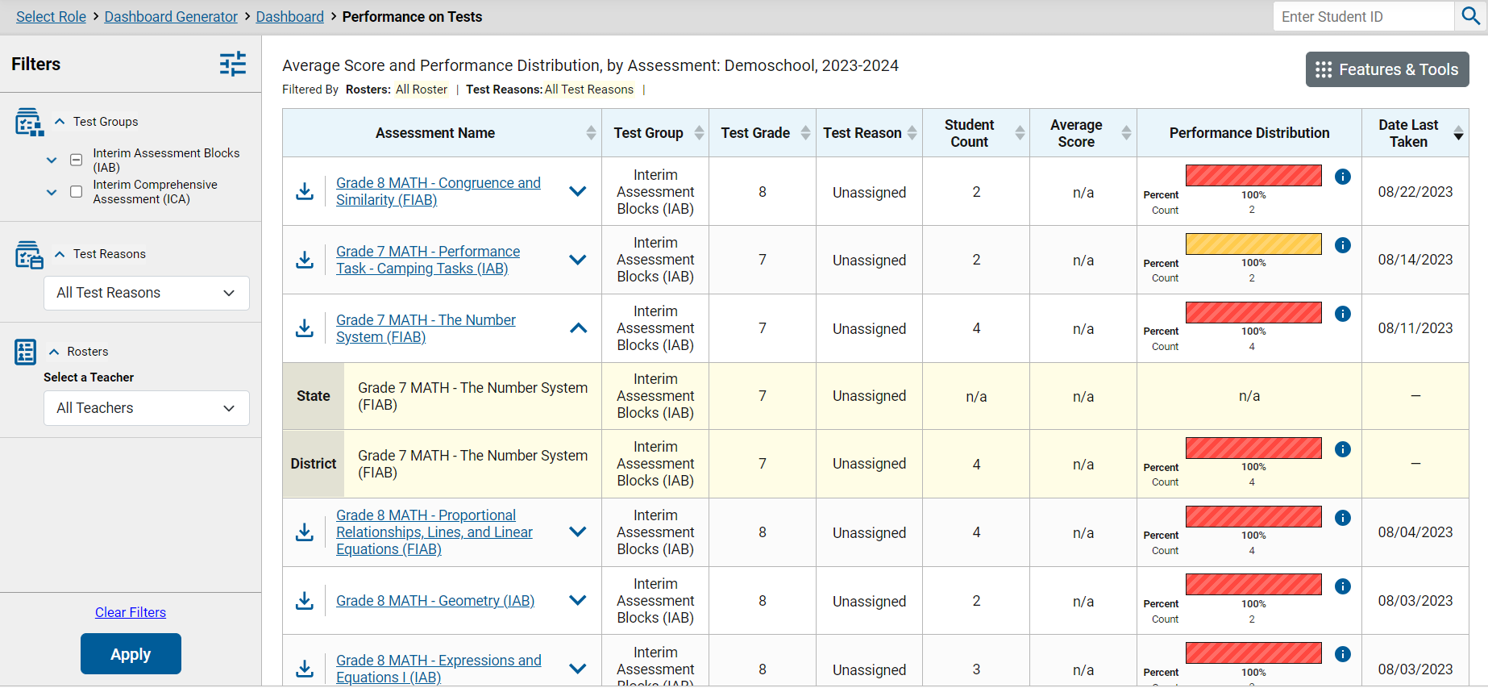
Performance on Tests Report for a School-Level User
Notes:
Here is the Performance on Tests report for a school-level user who selected the mathematics test group card from the Dashboard. It lists all the mathematics tests the students in the school have taken. Notice there is a Rosters option included in the Filters panel. Principals and other school-level users can select a teacher then select one of their rosters to narrow down the results in the report. The school user will see State and District aggregates in the yellow comparison rows.

Slide 12
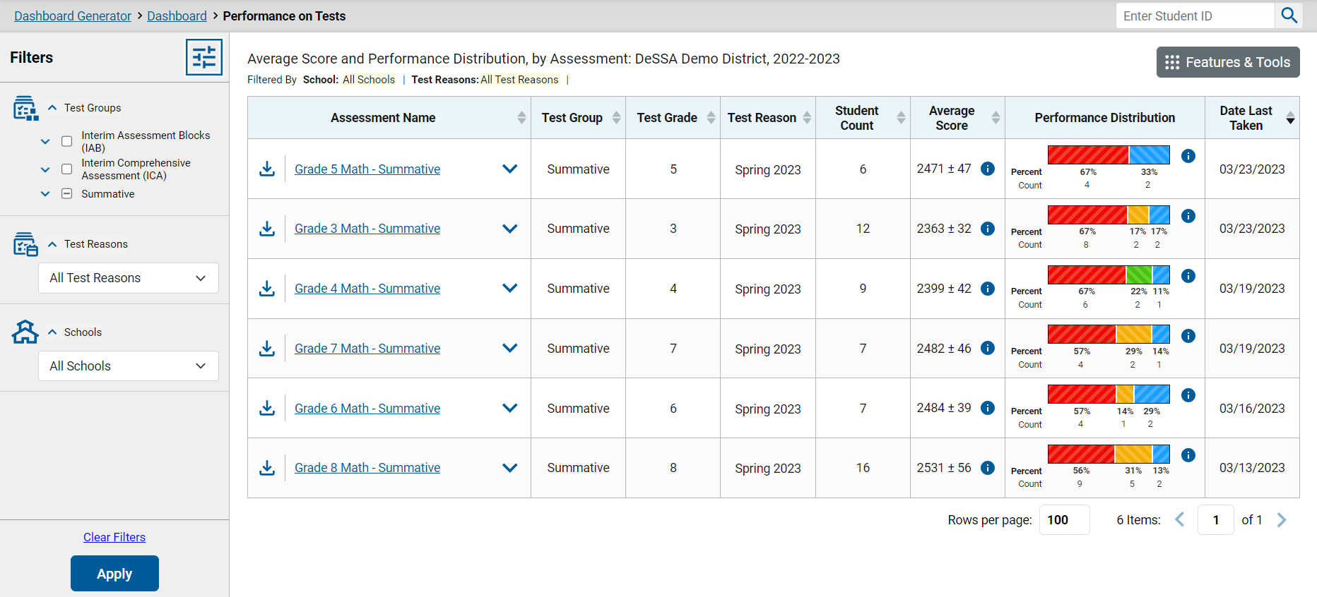
Performance on Tests Report for a District User
Notes:
Here is a Performance on Tests report as it displays for a district-level user who clicked the Classroom Tests card on the Dashboard. The Filters panel now includes a Schools drop-down menu so that users can filter for one specific school. Select an Assessment Name from that column to see the District Performance on Test report for that test.

Slide 13
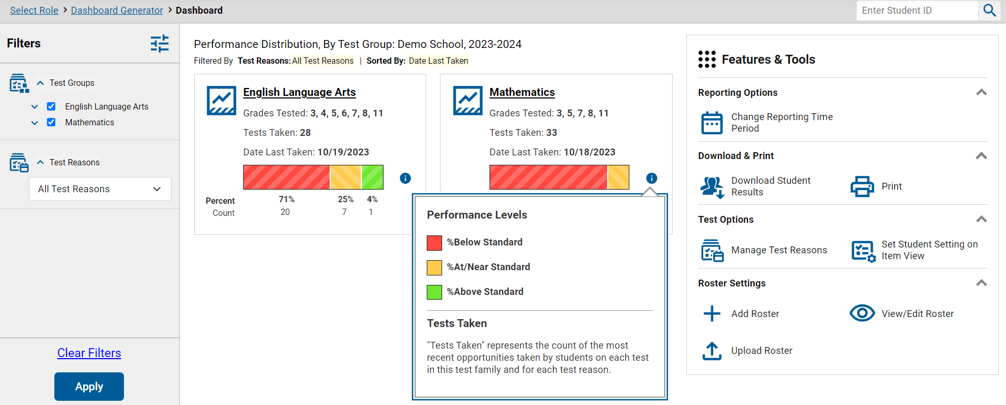
To Review
1
2
3
Notes:
To review the sequence of navigation: Reporting opens with the Dashboard Generator, followed by the customized Dashboard, then the Performance on Tests report. From there, you drill down into more specific test data. District users navigate to district reports, school-level users navigate to school reports, and teachers navigate to “My Students’” reports.

Slide 14
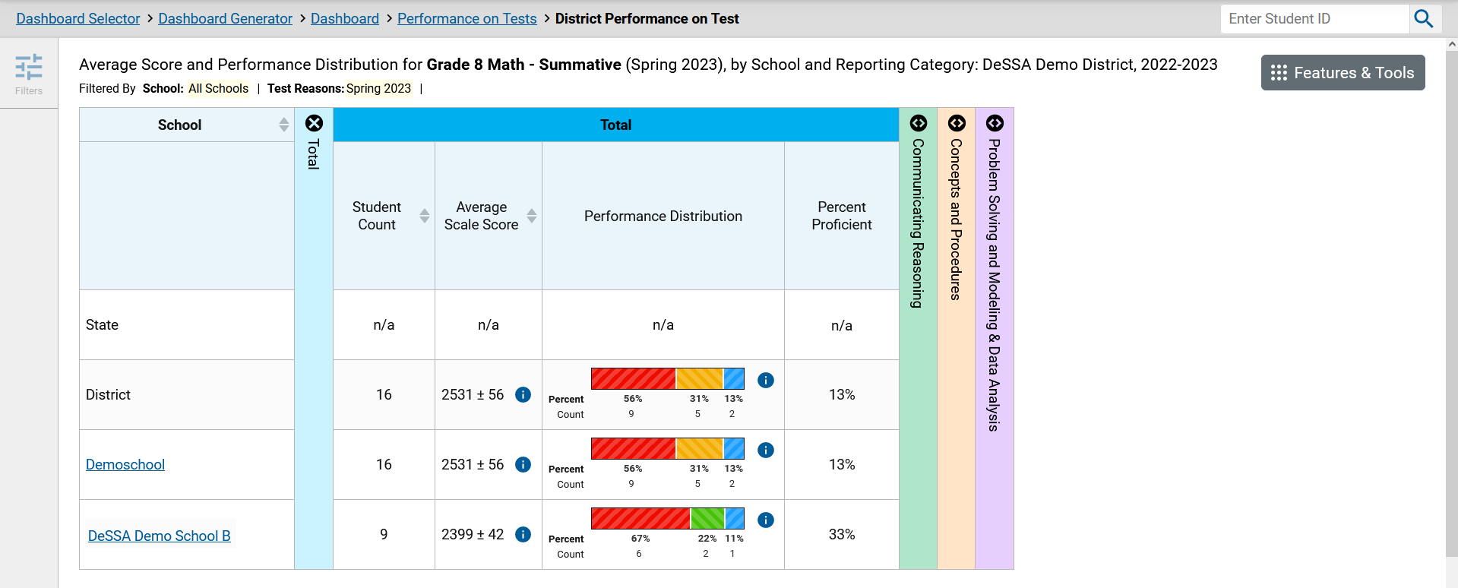
District Performance on Tests Report: Summative
Notes:
When district-level users select a test from the Performance on Tests report, the District Performance on Test report opens with a display of the schools in the district and the aggregate data for each school for the test group you selected. The State and District comparison rows now display at the top of the results table, along with Student Count, Average Scale Score, and the Performance Distribution indicator.
The performance measures used in a report depend on your state or district and the type of assessments administered. Two typical measures are scale score, or Average Scale Score and Performance Distribution as shown on this report for this summative Grade 5 Mathematics test. Interim tests typically report average scale scores while shorter benchmark tests report raw scores. Interim tests are covered in a separate section of this module.
The reporting categories, displayed in different-colored columns, are explained in the More Advanced portion of this module.
To navigate to school-level results, click the name of a school.

Slide 15
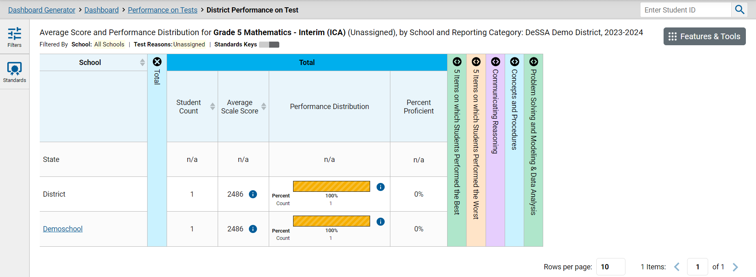
District Performance on Tests Report: ICA
Notes:
When district-level users select a test from the Performance on Tests report, the District Performance on Test report opens with a display of the schools in the district and the aggregate data for each school for the test group you selected. The State and District comparison rows now display at the top of the results table, along with Student Count, Average Scale Score, and the Performance Distribution indicator.
The performance measures will include scale score, or Average Scale Score and Performance Distribution as shown on this report for this interim Grade 5 Mathematics test. Interim tests typically report average scale scores while shorter benchmark tests report raw scores. Interim tests are covered in a separate section of this module.
The reporting categories, displayed in different-colored columns, are explained in the More Advanced portion of this module.

Slide 16
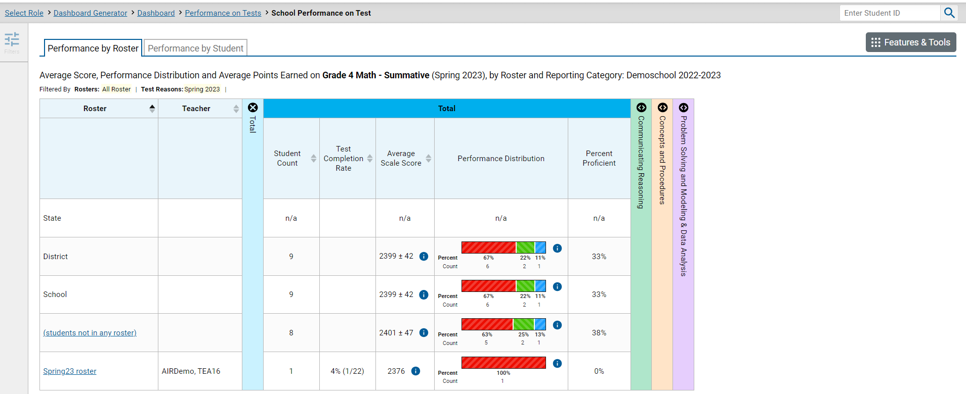
School Performance on Test Report—Roster Tab
Notes:
In the School Performance on Test report, results are organized by Roster, by default. Two tabs, Performance by Roster and Performance by Student, appear at the top of the results table, allowing the school-level user to toggle between roster results or student results.
You may be able to check the Test Completion Rate for each roster in the school using this report, as well as Average Scale Score, Performance Distribution, and any other performance measures in use.

Slide 17
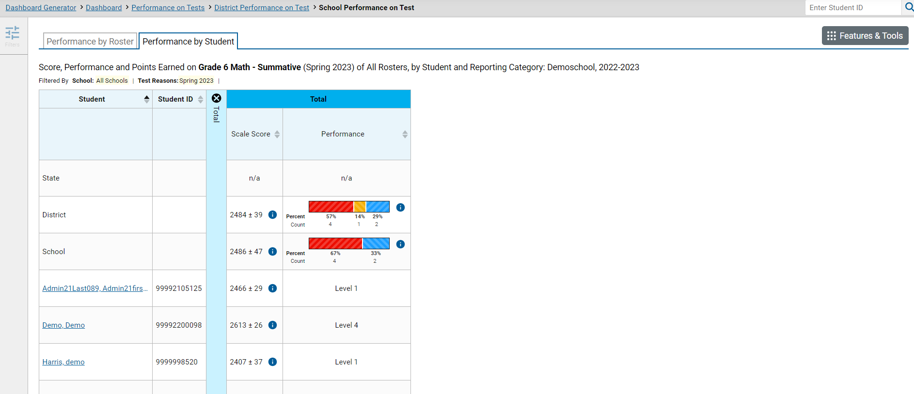
School Performance on Test Report—Student Tab
Notes:
Here is the same School Performance on Test report showing Performance by Student. There is one more drill-down option at this point—to isolate a student’s test results, click the underlined Student name.

Slide 18
Student Performance on Test
Notes:
Here is the Student Performance on Test report showing a single student’s performance. Note that the student’s name is no longer underlined. This is the end of the navigation trail.

Slide 19
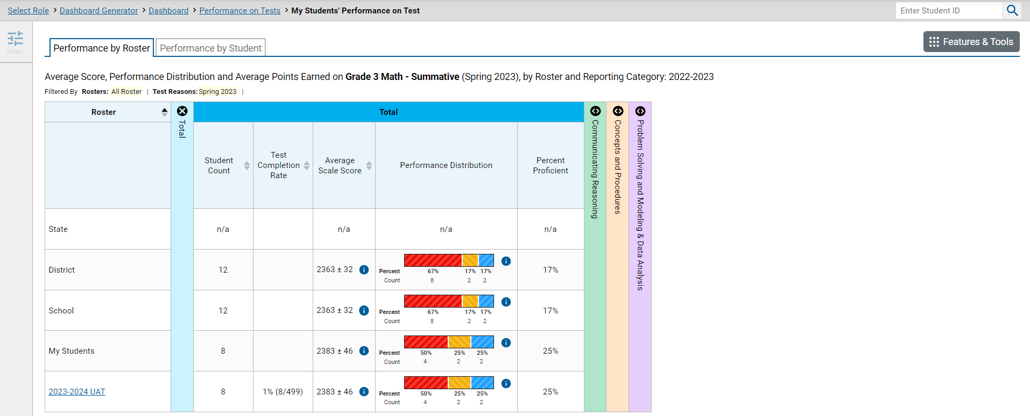
The My Students’ Performance on Test Report—by Roster
Notes:
This is a My Students’ Performance on Test report for a teacher who clicked the grade 3 mathematics assessment from his or her Performance on Tests report. The My Students’ Performance on Test table lists the class rosters in the left column with the State, District, School, and My Students comparison rows above. You can toggle to Performance by Student to see all the students in all the rosters listed.

Slide 20
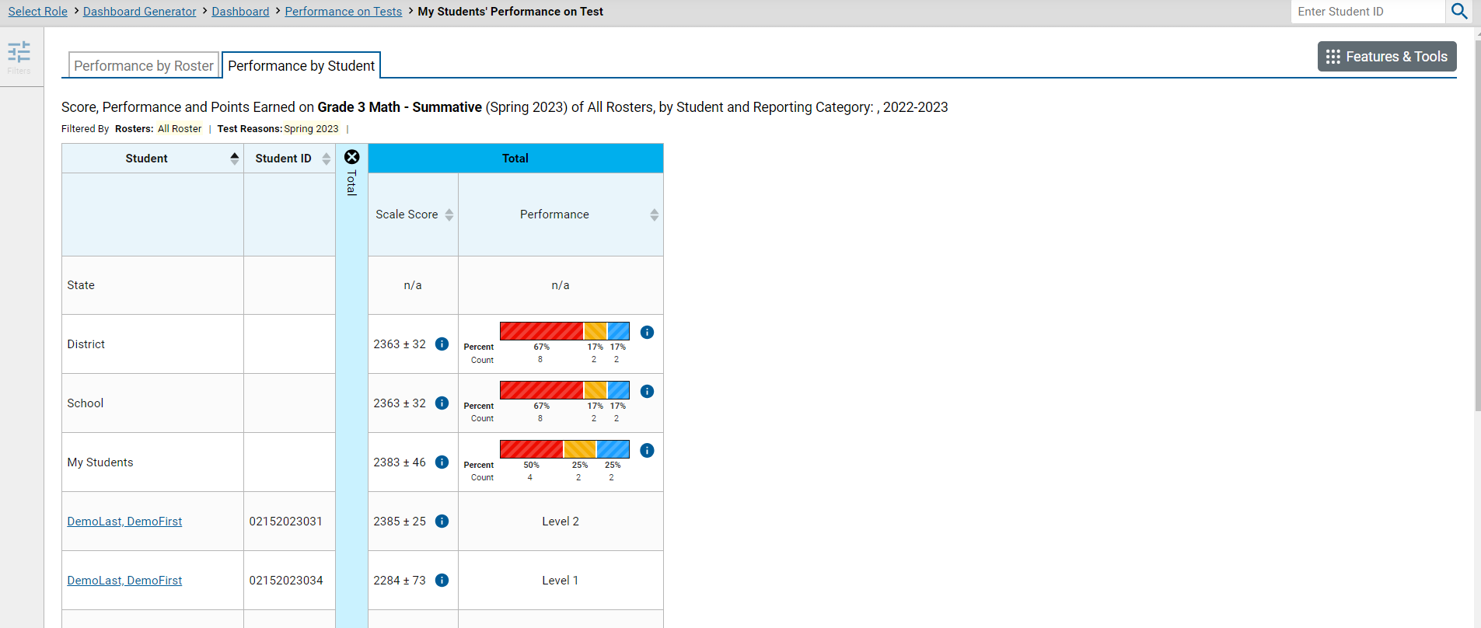
The My Students’ Performance on Test Report—Student Tab
Notes:
Here is the same My Students’ Performance on Test report, organized by student. Click a Student name to display the Student Performance on Test report.

Slide 21
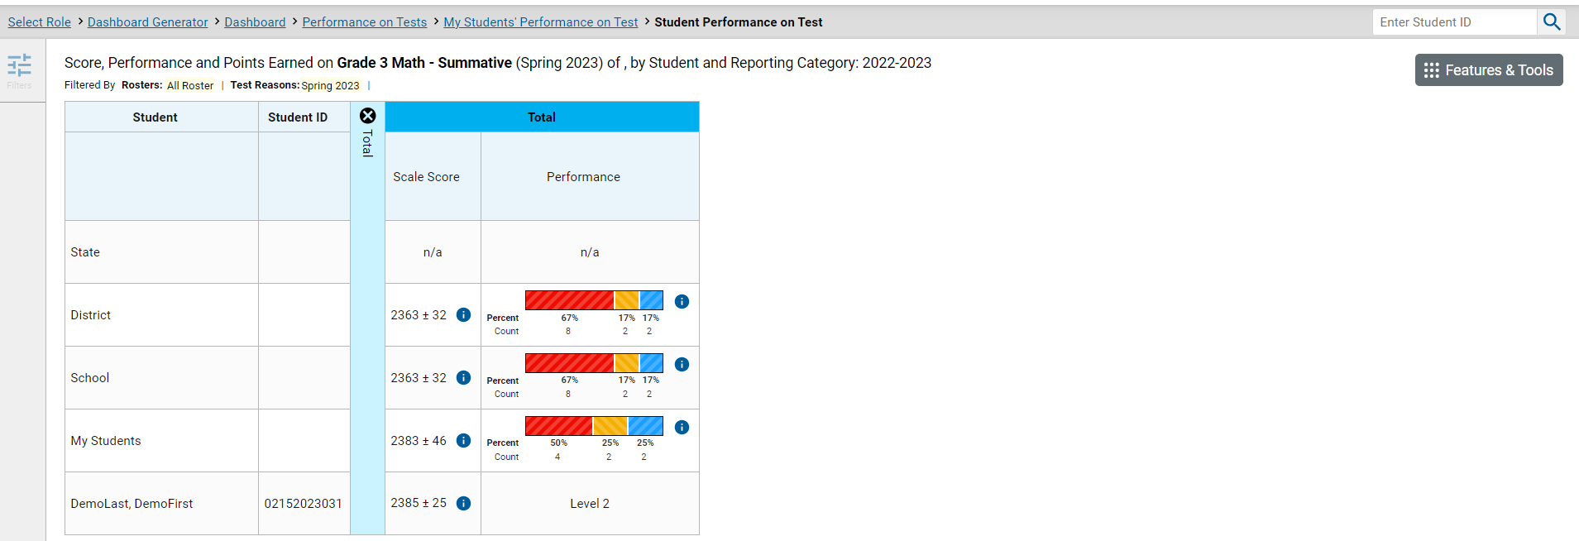
My Students’ Performance on Test
Notes:
This Student Performance on Test report is the end of the navigation trail for a teacher. The Student name is no longer underlined.

Slide 22
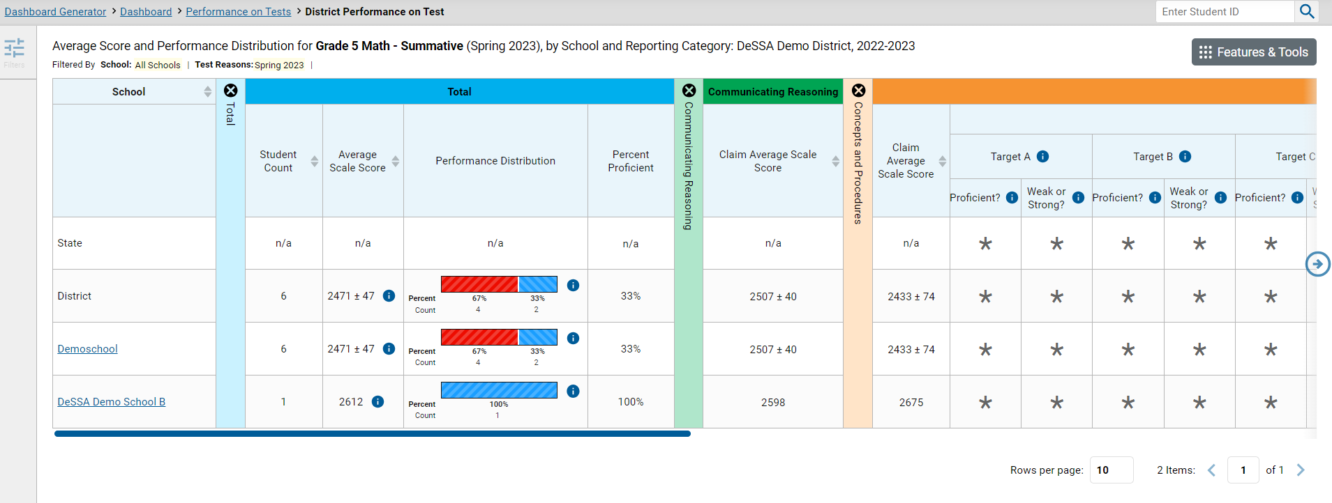
Tests with Reporting Categories
Notes:
For tests with reporting category sections, you can compare the performance of your district and schools in each area of the test. Click each vertical section bar to expand or collapse it. In this example, you can view the performance level for each school under the reporting categories for this grade 5 mathematics test.
NOTE: Claim and Target level data at the student level for summative assessments is available for 2018-2019 and prior and will be again for 2023-2024. Claim and Target level data is only available at the aggregate (state, district, school) level for 2020-2021, 2021-2022, 2022-2023.

Slide 23
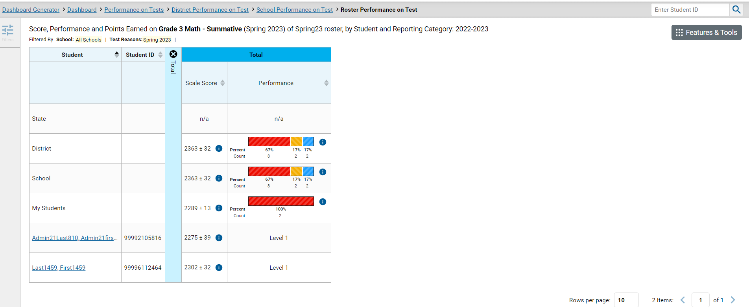
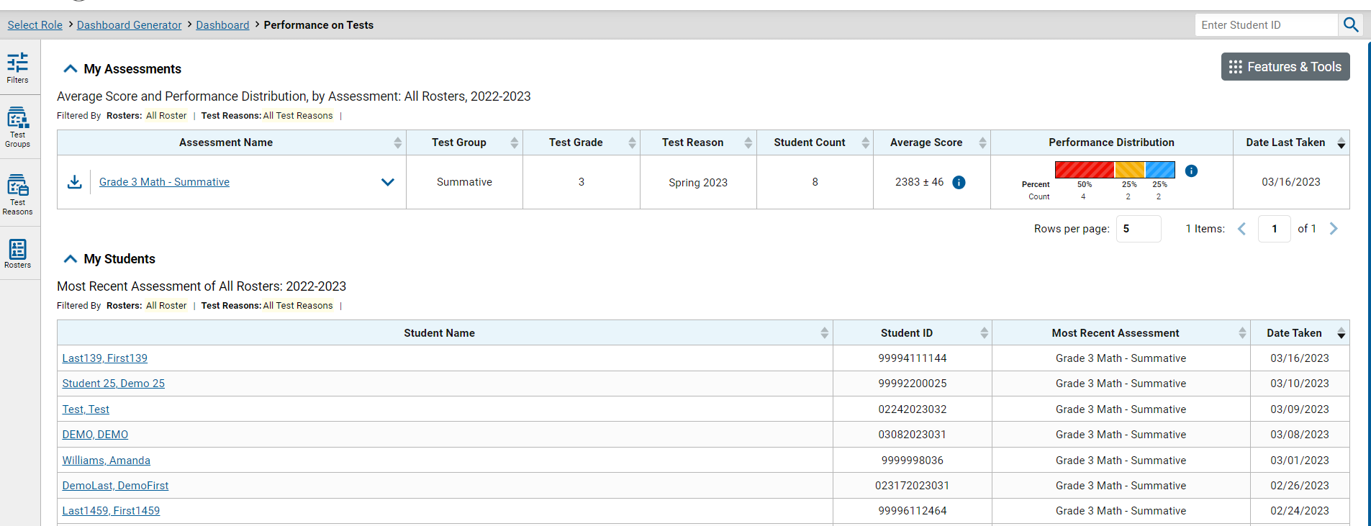
Access the Student Portfolio Report
Notes:
All users can access the standalone Student Portfolio report from any test report page. Copy and paste the student ID number into the search box and then click the search button, as shown in the upper-left image.
Teachers have a fast pass to this report from their My Students table on their Performance on Tests report page. Simply click the student’s name or the magnifying glass view button and the report displays.

Slide 24
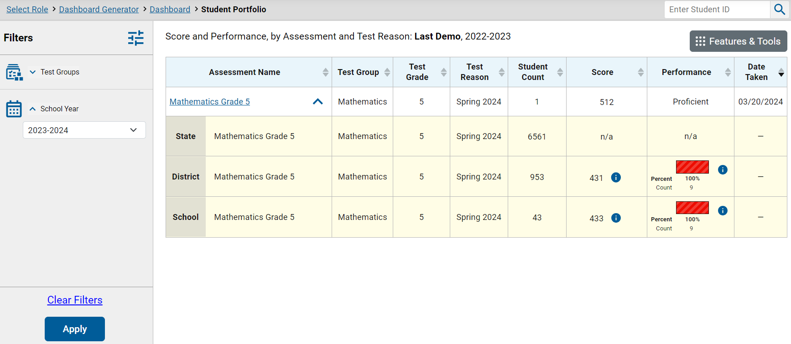
Ways to Use the Student Portfolio Report
4
5
1
2
3
6
Notes:
The Student Portfolio report lists all the tests the student has taken in the current school year.
This report is designed so that users can quickly:
Filter by Test Group to eliminate test groups you do not need to see.
Add tests from previous school years to get a complete list of all tests taken by the student.
Compare a student’s results with state-, district-, school-, and/or teacher-level data using the expansion arrows to the right of each assessment name.
4. Sort results in any column with a set of sorting arrows in the header.
5. Generate and print an Individual Student Report (ISR) or a Student Data File using the Features & Tools button.
And access specific test data directly from the report by clicking the Assessment Name.

Slide 25
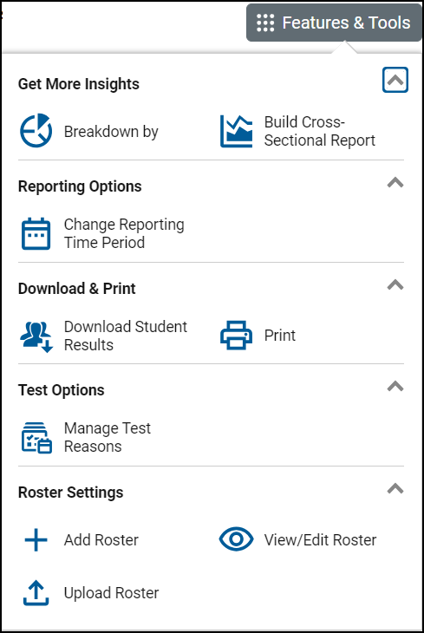
Download and Print Features
Two Types of Results
Individual Student Reports (ISRs)
The Student Data File
Notes:
The Features & Tools menu is available at the upper-right corner of every page in Reporting. The actions displayed here vary, depending on the type of assessment and the user’s role. This section covers how to print reports and how to download student results in the form of ISRs and the Student Data File.

Slide 26
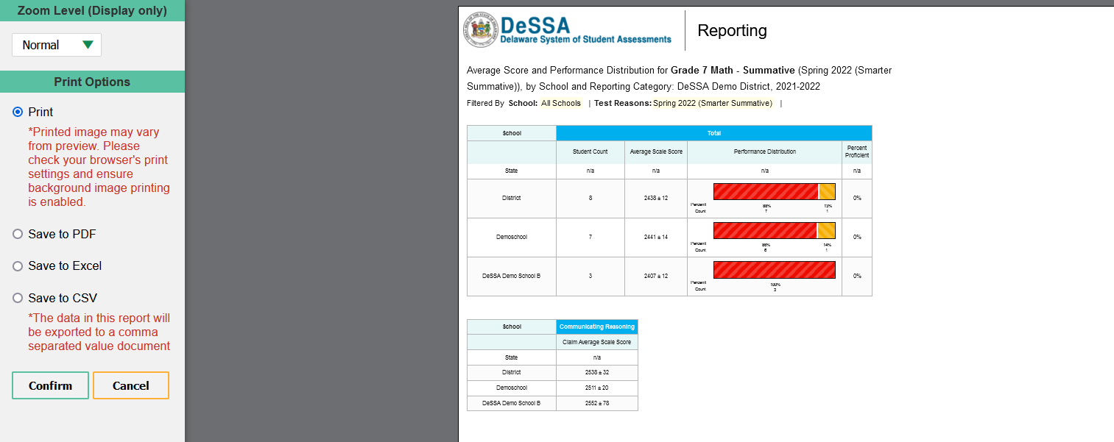
Print Anything You See on Your Screen
Notes:
You can order a print file from any page in Reporting except the Dashboard Generator. You are presented with Zoom Level and Print Options and a preview of what will print. Make your selections from the gray panel on the left side of the page and click Confirm. If you save to PDF, Microsoft Excel, or CSV, the file is stored in your Secure File Center for 29 days. Here, you see a print preview of the District Performance on Test report for a grade 7 mathematics test.

Slide 27
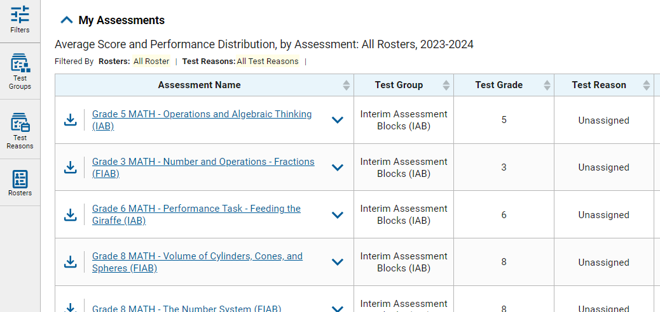
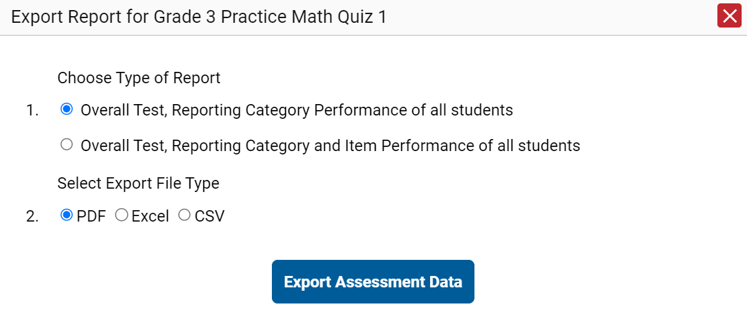
Export Options
Notes:
You can export data from any report where you see the export icon located to the left of the Assessment Name. Your export options depend on the test report type. You may have the option of selecting summary reports including just the reporting category performance, or you may choose to export them with the item performance of all students included. Make your Export File Type selections and click Export Assessment Data. Retrieve the report from your Secure File Center.

Slide 28
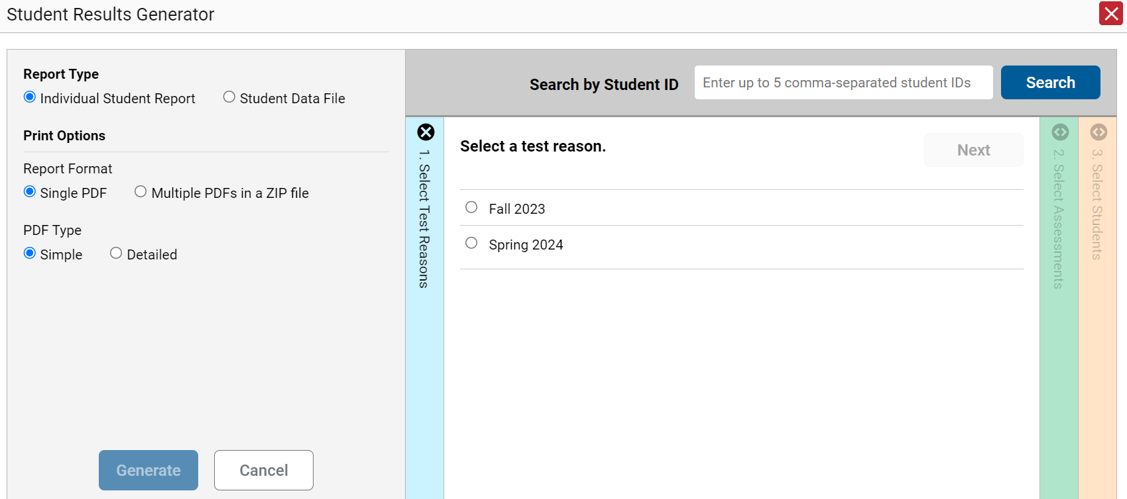
Build ISRs and Student Data Files/Test Reasons
1. Select a test reason.
Notes:
The Download Student Results button allows you to generate an ISR or a Student Data File. An ISR is a PDF that displays test results for a single test opportunity taken by a student. It may consist of a single page or multiple pages. ISRs are useful for sharing performance information with students and their parents and guardians. A Student Data File is a Microsoft Excel, CSV, or text file of the information used for analysis.
The Student Results Generator button is the “head and shoulders” icon located in the Features & Tools menu, under the Download & Print options. When you click it, the Student Results Generator pop-up window displays. Both reports, the ISR and the Student Data File, are typically built by completing three numbered and colored sections:
#1 Select Test Reasons
#2 Select Assessments
#3 Select Students
In this section, we take you through the steps of generating an ISR. You construct the Student Data File in the same way, but your report will be in the form of a Microsoft Excel, CSV, or text spreadsheet.
Here is the Student Results Generator window showing pre-populated or pre-selected options, although you can change those selections to match your needs.
Test Reasons are typically test administration windows. They can also be categories, like Pre-test or Post-test, or a numbered opportunity. Select the test reason you need. You can only select one test reason.
Now, go to the other two sections and confirm or change the selections. You open and close each column by clicking the symbols at the top of the columns, or you can click the Previous and Next buttons at the top of each open column.

Slide 29
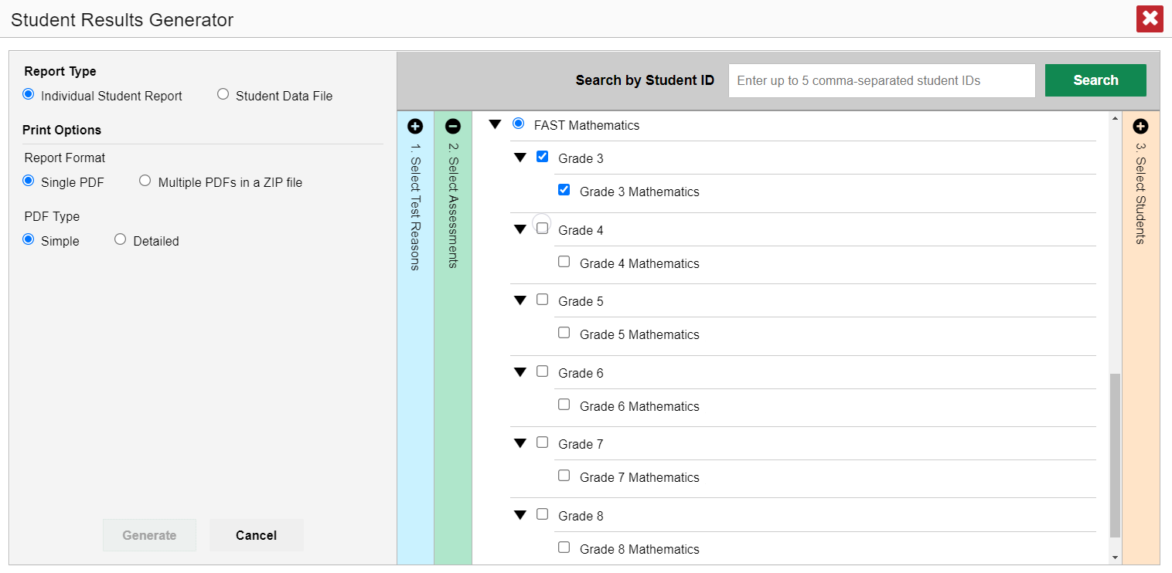
Select the Assessments
2. Select the assessments.
MATHEMATICS
Notes:
Column 2 lists assessments by subject and grade. Select individual assessments or subjects. When you are generating ISRs, you can select multiple grades under ONE subject, but not multiple subjects.

Slide 30
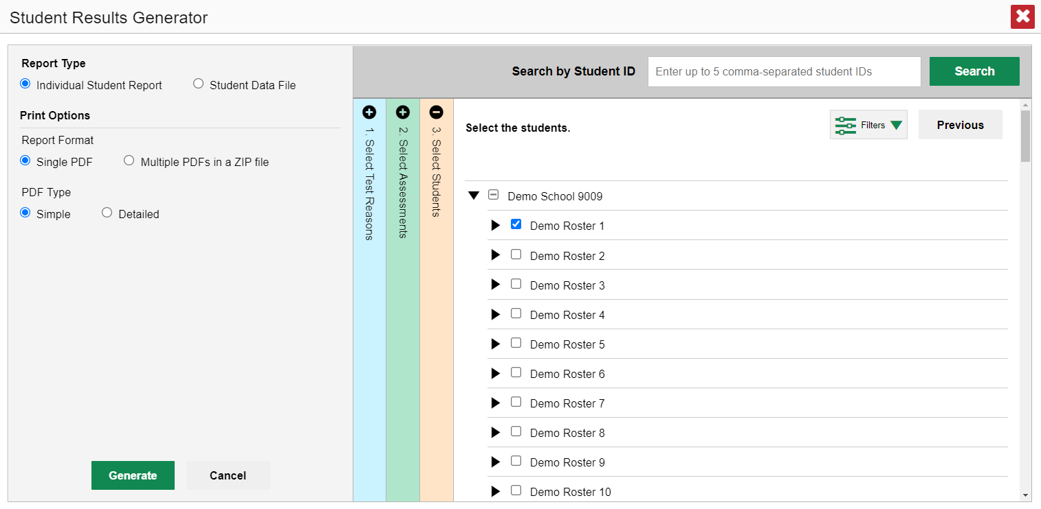
Select the Students
3. Select the students.
Notes:
Column 3 is labeled Select Students. The Select Students column displays the rosters in the Demo School. Each roster can be expanded to show the students on that roster by clicking on the arrow next to the roster name.
District assessment coordinators are limited to selecting students from up to THREE schools only.

Slide 31
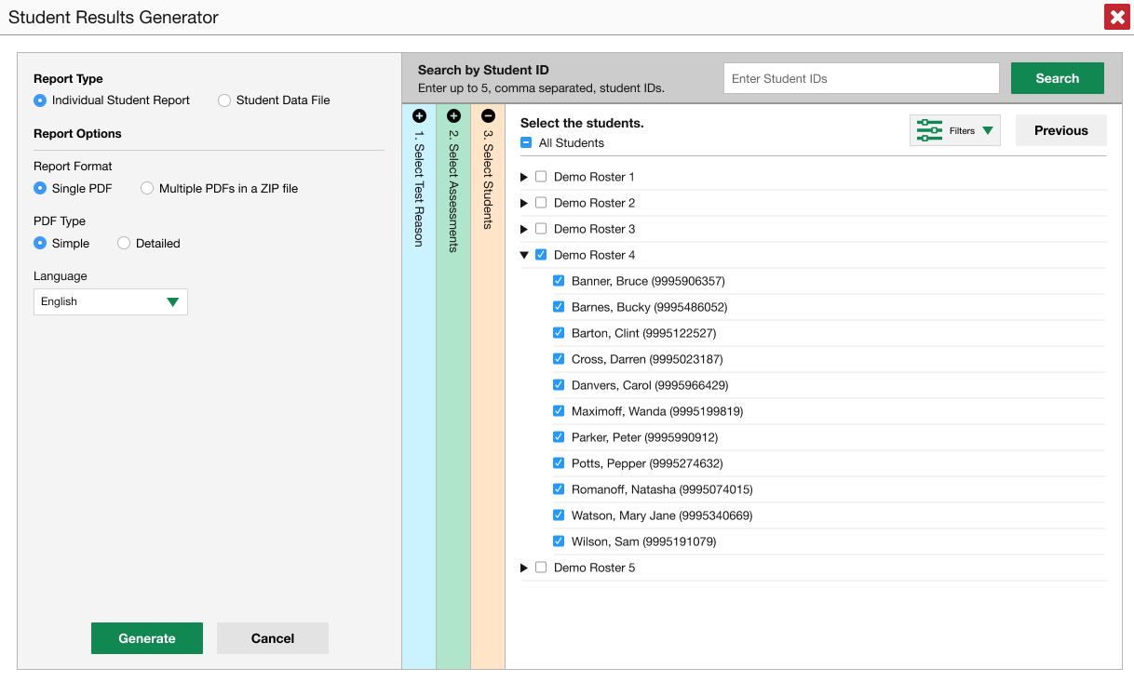
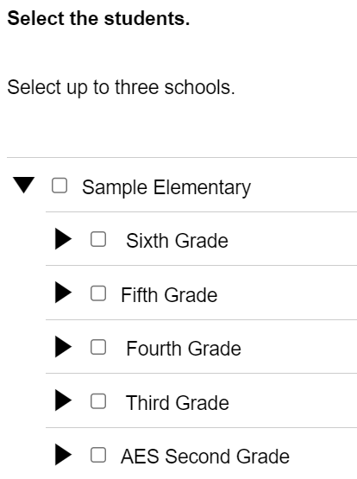
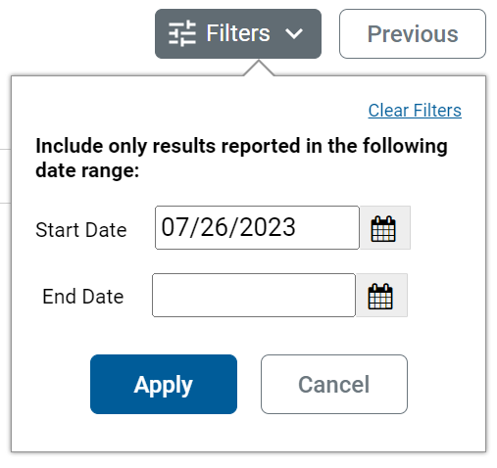
Another Customizing Option
4. Set date range.
Notes:
Another customizing option is accessed via the Filters button, which is in the Select Students section to the left of the Previous button. You can select a range of dates to be included in the ISR by using the calendar to enter a start date and an end date. After making your customizations, click the Generate button and the ISR(s) will post to the Secure File Center.

Slide 32
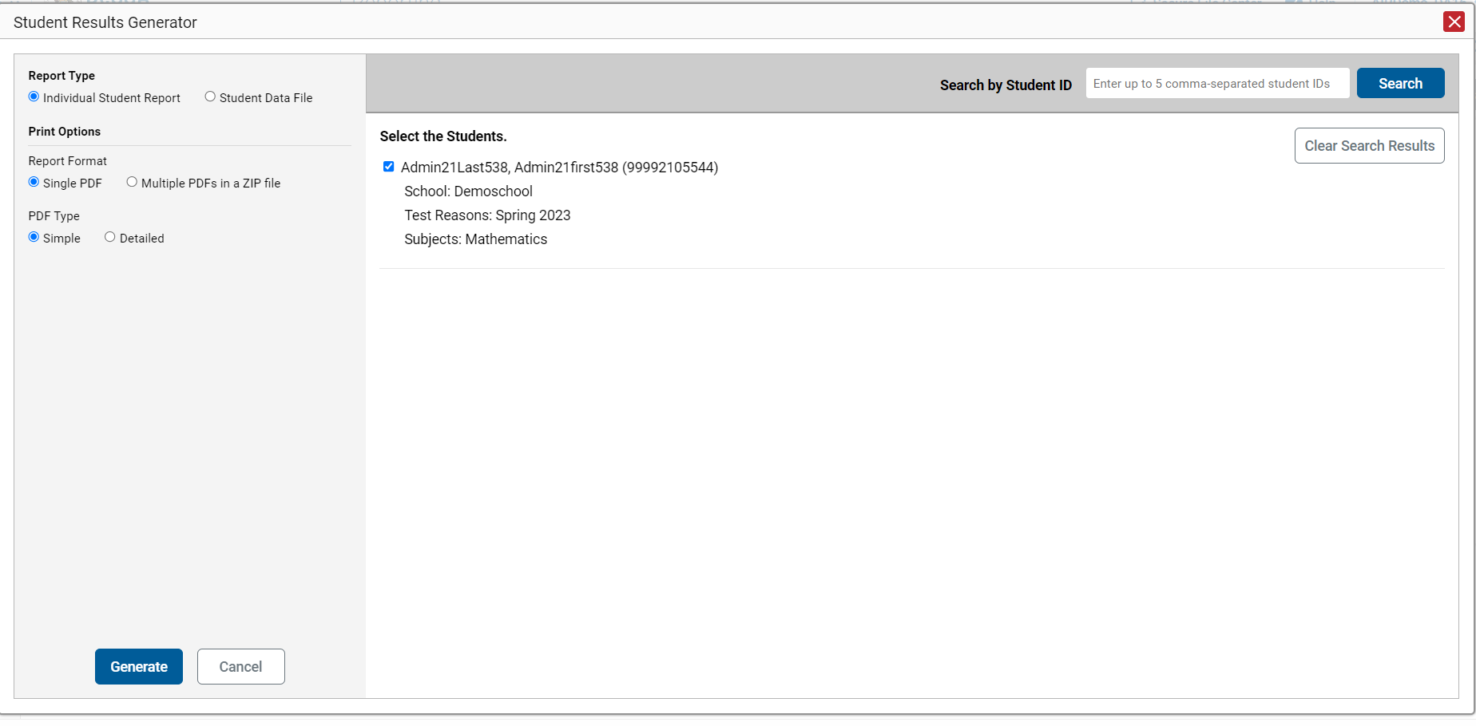
ISR from the Student Portfolio Report
Notes:
If you click the Download Student Results button from the Student Portfolio Report, the data will load pre-populated, as shown here, without the three colored panels. You see the student’s name and ID number, the school, the test reasons which display as test administrations of the current school year, and the subjects. You can clear the Student Portfolio selection by clicking Clear Search Results. That removes the selected student and takes you to the three panels you can select from, with nothing pre-selected.
When you click the Generate button, the report will post to the Secure File Center.
If you need to print just a few more students’ ISRs, you can enter up to five, comma-separated student IDs in the Search by Student ID box, and the same pre-populated template will display, allowing you to generate the ISRs for all those students’ tests.

Slide 33
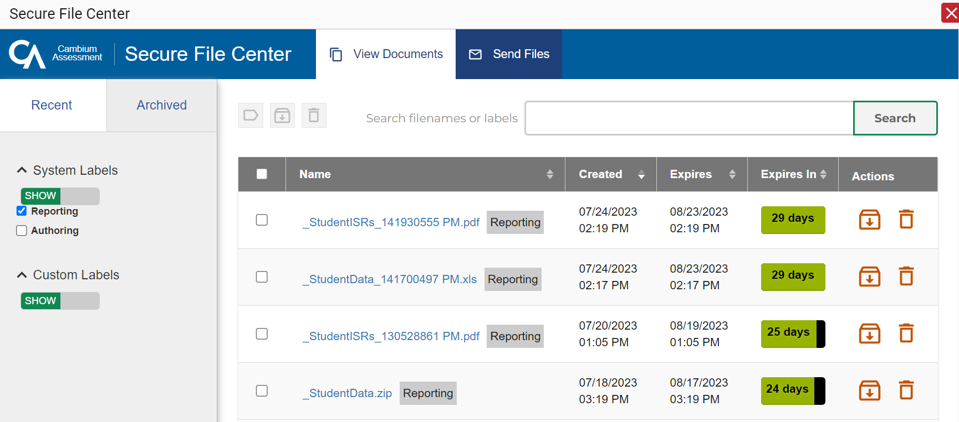
Secure File Center
Notes:
Here is a sample Secure File Center showing multiple ISR postings. You can archive or delete a file at any time by using the buttons under the Actions column in the results table. Click the name of a file to download it to your computer.
Files are automatically deleted after 29 days in both the Recent and the Archived boxes.

Slide 34
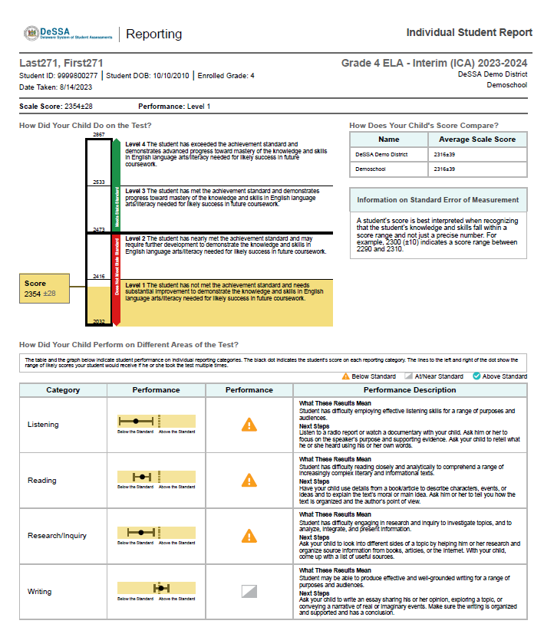
Sample Simple ISR: ICA
Simple ISR
Notes:
Here is a sample ISR for an ICA. You can generate a simple report or the more detailed report. The simple ICA ISR includes overall scale score and performance levels as well performance level for individual claims.

Slide 35
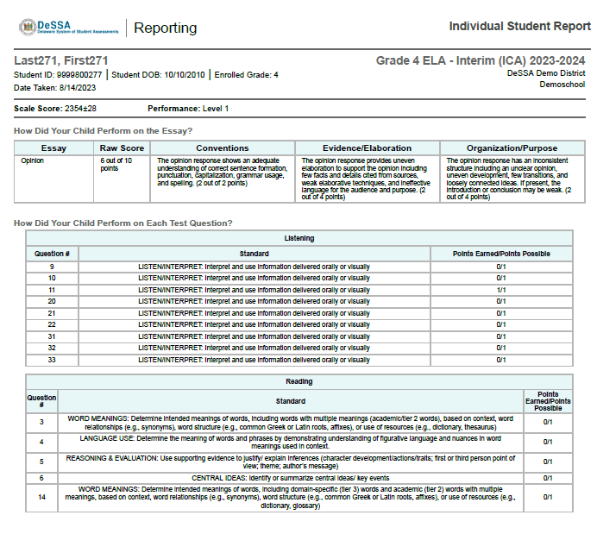
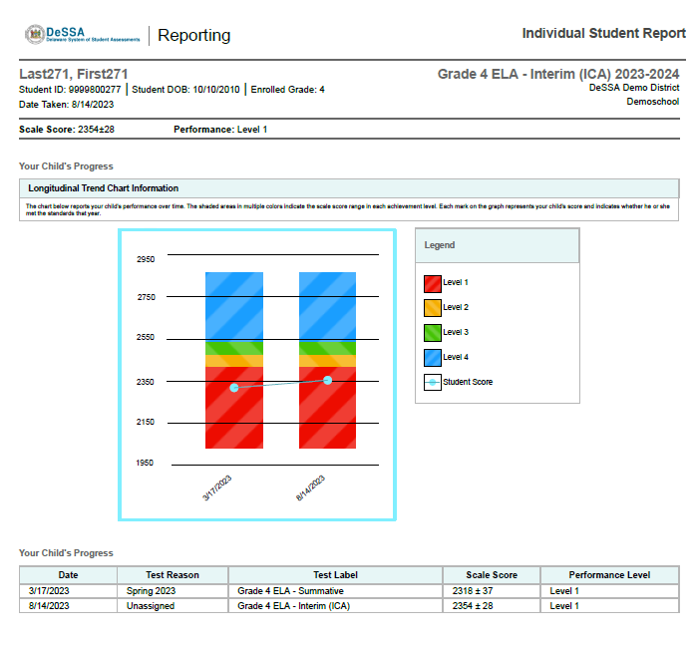
Sample Detailed ISR: ICA
Detailed ISR
Notes:
Here is a sample Detailed ISR. The detailed ICA report includes the raw score for each item. The detailed report may also include a longitudinal trend chart section, like the one shown here. You can see the student’s progress over time as the two tests results display as performance level and scale score.

Slide 36
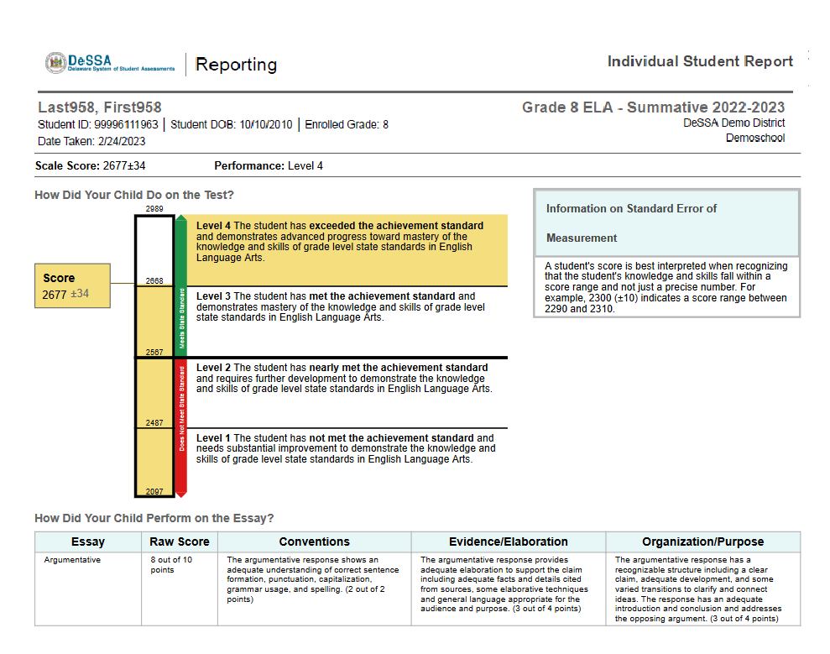
Sample Simple ISR: Summative
Simple ISR
Notes:
Here is a sample Summative ISR. The simple Summative ISR includes overall scale score and performance levels as well performance level for individual claims. The simple Summative ELA ISR also includes the raw score for the essay.
NOTE: Claim and Target level data at the student level for summative assessments is available for 2018-2019 and prior and will be again for 2023-2024. Claim and Target level data is only available at the aggregate (state, district, school) level for 2020-2021, 2021-2022, 2022-2023.

Slide 37
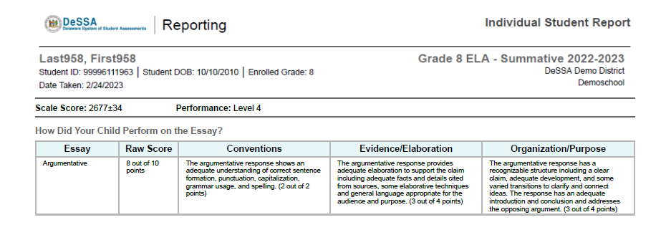
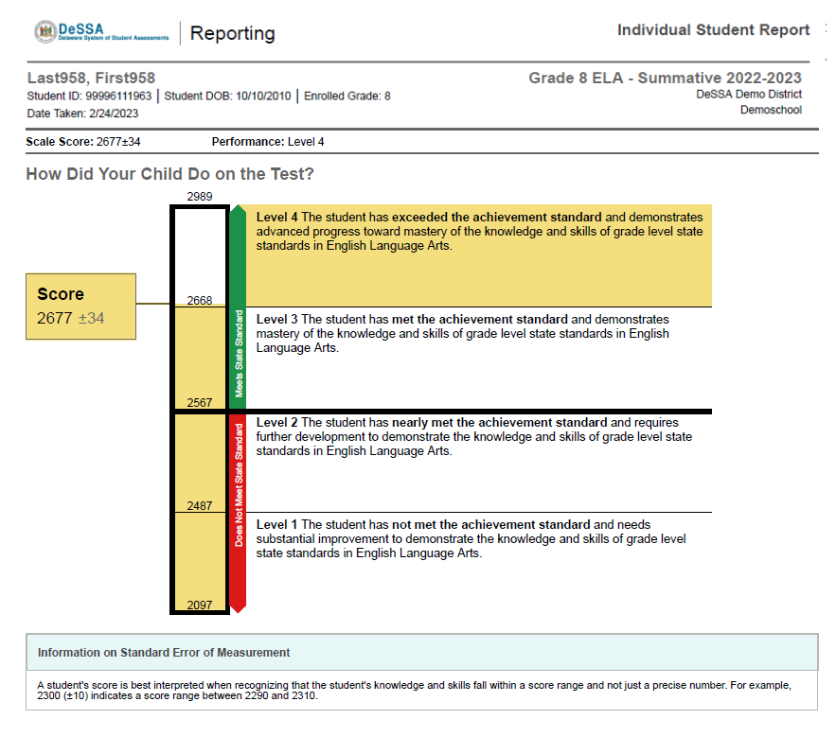
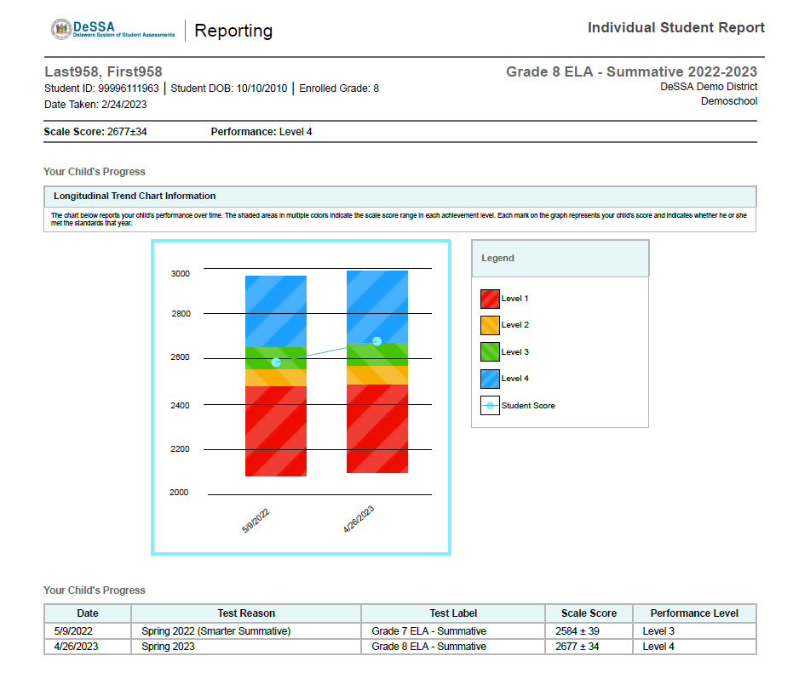
Sample Detailed ISR: Summative
Detailed ISR
Notes:
Here is a sample detailed summative ISR. The detailed Summative report may also include a longitudinal trend chart section, like the one shown here. You can see the student’s progress over time as the two tests results display as performance level and scale score. The detailed Summative ELA report also includes the raw score for the essay.
NOTE: Claim and Target level data at the student level for summative assessments is available for 2018-2019 and prior and will be again for 2023-2024. Claim and Target level data is only available at the aggregate (state, district, school) level for 2020-2021, 2021-2022, 2022-2023.

Slide 38
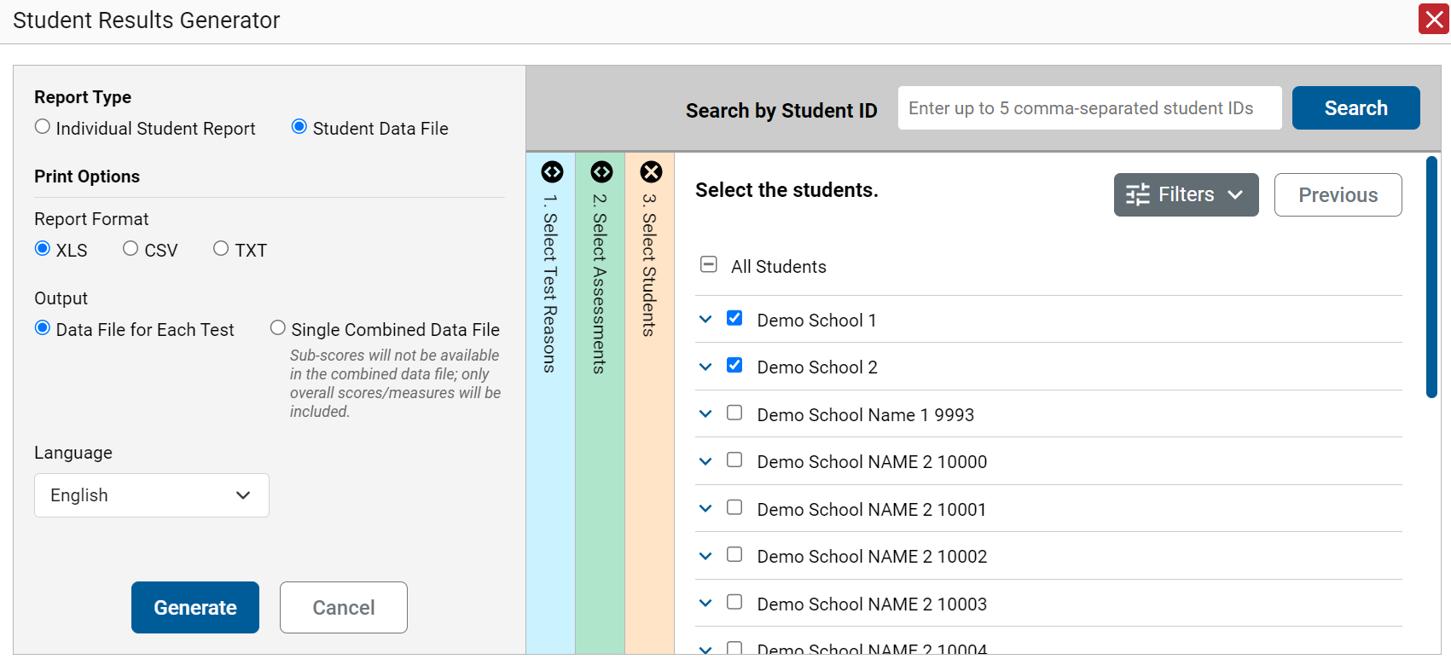
Generate a Student Data File
Student Data File—
Excel Worksheet
Notes:
A Student Data File is a user report of performance data in Microsoft Excel, CSV, or text format. Files of this nature allow the user to employ the workbook features of a spreadsheet application to organize and sort the data. The process to generate a Student Data File is the same one used for the ISR with different print options and fewer restrictions. You can select tests in as many subjects as you want.
Customize the Student Data File using the same three selection columns and the Filters button. Choose your desired export format and click the Generate button. The Student Data File displays in the Secure File Center. A sample downloaded file is shown here.

Slide 39
Generating ISRs and Student Data Files
ISRs
Student Data Files
One test reason
A single subject; multiple grades
Up to three schools for district-level users
One test reason
Multiple subjects; multiple grades
Multiple schools in a district
Data file for each test or combined data file
Multiple subjects and tests may be generated from the Student Portfolio Report
Multiple subjects and tests may be generated from the Student Portfolio Report
Notes:
Here is a review of the parameters of the options for each type of file: ISRs and Student Data Files.

Slide 40
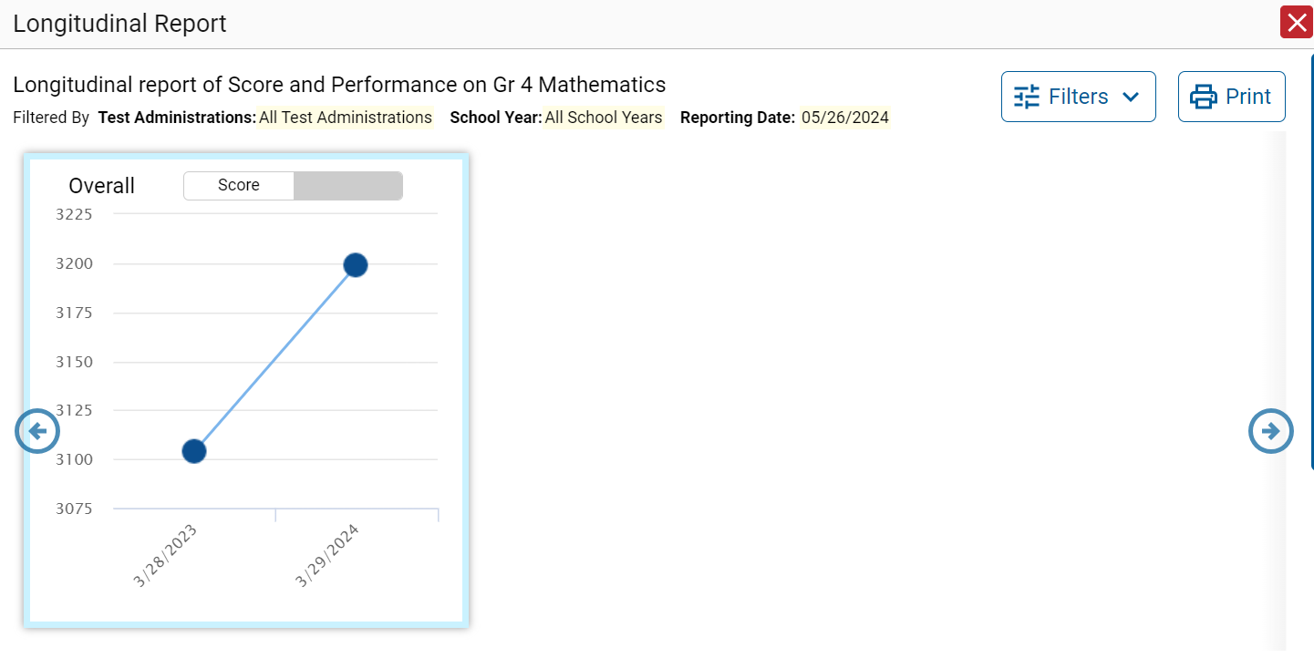
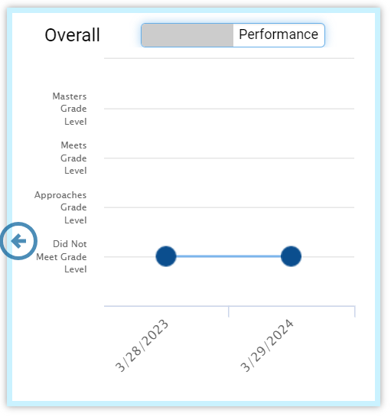
The Longitudinal Report—Scores Over Time
Notes:
When multiple tests are related and have been linked in the system, a Build Longitudinal Report button will display in the Features & Tools menu. Here is a sample Longitudinal Report for a student who took the grades 3 and 4 mathematics tests in two school years.
The graph in the upper-left corner of the report shows the scores for both test administrations. If you hover over the point, you can see the score displayed for each administration of the test. The first score was 3104 and the second score was 3199. The information in the graph is mirrored in the table below.
Toggle the switch at the top of the graph to see the results by Performance level. You can see that the student stayed at the same level of performance across the two years.

Slide 41
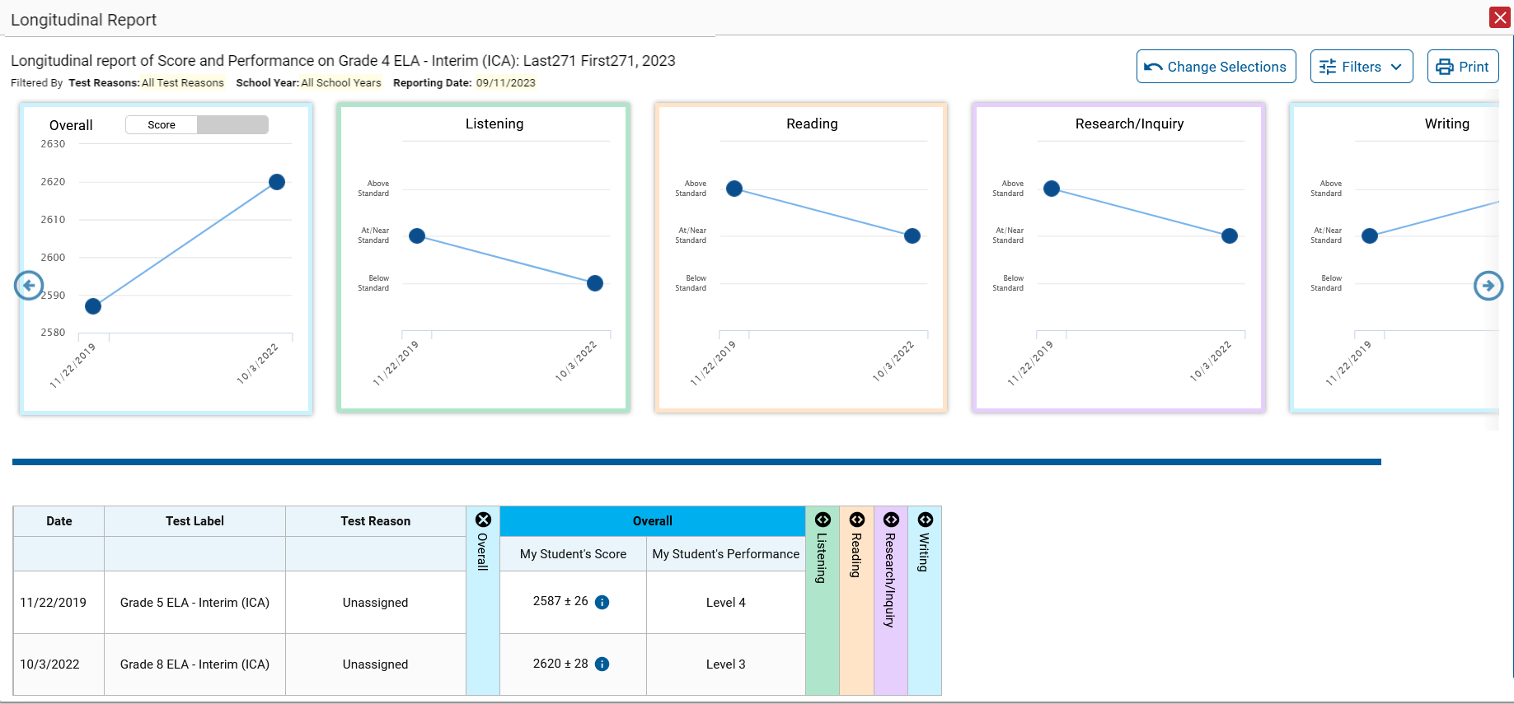
The Longitudinal Report—Reporting Categories
Notes:
When a test has reporting categories, they display as separate graphs in the Longitudinal Report, as shown here on these grades 5 and 8 ELA test scores for an individual student.

Slide 42
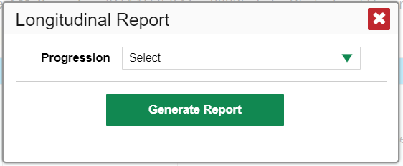
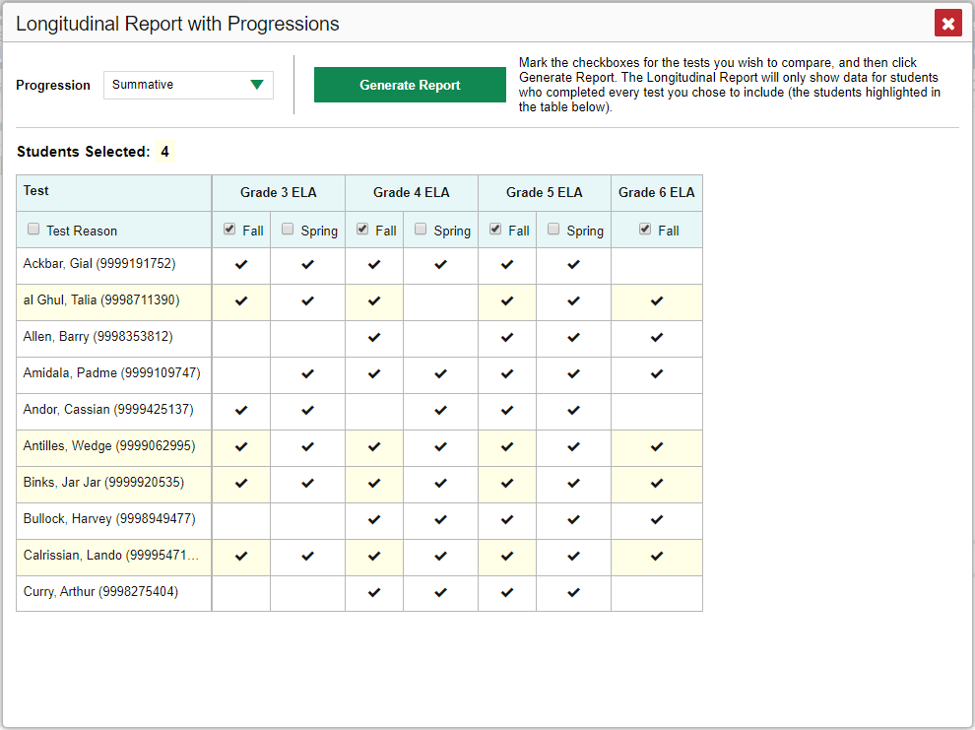
Longitudinal Report with Progressions
Drop-down options are:
Summatives
Interims
Both
Only students highlighted in yellow will appear on the Longitudinal Report.
Notes:
Depending on your role, the test types, and the number of students in the report, the system may display a report options page rather than the Longitudinal Report itself. If you are viewing a Longitudinal Report for which both interims and summatives are available, the Progression drop-down list appears, allowing you to select Summatives only, Interims only, or a combination of both test types.
Click the drop-down arrow to select summative tests only, interim tests only, or a combination of both. Then click the Generate Report button.
Teachers viewing a Longitudinal Report for multiple students are presented with a Longitudinal Report with Progressions window. The Progression drop-down menu is located at the top of the window followed by a table of their students and the related tests. Each test appears in its own column, with sub-columns below for each test reason (categories of tests, or for a summative, a testing window).
The cells in the columns display checkmarks to indicate which students completed which test and test reason combinations. The students highlighted in yellow have completed all the related tests and will appear on the Longitudinal report unless you change the tests you want included in the report.
Mark the checkbox for each test/test reason combination you wish to include in the report. Mark the Test Reason checkbox on the left to include all test reasons or clear it to remove all. Click the Generate Report button at the top of the window to view the Longitudinal Report.

Slide 43
Filter Test Opportunities to Show Some and Not Others
School Year: By default, data is shown for all years. Selecting a date, such as “2020,” will filter the results for the 2020—2021 school year results.
Test Reason: Most helpful for numerous interim and benchmark tests that can be screened by category, omitting those you do not need to see. Test reasons for summative tests are determined by administration date, typically the end of the school year or the course.
Test Label: Deselect the names of the tests you don’t need to see.
Notes:
You may want to filter a Longitudinal Report in order to focus on some test opportunities and not others. Note that filtering tests may affect the set of students whose data are included in the report.
Open the filter menu at the upper-right corner and select the filter options you prefer from the drop-down lists. You may want to filter by a particular school year or years.
Note that years are not calendar years. “2020” refers to the 2020–2021 school year. By default, Longitudinal Reports show data for all years.
Longitudinal Reports can show student performance from a time when the students were not yet associated with you. For example, if you are a fourth-grade teacher, you can use these reports to view your current students’ performance on last year’s third-grade tests.
If the report includes interim assessments, you may wish to filter by a test reason (a category of test), which means excluding all other test reasons from the data. For example, you may want to narrow the report down to show only tests taken in the spring.
For summative assessments, test reasons are the same as test windows and are not useful.
Finally, you may find that certain individual tests are less relevant than others. In that case, you can use the Test Label options to deselect the names of the tests you don’t want to see.
Click Apply.
Optional: To revert all filters to their defaults, open the filter menu again and click Clear Filters. Click Apply. A row of filter details appears below the report header, showing the test reasons and school years included in the report.

Slide 44
The Longitudinal Report—Change Selections
2023-2024
Notes:
If you generated the report using the report options page, a Change Selections button displays in the upper-right corner of the report window. You can use it to change your selection of test types and, if you are a teacher viewing multiple students, your selection of tests and test reasons, as well.

Slide 45
The Longitudinal Report—Filter Options
School Year: By default, data are shown for all years. Selecting a date, such as “2023,” will filter the results for the 2023—2024 school year results.
Test Reason: Most helpful for numerous interim and benchmark tests that can be screened by category, omitting those you do not need to see.
Test Label: Deselect the names of the tests you do not need to see.
Notes:
You may want to filter a Longitudinal Report in order to focus on some test opportunities and not others.
Note that filtering tests may affect the set of students whose data are included in the report.
Open the Filters menu at the upper-right corner and select the filter options you prefer from the drop-down lists.
You may want to filter by a particular school year or years. By default, Longitudinal Reports show data for all years. Longitudinal Reports can show student performance from a time when the students were not yet associated with you. For example, if you are a seventh-grade teacher, you can use these reports to view your current students’ performance on last year’s sixth-grade tests.
If the report includes interim assessments, you may wish to filter by a test reason (a category of test), which means excluding all other test reasons from the data. For example, you may want to narrow the report down to show only tests taken in the spring. For summative assessments, test reasons are the same as testing windows and are not useful.
Finally, you may find that certain individual tests are less relevant than others. In that case, you can use the Test Label option to deselect the names of the tests you do not want to see.
Click Apply.

Slide 46
Longitudinal Reports—Ways to Customize
Results from current and previous school years
Filter options: school year, test reason, test label
INDIVIDUAL REPORTS
GROUP REPORTS
Multiple instances of the same test (interims )
Related tests (typically related by standard and determined by school/district administration)
Students who completed the same test multiple times (interims)
Students who completed related tests
Notes:
To review, you can set up your Longitudinal Reports using results from current and previous school years, including data for your current and former students. Longitudinal Reports can be generated for individual students or for a group of students as outlined. Three filter options (school year, test reason, and test label) allow you to drill down into a Longitudinal Report to access specific data relevant to your needs.

Slide 47
How to Build a Demographic Breakdown Report
Notes:
There is a tool that allows users to break down data by demographic subgroup. You can create a Breakdown report from any page in Reporting that displays data for multiple students. Open the Features & Tools menu and click the Breakdown by button. A Breakdown Attributes window opens, displaying the options available to you.
For example, here, you see a My Students’ Performance on Test report for the Grade 3 Math-Summative. You can build a report for a specific group of students based on any three attributes listed in the Breakdown Attributes window.
For a sample report, the English Learner Status, Enrolled Grade, and Gender options have been selected. A checkbox is displayed next to the term, “Include unspecified values.” This option, when selected, will include any of the user’s students with no demographic information assigned to them in TIDE. Click Apply. The customized report displays, as shown on the next slide.

Slide 48
Demographic Breakdown Report
Notes:
The Breakdown page is organized according to the combinations selected. A row appears for each possible subgroup combination. The number of rows in the table will depend on how the students fall into the demographic categories.
For example, here you see a row for ALL the students, followed by some possible combinations. If a combination does not appear in the table, it means none of the students fall into that subgroup. Notice that the table header has updated to reflect the chosen attributes. You see from this Breakdown report that there are 12 students who are divided into four subgroups. You can sort the subgroups in a few different ways: by English Learner Status, Enrolled Grade, and Gender. To look closer into a specific subgroup, click the View Details button in that row.

Slide 49
View Details Window/Breakdown Report
Notes:
A Breakdown window opens, displaying detailed results for that subgroup. A row of drop-down menu buttons appears above the table, displaying the attributes of the group you chose. To quickly transition to another demographic subgroup for the same test, you can apply the breakdown menu options that display above the table of results. Select an attribute you want from the drop-down menus and click Apply. The new subgroup will display.

Slide 50
Change Reporting Time Period
Notes:
The Change Reporting Time Period option under Features & Tools allows you to view test results from a previous point in time for your current students and/or for your former students.
When you want to view previous test results for your current students, select the school year from the drop-down menu in the school year field. Leave the calendar tool set to the current date.
When you want to view test results from students you had in the past, select a school year from the menu in the school year field AND use the calendar tool to set a date on which you know these former students were assigned to you. For example, a day in the month of May of that school year, after testing has begun.
When you click Save for either of the two options, your reports will reflect data according to those settings. When you log out of the system, the reporting time period defaults back to the current school year.

Slide 51
How Can I Get More Information?
You can contact the DeSSA Help Desk for assistance with any technical issues you encounter.
When contacting the DeSSA Help Desk, please be ready to provide the following:
Any error messages that are appearing (including codes)
Your operating system and browser information
Your network configuration information
Your contact information for follow-up by phone or email
Any other relevant information, such as test names or content areas, student IDs, session IDs, and search criteria
For test administration or policy issues, please contact your District Test Coordinator.
You can find more announcements on your assessment portal.
Notes:
We hope this module has given you a solid, basic understanding of the features and functions of the Reporting system. Watch for future announcements on the DeSSA portal page. A Centralized Reporting System User Guide is posted there. You can also call or email the DeSSA Help Desk with your questions.

Slide 52
Additional Information
DeSSA Portal:
https://de.portal.cambiumast.com/
DeSSA Help Desk:
E-mail Support: DeSSAHelpDesk@cambiumassessment.com
Support Toll-Free Number: 877.560.8331
Hours: 6:30 a.m. to 6:30 p.m. ET- Mondays–Fridays (except holidays)
DDOE Contact:
Phone number: (302) 857-3391
https://helpdesk.doe.k12.de.us/
Notes:
Thank you for taking the time to view this training module. For additional information, refer to your CRS User Guide located on the DeSSA portal or contact the DeSSA Help Desk.

