Slide 1
Data Entry Interface (DEI) For Paper Test Administrations
Training Module
2023-2024
Copyright © 2020 Cambium Assessment, Inc. All rights reserved.
Notes:
In this training module, we will discuss how to use the Data Entry Interface (DEI) to enter student responses on paper-based accommodated test form.
This module covers information that Test Administrators (TAs) should be aware of before using the Data Entry Interface. For more detailed information on using the DEI, please refer to the Data Entry Interface User Guide available on the DeSSA portal.

Slide 2
Module Objectives
After viewing this presentation, you should be able to:
Understand what the Data Entry Interface (DEI) is and how to access it
Enter student responses into the DEI
Use the different features available in the DEI
Notes:
After viewing this presentation, you should be able to:
Understand what the Data Entry Interface is and how to access it
Enter student responses into the DEI and
Use the different features available in the DEI

Slide 3
How the DEI is Used
The DEI can only be used for paper test administration:
To enter and transcribe student responses for all test items.
Notes:
The DEI is used to enter student responses for students taking the test in paper forms.

Slide 4
Confirming Student Settings in TIDE
The Test Information and Distribution Engine (TIDE) is the “home” for all student data and accommodations.
Before a TA can enter data for a student into the DEI, that student’s record should be checked in TIDE to ensure that the correct flag has been set for a paper form.
Notes:
For the TA to enter data for a student in the DEI, the student’s record in the Test Information and Distribution Engine (TIDE) needs to be updated to allow for a paper form. TIDE is the “home” for all student data and accommodations. That student’s record should be checked in TIDE to ensure that the correct flag has been set for a paper form. The TIDE User Guide has more information about how to do this.

Slide 5
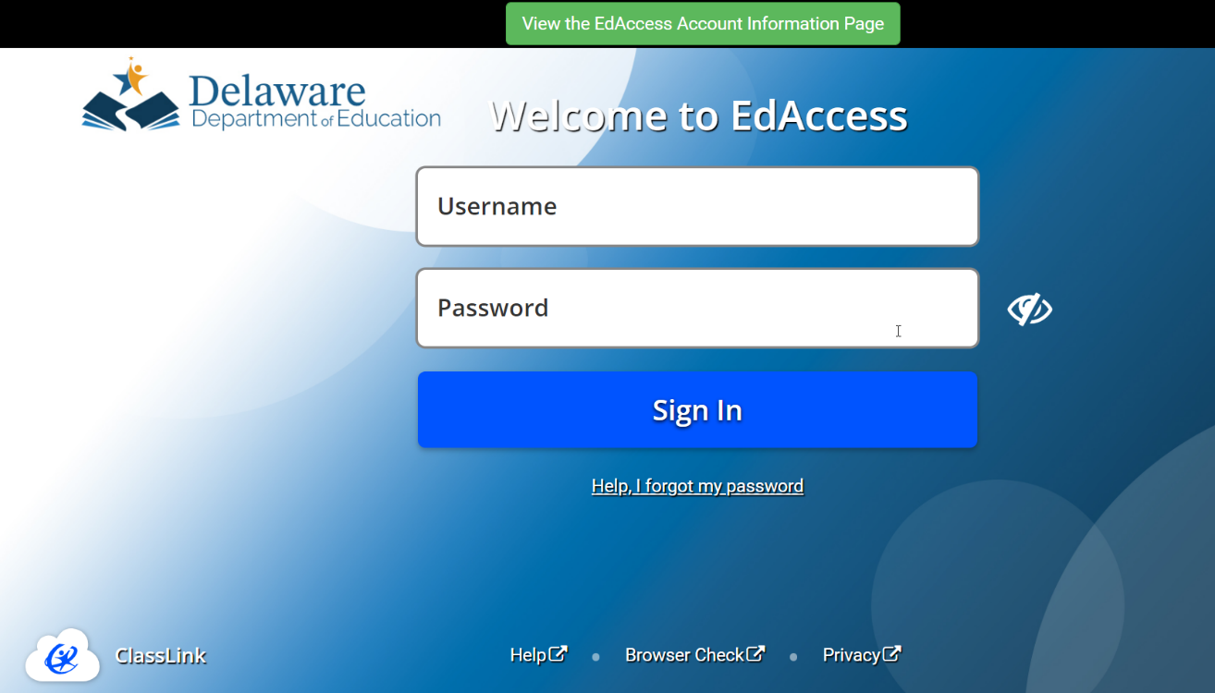
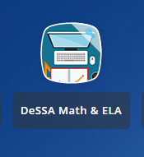
Accessing the Data Entry Interface
DEI is accessed through the Delaware Department of Education’s (DDOE’s) EdAccess or LEA Classlink page application.
1. Access the DDOE EdAccess or LEA ClassLink login page at launchpad.classlink.com/ddoe. Use your regular EdAccess ID and password to log in.
2. After you have successfully logged in, you will see a list of authorized applications, including DeSSA Math & ELA.
Click the [DeSSA Math & ELA] button from your menu. You will be directed to the DeSSA portal.
Notes:
DEI is accessed through the Delaware Department of Education’s (DDOE’s) EdAccess or LEA Classlink page
application.
Access the DDOE EdAccess login page or LEA ClassLInk at launchpad.classlink.com/ddoe. Use your regular EdAccess ID LEA ClassLink and password to log in.
After you have successfully logged in, you will see a list of authorized applications, including DeSSA Math & ELA.
Click the [DeSSA Math & ELA] button from your menu. You will be directed to the DeSSA portal.

Slide 6
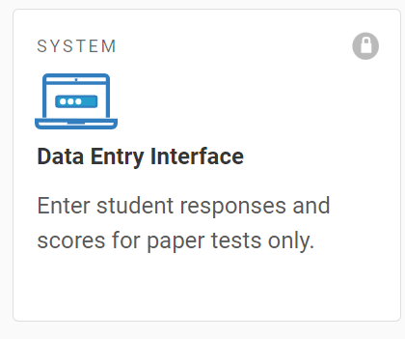
Accessing the Data Entry Interface
DEI is accessed through the Delaware Department of Education’s (DDOE’s) EdAccess application.
3. Click the [ELA & Mathematics] user card to access DeSSA applications.
4. Click the [Data Entry Interface] button. If you are authorized to access this application, you will be automatically directed to the DEI site. You will not have to log in again.
Notes:
DEI is accessed through the Delaware Department of Education’s (DDOE’s) EdAccess or LEA Classlink page
application.
Access the DDOE EdAccess login page or LEA ClassLInk at launchpad.classlink.com/ddoe. Use your regular EdAccess ID LEA ClassLink and password to log in.
After you have successfully logged in, you will see a list of authorized applications, including DeSSA Math & ELA.
Click the [DeSSA Math & ELA] button from your menu. You will be directed to the DeSSA portal.
Click the [ELA & Mathematics] user card to access DeSSA applications.
Click the [Data Entry Interface] button. If you are authorized to access this application, you will be automatically directed to the DEI site.

Slide 7
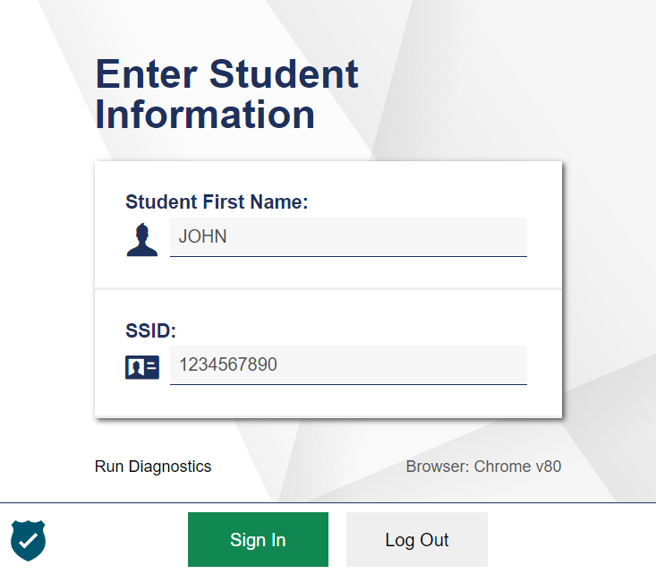
Accessing the Data Entry Interface
You will be prompted to enter information for the student you are testing.
Enter the student’s first name and student ID, and then click Sign In.
Notes:
After logging in to the DEI, you will be prompted to enter information for the student you are testing. Enter the student’s first name and student ID number. Please note that the student’s first name and ID must match what is pre-identified in TIDE. If the student does not have a permanent student ID yet, then you should enter the temporary ID listed for the student in TIDE. For information about registering students in TIDE, please review TIDE User Guide.
When you have entered the information, click Sign In.

Slide 8
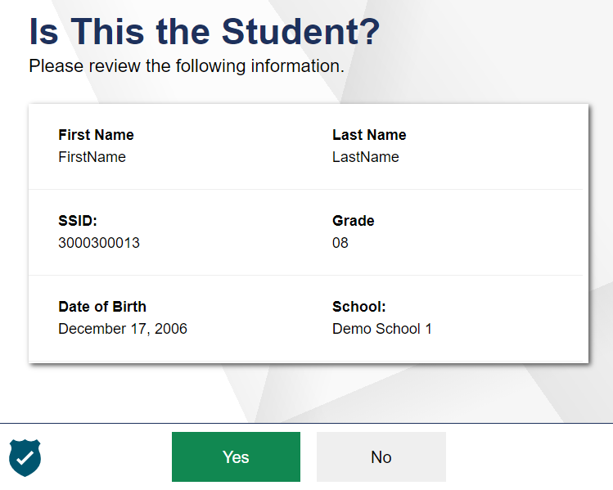
Accessing the Data Entry Interface
Verify that the student’s demographic information is correct.
If all the student’s information is correct, click YES. If any information is incorrect, click NO and then contact your test coordinator.
Notes:
Next, you will be prompted to verify that the student’s demographic information is correct. Please be sure to review every field. If all the student’s information is correct, click YES. If any information is incorrect, click NO, and contact your test coordinator.

Slide 9
Test Selection
Notes:
After verifying the student’s information, the Available Tests screen will appear. Please note two things about this page:
First, the page lists the tests available for the student based on the student’s grade level. Please verify that the appropriate test is listed for the student. If the test for this student is missing or incorrect, please contact your test coordinator.
Second, the arrows on this page signal the test’s status. A solid background indicates that the test has not been started and no data has been entered. A clock face shaped arrow indicates that the test has been started, but still needs to be reviewed and submitted.

Slide 10
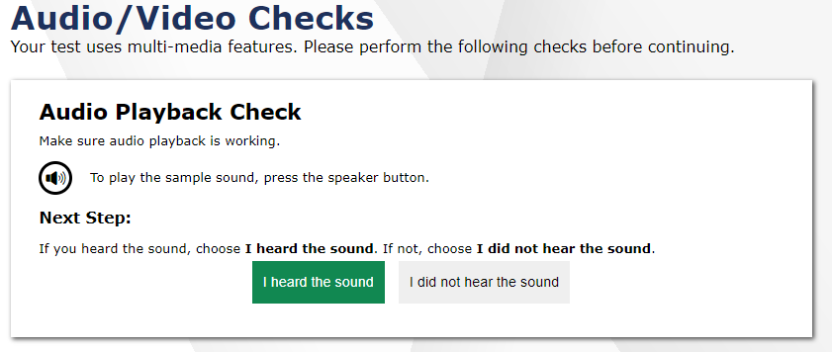
Audio/Video Checks
Notes:
After selecting a test requiring audio, you will see an Audio Playback Check panel. Click the sound icon and indicate whether the sound is audible by choosing either the I heard the sound or I did not hear the sound button.
If you click I did not hear the sound, you will receive a message advising you to adjust your device’s volume settings and try again. Make sure the audio is not muted on the computer and the headset is properly connected.

Slide 11
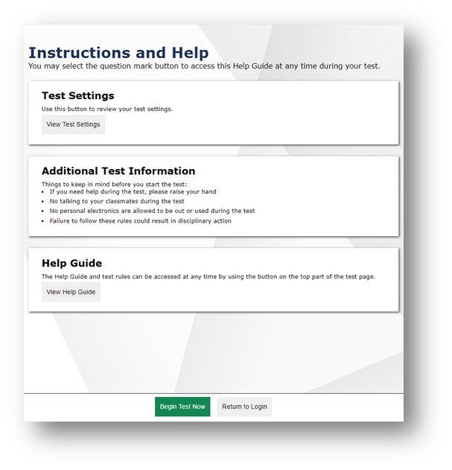
Instructions and Help
Notes:
Before beginning data entry, the Instructions and Help page will appear.
The Help Guide will bring up content that explains the Test Rules and gives an overview of the Data Entry Interface.
The Test Settings will show the student’s test settings.
Some important reminders are listed under Additional Test Information.
Selecting the Begin Test Now button will take you to the first question of the test. You may select the question mark button to access this Help Guide at any time during the test.

Slide 12
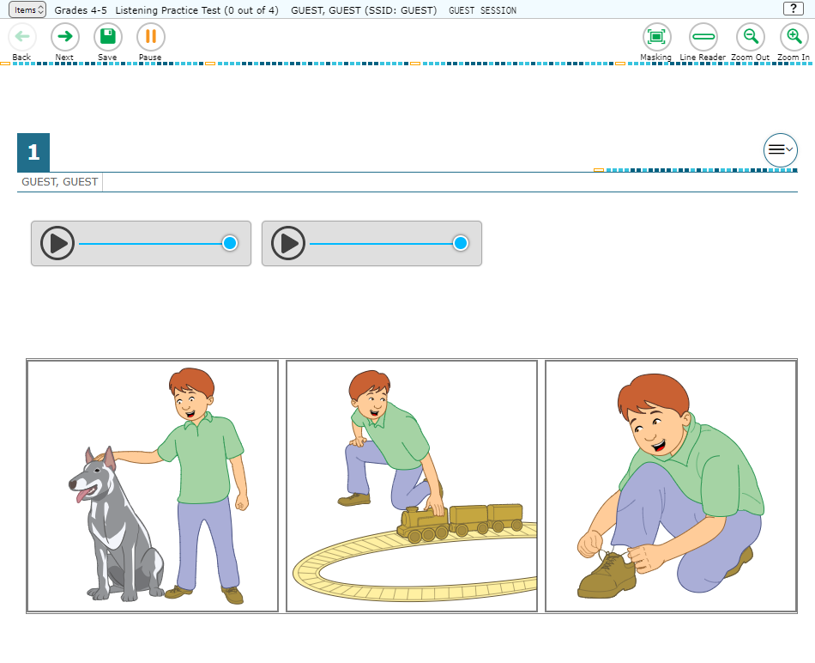
Entering Data into the DEI
Notes:
After selecting Begin Test Now, you will see the data entry page for an item. Similar to the test booklet, the item questions are presented in bold text. This screenshot shows you an example of what a listening item looks like.

Slide 13
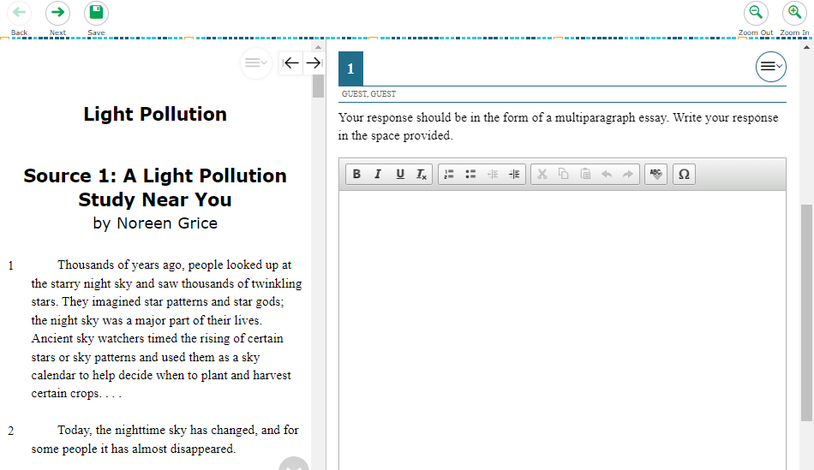
Entering Student Response Data
Notes:
When entering the paper administration data for the multiple choice Listening, Reading, and Writing sections, students mark their responses in their test booklet. At the conclusion of the testing session, the TA will input the student’s responses into the DEI.
For the Writing constructed response & word and sentence builder section, the TA will copy the student’s response from the test booklet into the DEI for scoring. For the word & sentence builder items, the TA will drag and drop the response tiles to match the student’s response exactly.
For the constructed-response items, the TA will use the DEI to transcribe the student’s written responses verbatim.
For the Speaking section, the TA will record the student’s spoken responses directly into the DEI during testing.

Slide 14
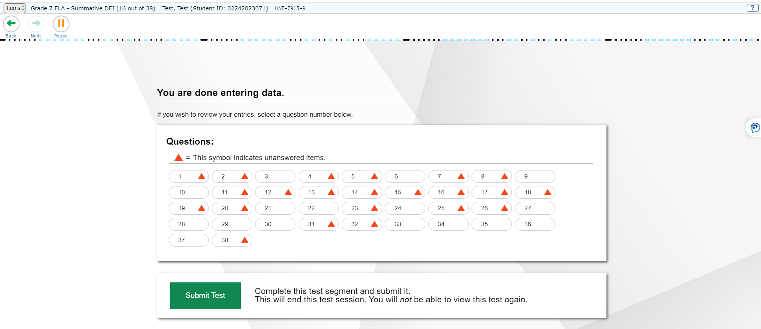
Submitting the Test
Notes:
After completing data entry, be sure to review all entered data.
When you have checked all responses you have entered and are ready to submit the test, click the green Submit Test button to continue.
If you are not ready to submit answers at this time, click the Pause button to save your work and navigate away from the system. In the process, you will be logged out of this student’s data entry session. If you choose to pause your session, remember to complete data entry and submit the test by the end of the administration window.
Please note that you must click the Submit Teat button in order to submit scores. You will be asked to confirm that you would like to submit the test. Click Yes to continue.

Slide 15
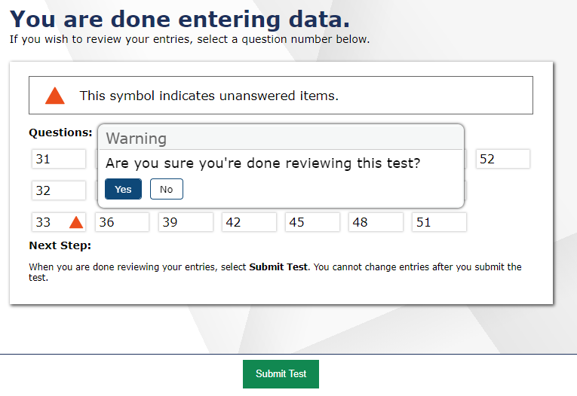
Review and Submit
You will receive one more opportunity to review your entries.
You may review your entries again or submit the test for scoring.
Select Submit Test and Yes to complete the submission process.
Notes:
When you have entered data for the final item on the test and select Next, you will see the You are done entering data page. From this page, you have one final opportunity to review your entries before submitting the test for scoring. Each unanswered question has an orange icon beside it. Both answered and unanswered questions are available for review. To review a question, select a question number.
If the test is ready for submission, select Submit Test. A pop-up window will ask you to confirm that you are done reviewing. Select Yes to submit the test. If you do not submit the student’s test, the test will be paused.
If the test was administered or submitted in error, your test coordinator may invalidate it after submission. Please consult your test coordinator if you believe that test answers were submitted in error.

Slide 16
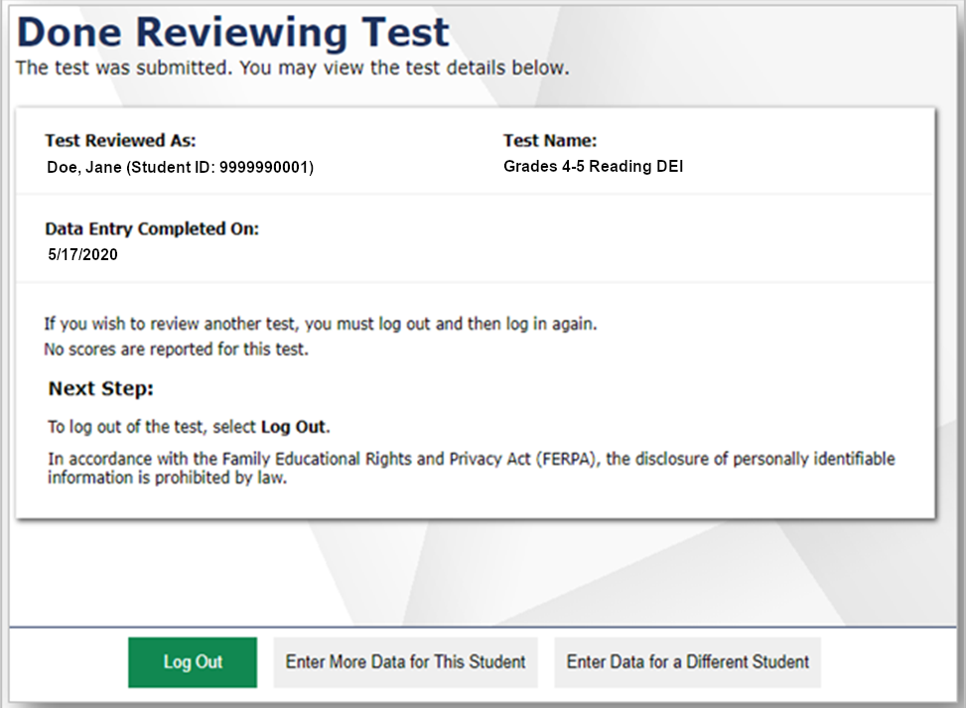
Submitting the Test
Notes:
The next screen will confirm that the student’s test has been submitted .
From here, you may choose to log out or enter data for a different student.

Slide 17
Helpful Hints
You may skip items that the student has not answered by clicking the Next button.
Questions may appear differently in the DEI from how they appear in the paper test booklets:
Instead of circling a letter, you may need to click on a word or image.
Instead of drawing a line between two objects, you may need to drag and drop one object on top of the other.
Instead of filling in a blank, you may need to choose an answer from a drop-down list.
Notes:
Here are some helpful hints to assist you with entering student responses in the DEI.
You may skip items that the student has not answered by clicking the Next button.
Questions may appear differently in the DEI from how they appear in the paper test booklets. It is important to emulate in the DEI how the student responded in the paper test booklet. For example:
Instead of circling a letter, you may need to click on a word or image.
Instead of drawing a line between two objects, you may need to drag and drop one object on top of the other.
Instead of filling in a blank, you may need to choose an answer from a drop-down list.

Slide 18
Thank You!
For additional information, consult the DeSSA Resources page, which contains:
DEI User Guide
For further assistance, please contact the Help Desk.
Notes:
Thank you for viewing this training module. If you need additional information, please visit the DeSSA portal, where you can find announcements and copies of the DEI User Guide. Remember to follow the secure Directions for Administration document you received with the student’s paper test while administering these tests for guidance.
For further assistance, please consult your Help Desk.

Slide 19
Thank You!
Further Information
https://de.portal.cambiumast.com/
DeSSA Help Desk:
E-mail Support: DeSSAHelpDesk@cambiumassessment.com
Support Toll-Free Number: 877.560.8331
Hours: 6:30 a.m. to 6:30 p.m. ET- Mondays–Fridays (except holidays)
DOE Contact:
Phone number: (302) 857-3391
https://helpdesk.doe.k12.de.us/
Notes:
Thank you for taking the time to view this training module. For additional information, refer to the Data Entry Interface User Guide located on the portal or contact the Delaware Help Desk.

