Slide 1
Family portal: Overview and how to get access codes
Training module
2023-2024 DeSSA ELA and Mathematics
Notes:
In this training, we will review how to find Family Portal Access Codes for your students and how to distribute those Access Codes to families. Family Portal Access Codes will be used by families to access DeSSA summative ELA and Mathematics score reports for their student. Each student will be assigned a unique Access Code which will remain with that student while in grades 3 through 8.

Slide 2
The Family Portal
What information can be found on the Family Portal?
Your student’s results from the test administration
Your student’s individual score reports with interpretative guides that can be downloaded and printed
Glossary
FAQs
Performance levels
Notes:
The Family Portal allows families to view their student’s DeSSA ELA and Mathematics test results in one central location. It also provides families with a deeper look into how their child is performing in different subject areas and where they might need additional support.

Slide 3
Family Portal Overview
Notes:
Let us first review what the Family Portal looks like for families.

Slide 4
Login Page
Notes:
This is what families will see to log in to the Family Portal. Families will have the option of viewing the portal interface in English (default) or Spanish by clicking on the globe at the top of the page. They will need three pieces of information to access their child’s assessment results: Access Code, date of birth, and first name.

Slide 5
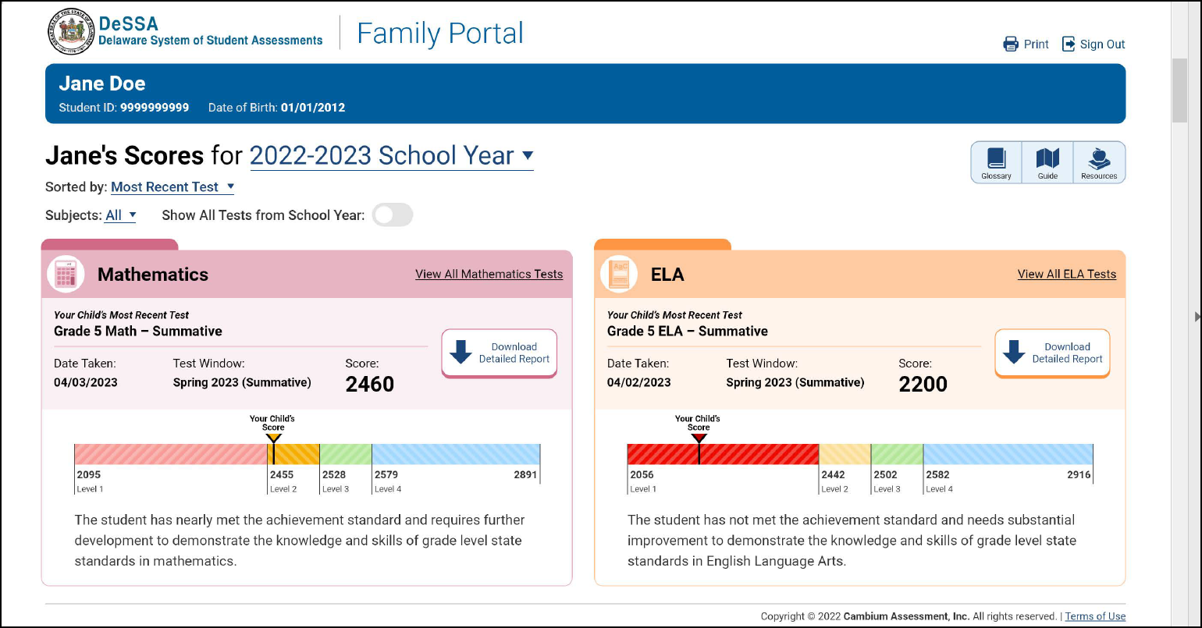
Landing Page
Notes:
After successfully logging in to the Family Portal, users will see this landing page, which displays the most recent test(s) that students took.

Slide 6
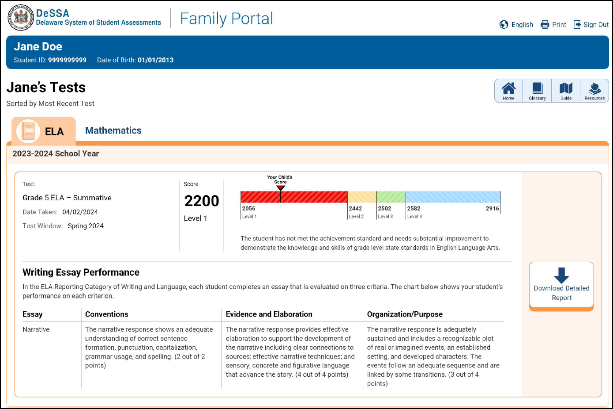
Subject Page
Notes:
The CAI Family Portal is also designed to display the subject-level information to offer families a complete view of the subject and the ability to download the score report.

Slide 7
Detailed Report Download
Notes:
To download and print a PDF report of the student’s test, families can click the Download Detailed Report button. Families can download the report in English or Spanish. English is the default language, and Spanish can be selected from the dropdown. Families can also download a score interpretive guide from the Download Guide option, shown on this page.

Slide 8
Glossary
Notes:
Families can use the Glossary to learn more about specific terms that districts and schools use.

Slide 9
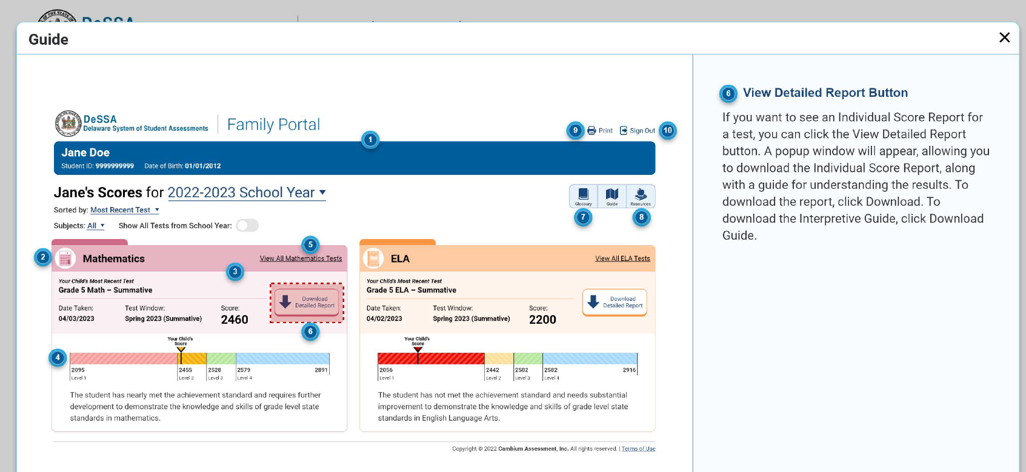
Interactive Guide
Notes:
Families can also use the Interactive Guide to learn more about how to use different pages and options on the Family Portal.

Slide 10
How to Get Access Codes
Notes:
Next, we will review different ways district and school users can retrieve the family access codes from the Test Information Distribution Engine (TIDE).

Slide 11
Family Portal Access Codes
TIDE users can view Family Portal Access Codes for individual students.
TIDE users can view and print Family Portal Access Codes in a roster.
TIDE users can generate a Microsoft Excel file containing Family Portal Access Codes, add email addresses for each student’s family, and then send codes to families through TIDE.
Notes:
A TIDE user can retrieve Family Portal Access Codes and communicate those codes to families in three ways.
- The first option we will review is viewing Family Portal Access Codes for individual students.
- Then we will look at how to view and print Family Portal Access Codes in a roster.
- Finally, we will walk through how to generate a Microsoft Excel file containing Family Portal Access Codes for multiple students, add email addresses for each student’s family, and then send codes to families through TIDE.

Slide 12
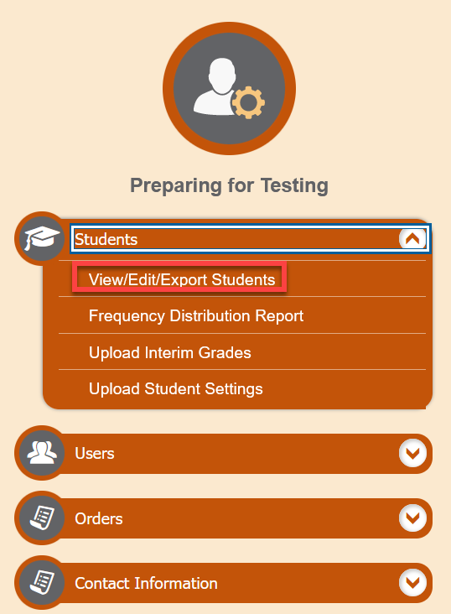
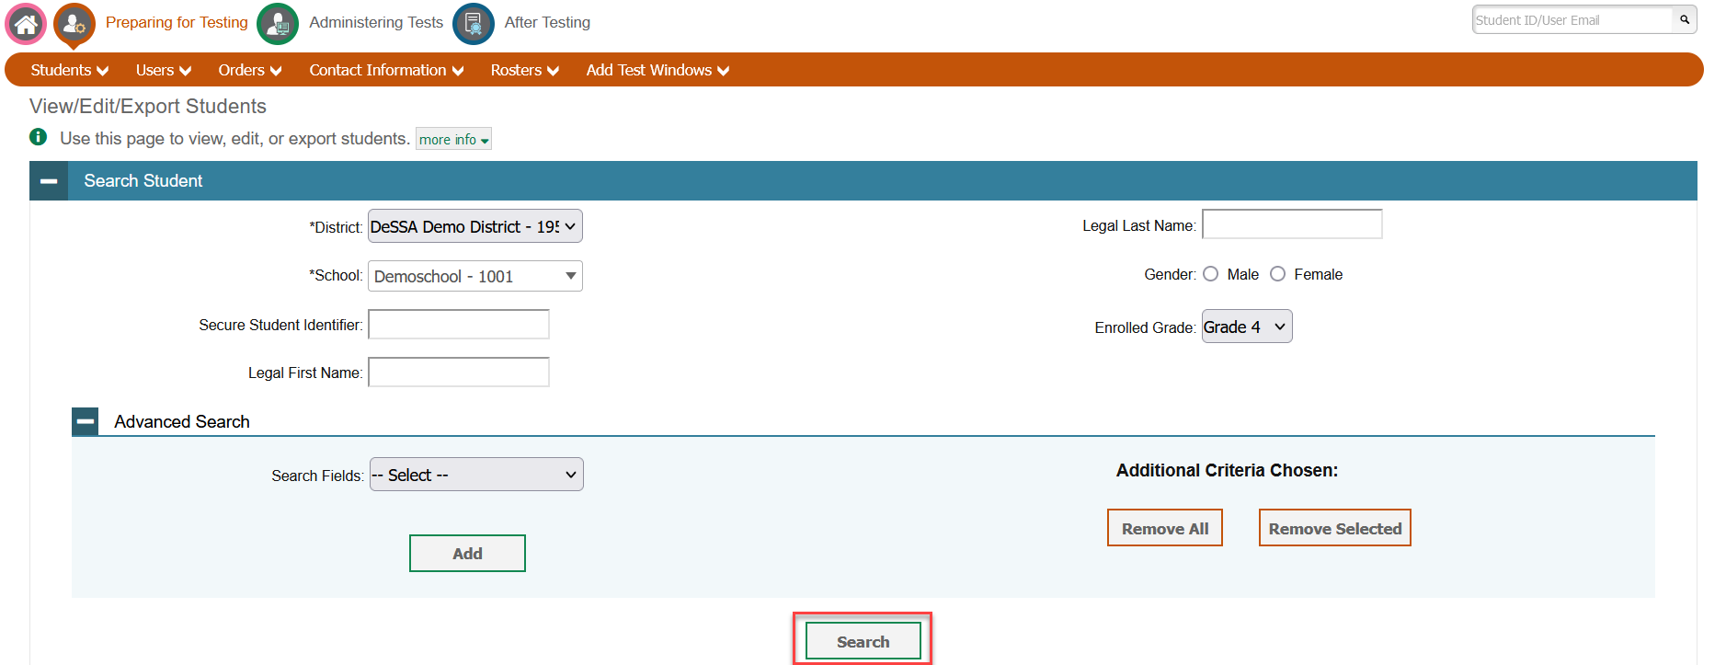
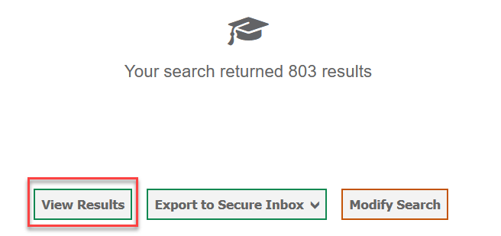
View Access Codes for Individual Students
Notes:
To view access codes for individual students, begin on the TIDE dashboard. In the Preparing for Testing section of the dashboard, click Student Information, and then click View/Edit/Export Students.
When the View/Edit/Export Students page appears, enter your search criteria to find specific students, then select Search.
The search results pop-up window will appear, showing you the number of students who satisfy your search criteria. Click View Results.

Slide 13
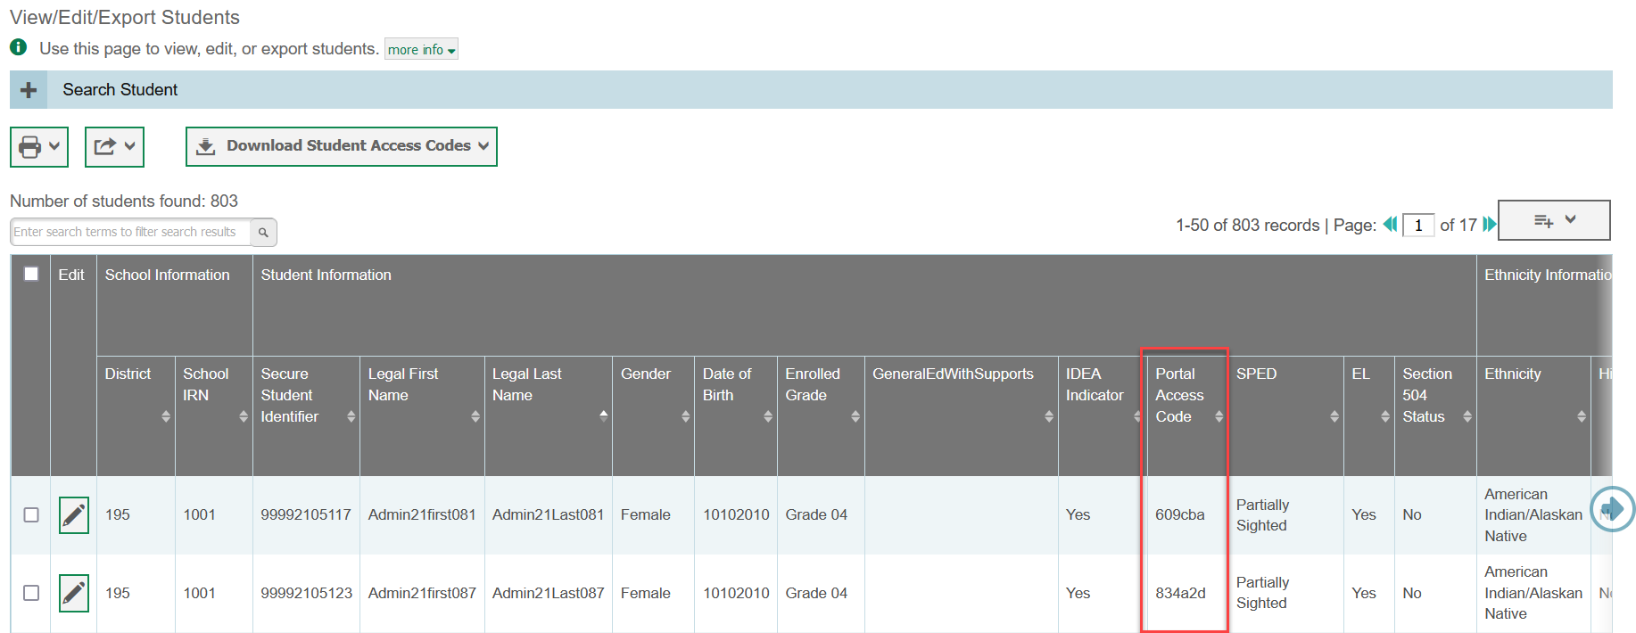
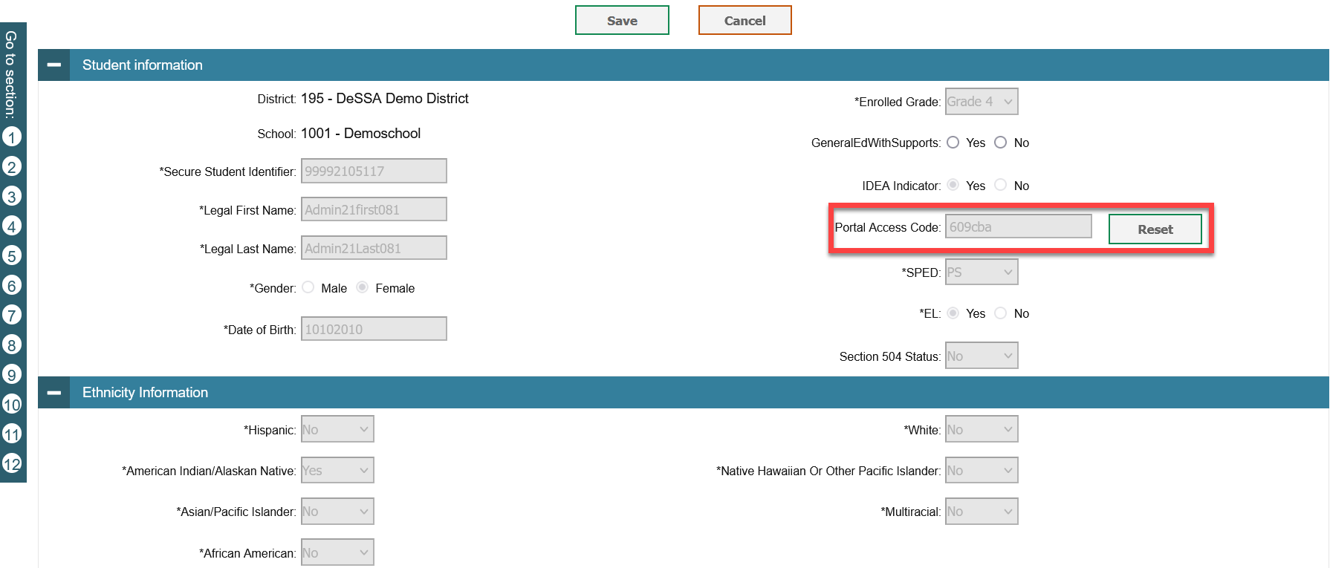
View and Reset Access Codes for Individual Students
Notes:
The search results grid appears, displaying Access Codes for any students found in your search. Keep in mind that you may have to scroll to the right to view a student’s Access Code.
Authorized users can view and reset access codes on the Student Details page.
- To view the Student Details page, click the green pencil icon in the Edit column of the search results grid. From there, you can view access codes (or reset it if necessary)
To send Access Codes to each student’s family, use whatever secure means of communication your school or district already has in place.

Slide 14
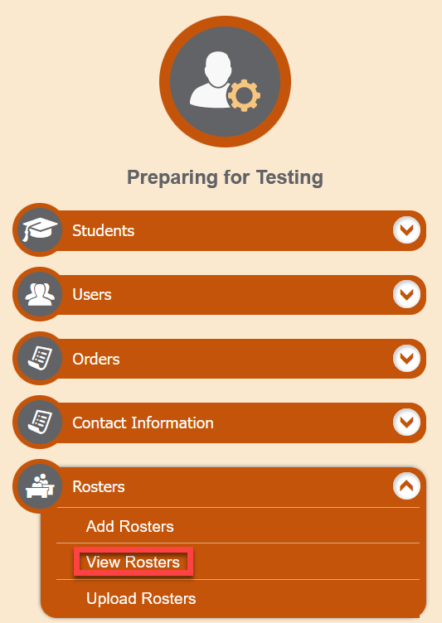
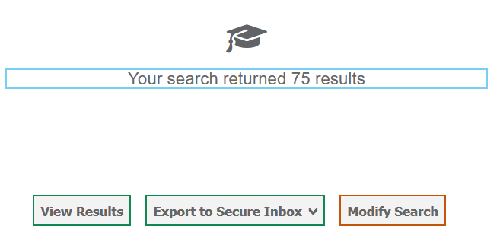
View Access Codes in a Roster
Notes:
To view Access Codes in a roster and print the codes for students to take home, begin on the TIDE dashboard. In the Preparing for Testing section of the dashboard, click Rosters, and then click View Rosters.
When the View Rosters page appears, enter your search criteria as needed. Click Search. The search results pop-up window will appear, alerting you to how many rosters fit your search criteria. Click View Results.

Slide 15
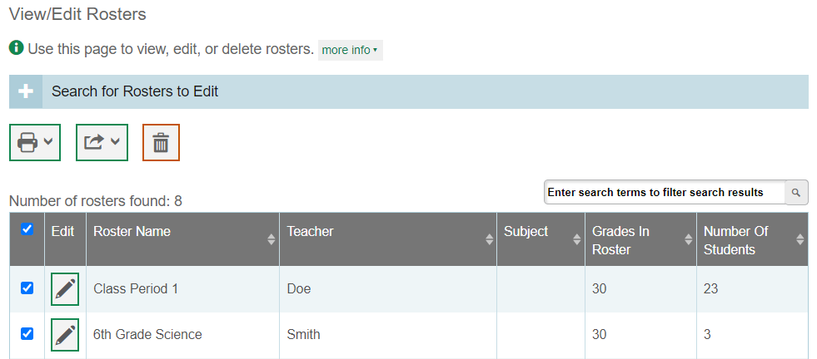
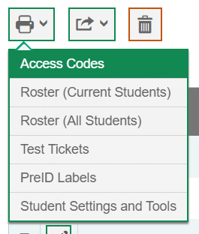
Print Access Codes in a Roster
Notes:
The search results grid appears, displaying rosters found in your search. From this page, you can print access codes for all rosters or selected rosters.
To print Access Codes for all rosters in the search results, mark the checkbox at the top of the search results grid. To print Access Codes only for selected rosters, mark the checkbox or checkboxes for rosters you wish to print.
After you have selected the appropriate rosters, click the print icon in the upper-left corner. A drop-down will appear. Click Access Codes.

Slide 16
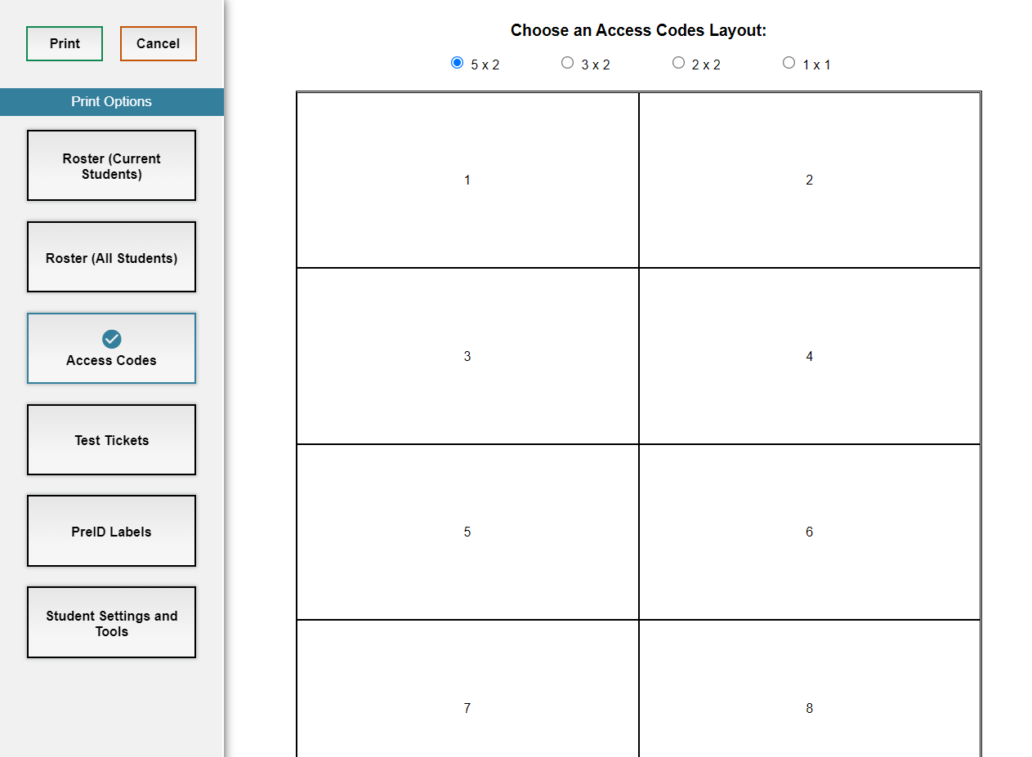
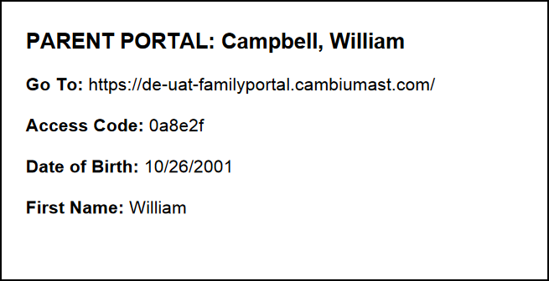
Print Access Codes in a Roster, Continued
Notes:
In the new browser window that opens, verify that Access Codes is selected in the Print Options section on the left side of the screen. You can then choose the Access Code layout by choosing a layout style on the top of the page.
When you click Print, your browser will download the generated PDF file. Print the PDF file, cut up the cards, and distribute the cards to students to take home to their families.

Slide 17
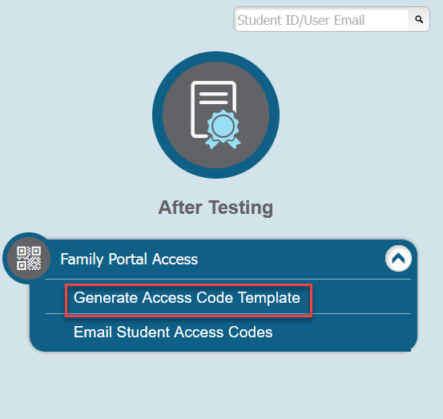
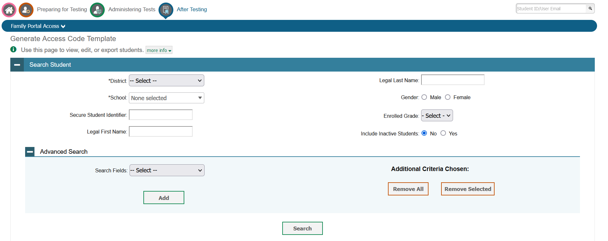
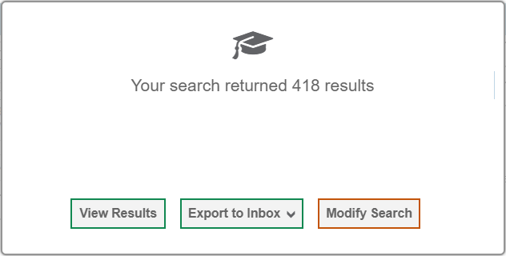
Generate an Excel File Containing Family Portal Access Codes
Notes:
To generate a Microsoft Excel document containing access codes and email those codes via TIDE, begin on the TIDE dashboard. In the After Testing section of the dashboard, click Family Portal Access, and then click Generate Access Code Template.
The Generate Access Code Template page will appear where you can enter your necessary search criteria. Click Search. The search results pop-up window will appear, alerting you to how many students fit your search criteria. Click View Results.

Slide 18
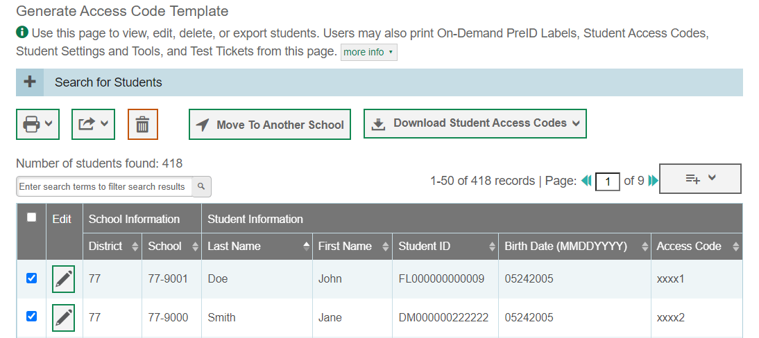
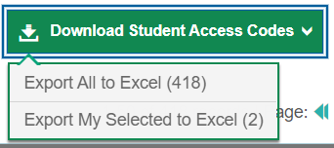
Download Family Portal Access Codes Template
Notes:
After you click View Results, the search results grid appears and displays Access Codes for any students appearing in your search.
If you want the Microsoft Excel document to include only some students from the search results, mark checkboxes next to the students you wish to include.
Next, select the Download Students Access Codes drop-down at the top of the page. From here, you will choose either Export All to Excel or Export My Selected to Excel. The template will then download to your computer.

Slide 19
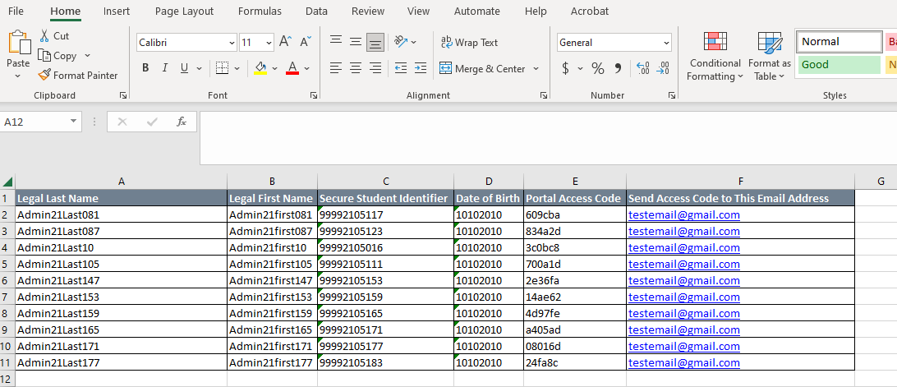
Family Portal Access Codes Template
Notes:
When you open the Microsoft Excel template, fill in the Send Access Code to This Email Address column for each student. You will want to enter the email address of the recipient you wish to receive the student’s access code. If you want to send a student’s access code to more than one recipient, duplicate that student’s row in the template and enter another email address.
When you have finished entering emails, save and close the template.
NOTE: During 2022-2023, DeSSA ELA and Mathematics Family Portal Access Codes were published on the printed score reports mailed to families. Family Portal Access Codes can be emailed to families as needed. Districts will need to determine the most effective way to communicate Family Portal Access Codes to families of third grade students during the 2023-2024 school year.

Slide 20
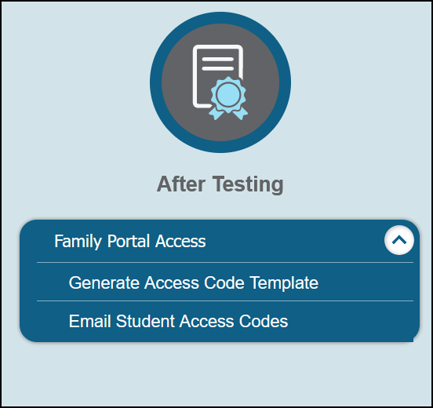
Email Family Portal Access Codes
Notes:
Return to the TIDE dashboard. In the After Testing section, click Family Portal Access, and then click Email Student Access Codes.
When the Email Student Access Codes page appears, click the Browse button, locate the Generate Access Code Template Microsoft Excel file that you created, and select Open to add the file to TIDE.
When you click Next, the preview page will appear. This way you can check if emails are incomplete.

Slide 21
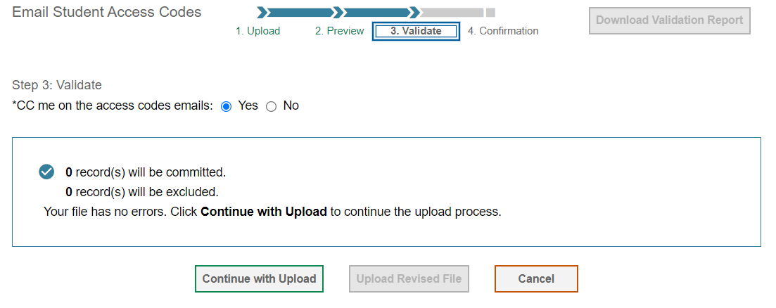
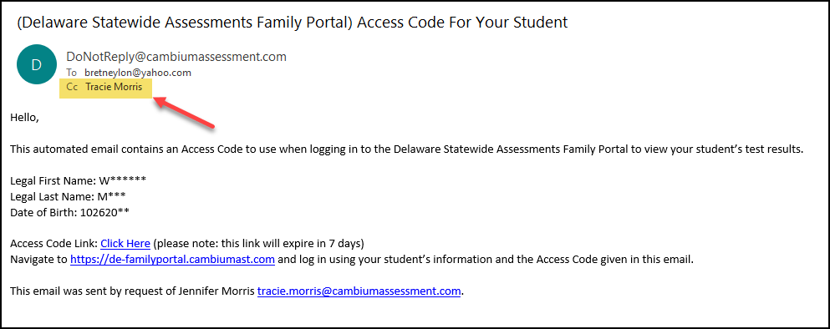
Email Family Portal Access Codes, Continued
Notes:
On the preview page, verify that the information is correct and select Next. The Validate page will appear. To CC yourself on the emails sent to families, in the CC me on the access code emails field, select Yes. If you do not want to receive these emails, select No. Please keep in mind that the CC option is only available if fewer than 50 records are included in the uploaded file.
Click Continue with Upload. The file will then be uploaded to TIDE and emails will be sent to the recipients listed in the Microsoft Excel document. To upload another file, select upload new file.

Slide 22
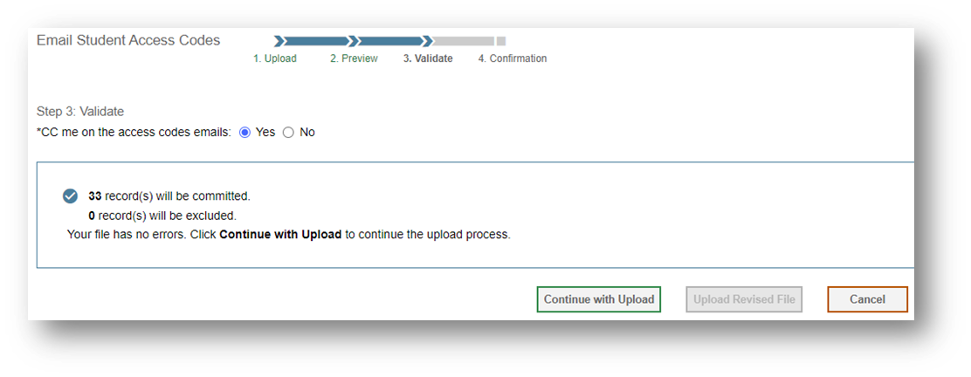
Email Family Portal Access Codes, Continued
Notes:
On the preview page, verify that the information is correct and select Next. The Validate page will appear. To CC yourself on the emails sent to families, in the CC me on the access code emails field, select Yes. If you do not want to receive these emails, select No. Please keep in mind that the CC option is only available if fewer than 50 records are included in the uploaded file.
Click Continue with Upload. The file will then be uploaded to TIDE and emails will be sent to the recipients listed in the Microsoft Excel document. To upload another file, select upload new file.

Slide 23
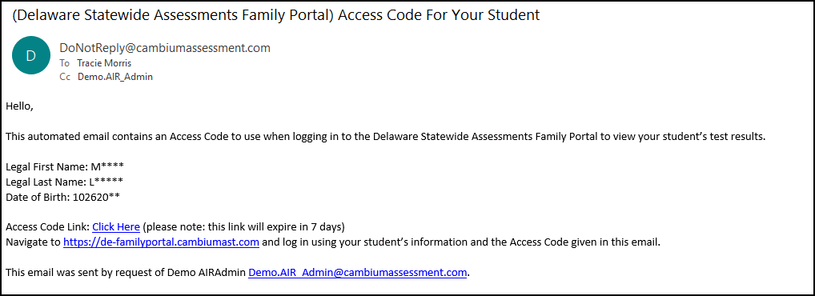
Family Portal Access Codes Email
Notes:
The emails that families receive contain links to a website where families can retrieve Access Codes. Each link will expire after seven days. If a link expires, the family will need to request a new link, and you will have to send a new email.

Slide 24
Contact Your Help Desk
You can contact the Help Desk for assistance with any technical issues you encounter.
When contacting the Help Desk, please be ready to provide the following information:
Any error messages that are appearing (including codes)
Your operating system and browser information
Your network configuration information
Your contact information for follow-up by telephone or email
Any other relevant information, such as test names or content areas, student IDs, session IDs, and search criteria
For test administration or policy issues, please contact your district test coordinator.
Notes:
You can find the TIDE User Guide and other helpful resources on your state assessment portal. However, if you still require assistance with troubleshooting a technical issue, you may also contact your Help Desk. When contacting your Help Desk, please be ready to provide the following information:
Any error messages that are appearing (including codes)
Your operating system and browser information
Your network configuration information
Your contact information for follow-up by telephone or email
Any other relevant information, such as test names or content areas, student IDs, session IDs, and search criteria
For questions about test administration or policy issues, please contact your district test coordinator.

Slide 25
Thank You!
Further Information
https://de.portal.cambiumast.com/
DeSSA Help Desk:
E-mail Support: DeSSAHelpDesk@cambiumassessment.com
Support Toll-Free Number: 877.560.8331
Hours: 6:30 a.m. to 6:30 p.m. ET- Mondays–Fridays (except holidays)
DOE Contact:
Phone number: (302) 857-3391
https://helpdesk.doe.k12.de.us/
Notes:
Thank you for taking the time to view this training module. For additional information, refer to your TIDE User Guide located on your portal or contact the Help Desk.

