Slide 1
The reporting system
— Generating ISRs and
Student Data Files
2023–2024
Training Module
2022–2023
Copyright © 2022 Cambium Assessment, Inc. All rights reserved.
Copyright © 2023 Cambium Assessment, Inc. All rights reserved.
Notes:
Welcome to this mini training module on Generating ISRs and Student Data Files in the Reporting System.
This training module is based on the Centralized Reporting System User Guide for Summative and Interim Assessments, 2023–2024, which is available on the DeSSA portal.

Slide 2
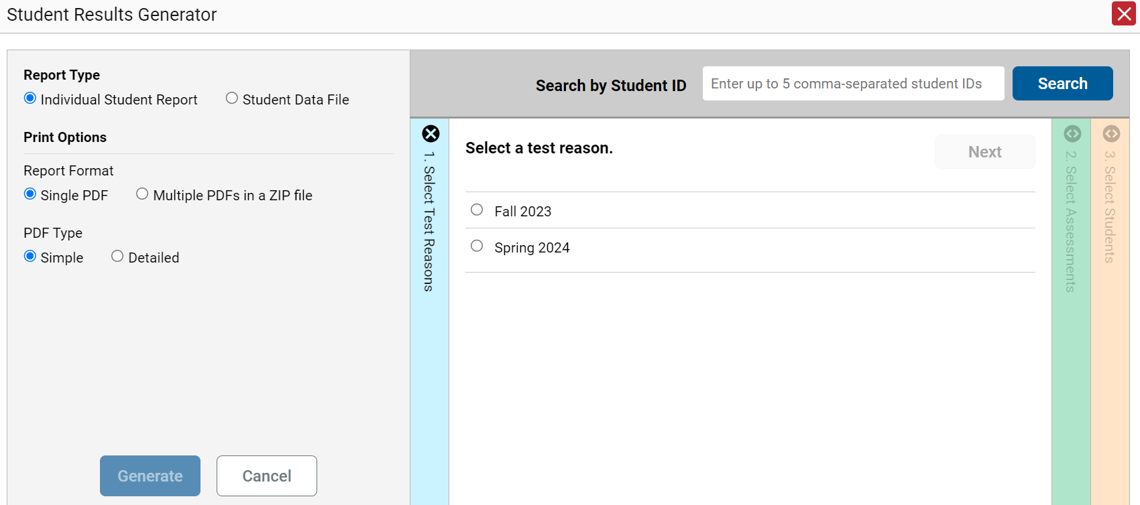
Build ISRs and Student Data Files/Test Reasons
1. Select a test reason.
Notes:
The Download Student Results button allows you to generate an ISR or a Student Data File. An ISR is a PDF that displays test results for a single test opportunity taken by a student. It may consist of a single page or multiple pages. ISRs are useful for sharing performance information with students and their parents and guardians. A Student Data File is a Microsoft Excel, CSV, or text file of the information used for analysis.
The Student Results Generator button is the “head and shoulders” icon located in the Features & Tools menu, under the Download & Print options. When you click it, the Student Results Generator pop-up window displays. Both reports, the ISR and the Student Data File, are typically built by completing three numbered and colored sections:
#1 Select Test Reasons
#2 Select Assessments
#3 Select Students
In this section, we take you through the steps of generating an ISR. You construct the Student Data File in the same way, but your report will be in the form of a Microsoft Excel, CSV, or text spreadsheet.
Here is the Student Results Generator window showing pre-populated or pre-selected options, although you can change those selections to match your needs.
Test Reasons are typically test administration windows. They can also be categories, like Pre-test or Post-test, or a numbered opportunity. Select the test reason you need. You can only select one test reason.
Now, go to the other two sections and confirm or change the selections. You open and close each column by clicking the symbols at the top of the columns, or you can click the Previous and Next buttons at the top of each open column.

Slide 3
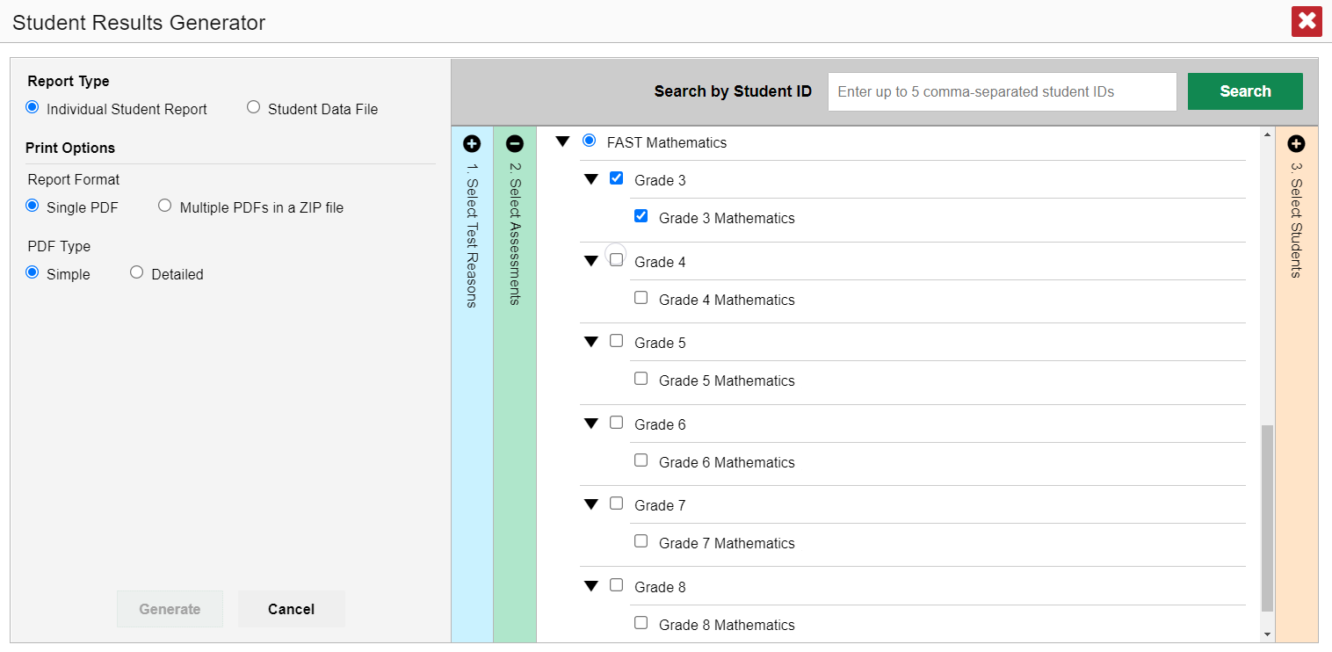
Select the Assessments
2. Select the assessments.
MATHEMATICS
Notes:
Column 2 lists assessments by subject and grade. Select individual assessments or subjects. When you are generating ISRs, you can select multiple grades under ONE subject, but not multiple subjects.

Slide 4
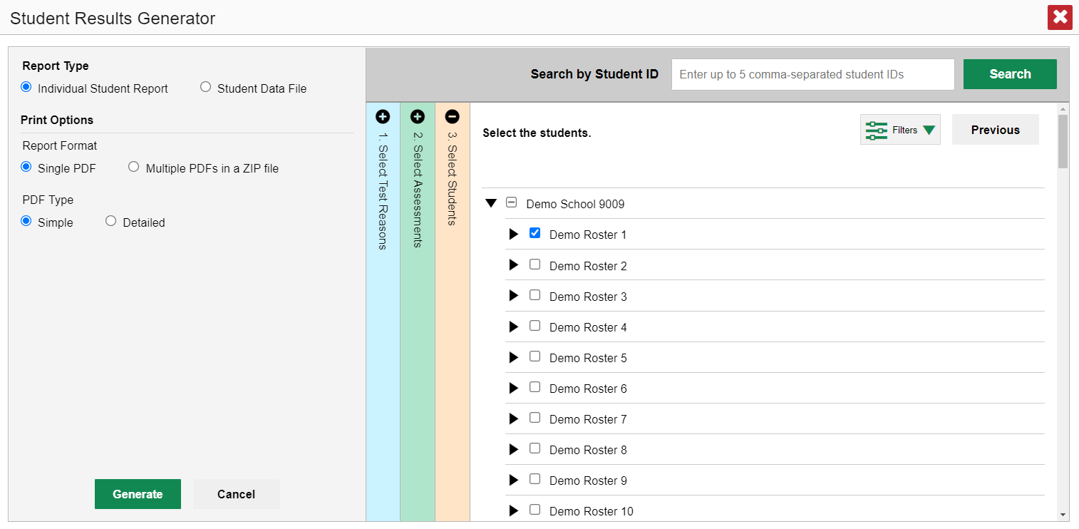
Select the Students
3. Select the students.
Notes:
Column 3 is labeled Select Students. The Select Students column displays the rosters in the Demo School. Each roster can be expanded to show the students on that roster by clicking on the arrow next to the roster name.
District assessment coordinators are limited to selecting students from up to THREE schools only.

Slide 5
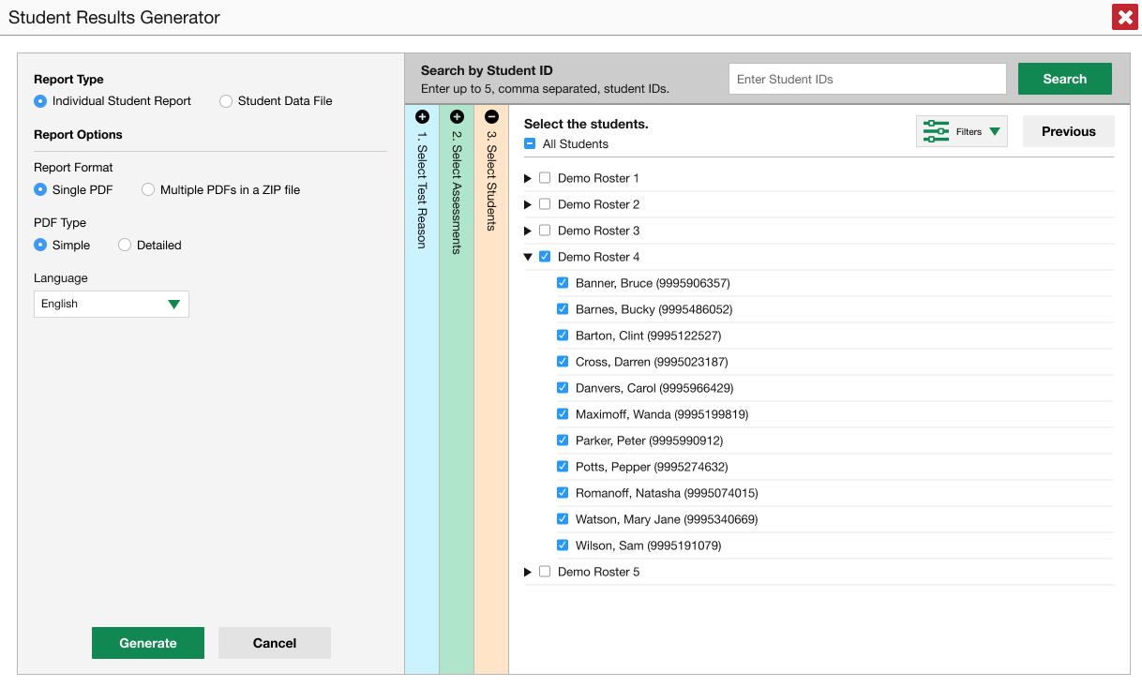
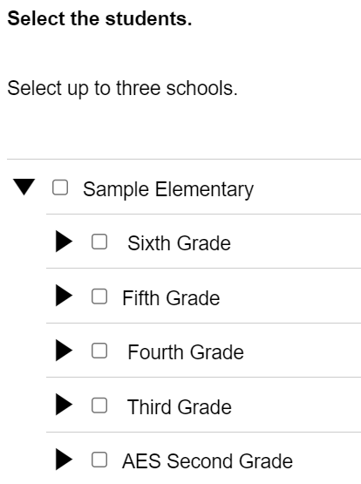
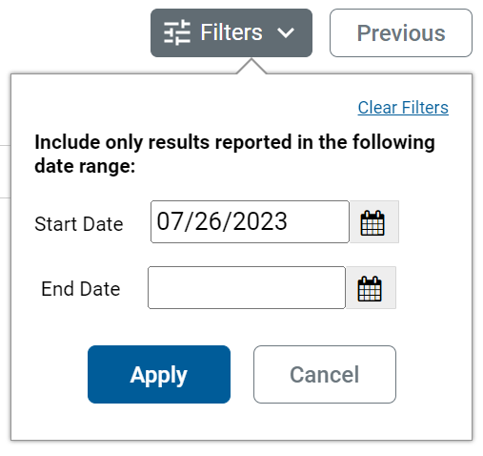
Another Customizing Option
4. Set date range.
Notes:
Another customizing option is accessed via the Filters button, which is in the Select Students section to the left of the Previous button. You can select a range of dates to be included in the ISR by using the calendar to enter a start date and an end date. After making your customizations, click the Generate button and the ISR(s) will post to the Secure File Center.

Slide 6
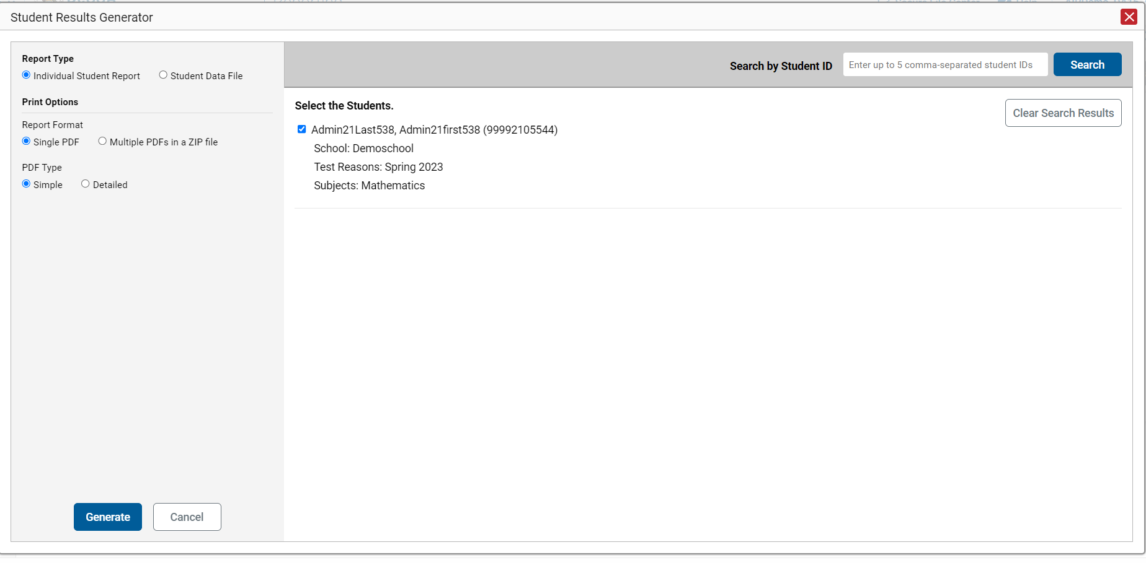
ISR from the Student Portfolio Report
Notes:
If you click the Download Student Results button from the Student Portfolio Report, the data will load pre-populated, as shown here, without the three colored panels. You see the student’s name and ID number, the school, the test reasons which display as test administrations of the current school year, and the subjects. You can clear the Student Portfolio selection by clicking Clear Search Results. That removes the selected student and takes you to the three panels you can select from, with nothing pre-selected.
When you click the Generate button, the report will post to the Secure File Center.
If you need to print just a few more students’ ISRs, you can enter up to five, comma-separated student IDs in the Search by Student ID box, and the same pre-populated template will display, allowing you to generate the ISRs for all those students’ tests.

Slide 7
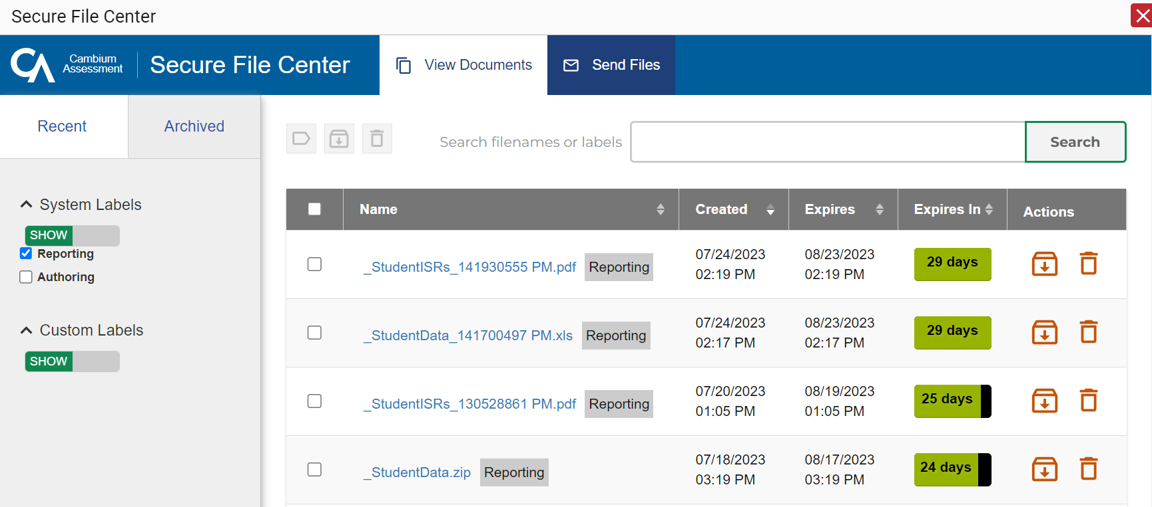
Secure File Center
Notes:
Here is a sample Secure File Center showing multiple ISR postings. You can archive or delete a file at any time by using the buttons under the Actions column in the results table. Click the name of a file to download it to your computer.
Files are automatically deleted after 29 days in both the Recent and the Archived boxes.

Slide 8
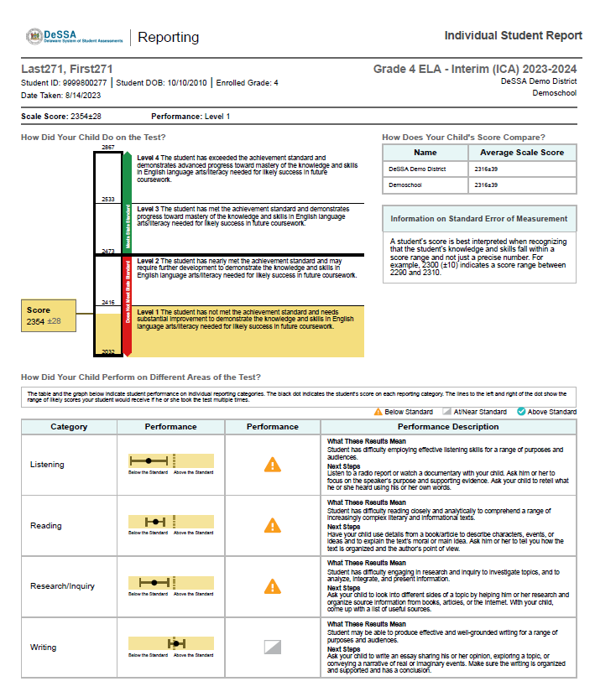
Sample Simple ISR: ICA
Simple ISR
Notes:
Here is a sample ISR for an ICA. You can generate a simple report or the more detailed report. The simple ICA ISR includes overall scale score and performance levels as well performance level for individual claims.

Slide 9
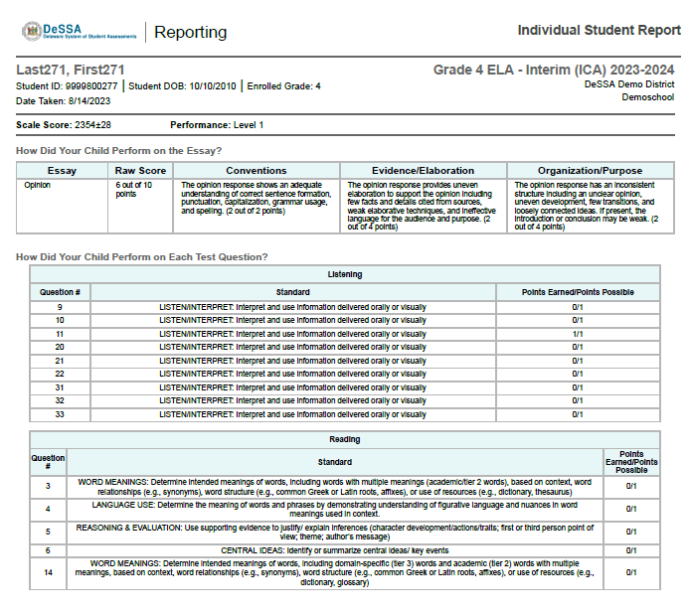
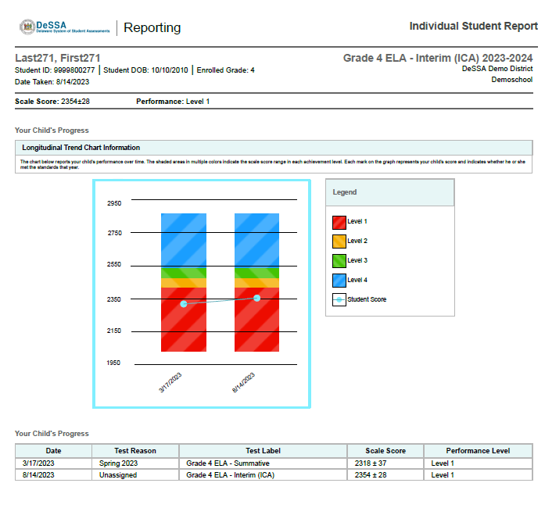
Sample Detailed ISR: ICA
Detailed ISR
Notes:
Here is a sample detailed ISR. The detailed ICA report includes the raw score for each item. The detailed report may also include a longitudinal trend chart section, like the one shown here. You can see the student’s progress over time as the three tests results display as performance level and scale score.

Slide 10
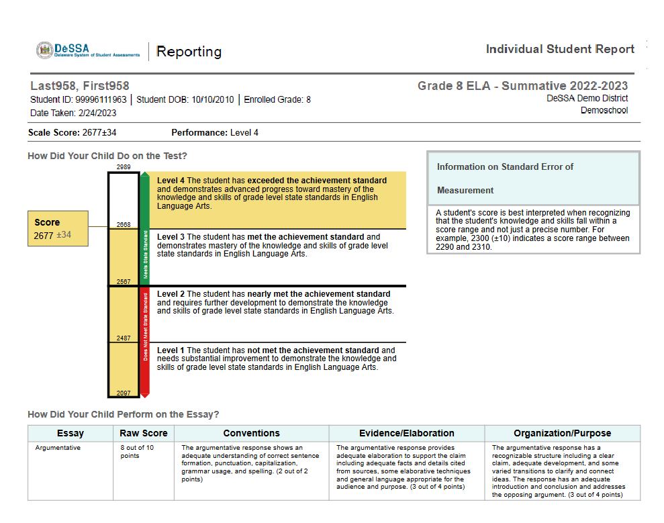
Sample Simple ISR: Summative
Simple ISR
Notes:
Here is a sample Summative ISR. The simple Summative ISR includes overall scale score and performance levels as well performance level for individual claims. The simple Summative ELA ISR also includes the raw score for the essay.

Slide 11
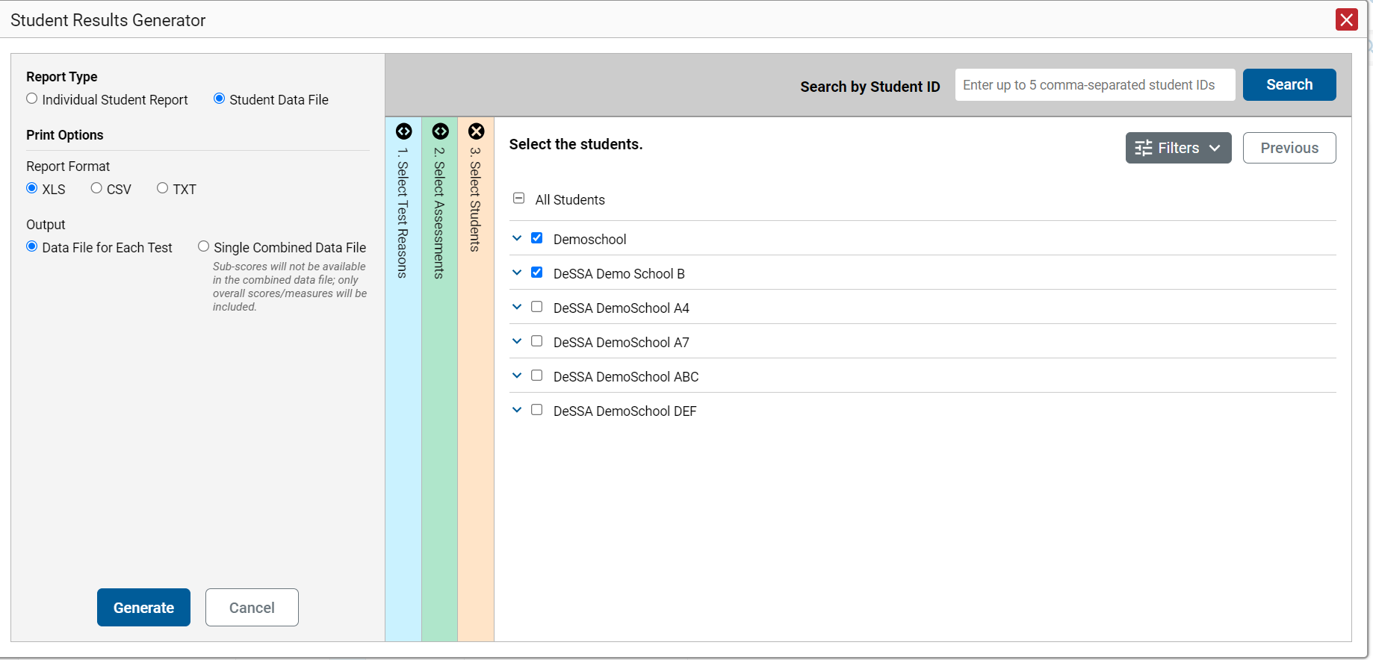
Generate a Student Data File
Student Data File—
Excel Worksheet
Notes:
A Student Data File is a user report of performance data in Microsoft Excel, CSV, or text format. Files of this nature allow the user to employ the workbook features of a spreadsheet application to organize and sort the data. The generation process for a Student Data File is the same one used for the ISR with different print options and fewer restrictions. You can select tests in as many subjects as you want.
Customize the Student Data File using the same three selection columns and the Filters button. Choose your desired export format and click the Generate button. The Student Data File displays in the Secure File Center. A sample file is shown here.

Slide 12
Generating ISRs and Student Data Files
ISRs
Student Data Files
One test reason
A single subject; multiple grades
Up to three schools for district-level users
One test reason
Multiple subjects; multiple grades
Multiple schools in a district
Data file for each test or combined data file
Multiple subjects and tests may be generated from the Student Portfolio Report
Multiple subjects and tests may be generated from the Student Portfolio Report
Notes:
Here is a review of the parameters of the options for each type of file: ISRs and Student Data Files.

Slide 13
How Can I Get More Information?
You can contact the DeSSA Help Desk for assistance with any technical issues you encounter.
When contacting the DeSSA Help Desk, please be ready to provide the following:
Any error messages that are appearing (including codes)
Your operating system and browser information
Your network configuration information
Your contact information for follow-up by phone or email
Any other relevant information, such as test names or content areas, student IDs, session IDs, and search criteria
For test administration or policy issues, please contact your District Test Coordinator.
You can find more announcements on the DeSSA assessment portal.
Notes:
We hope this module has given you a solid, basic understanding of how to generate ISRs and Student Data Files in the Reporting system. Watch for future announcements on the DeSSA assessment portal page. A Centralized Reporting System User Guide is posted there. You can also call or email the DeSSA Help Desk with your questions.

Slide 14
Additional Information
DeSSA Portal:
https://de.portal.cambiumast.com/
DeSSA Help Desk:
E-mail Support: DeSSAHelpDesk@cambiumassessment.com
Support Toll-Free Number: 877.560.8331
Hours: 6:30 a.m. to 6:30 p.m. ET- Mondays–Fridays (except holidays)
DDOE Contact:
Phone number: (302) 857-3391
https://helpdesk.doe.k12.de.us/
Notes:
Thank you for taking the time to view this training module. For additional information, refer to your CRS User Guide located on the DeSSA portal or contact the DeSSA Help Desk.

