Slide 1
Test Administrator (TA) Interface for Online Testing
Training Module
2023–2024
Copyright © 2023–2024 Cambium Assessment, Inc. All rights reserved.
Notes:
Welcome to the Test Administrator Interface for Online Testing training module. This presentation describes the Test Administrator (TA) Interface that you will use to administer online tests. Please note that your state’s TA Interface may be different from the images shown in this presentation. Please consult your state’s assessment portal for additional information about specific features of your state's TA Interface.

Slide 2
Objectives
After viewing this presentation, you should be able to:
Use the TA Interface to start and run a test session
View student test settings and accessibility resources
Monitor the testing process
Pause and stop a test session
Transfer sessions between computers and mobile devices
Print test session information
Exit and log out of the TA Interface
Troubleshoot and resolve basic issues that might arise.
Notes:
After viewing this presentation, you should be able to:
Use the TA Interface to start and run a test session
View student test settings and accessibility resources
Monitor the testing process
Pause and stop a test session
Transfer sessions between computers and mobile devices
Print test session information
Exit and log out of the TA Interface

Slide 3
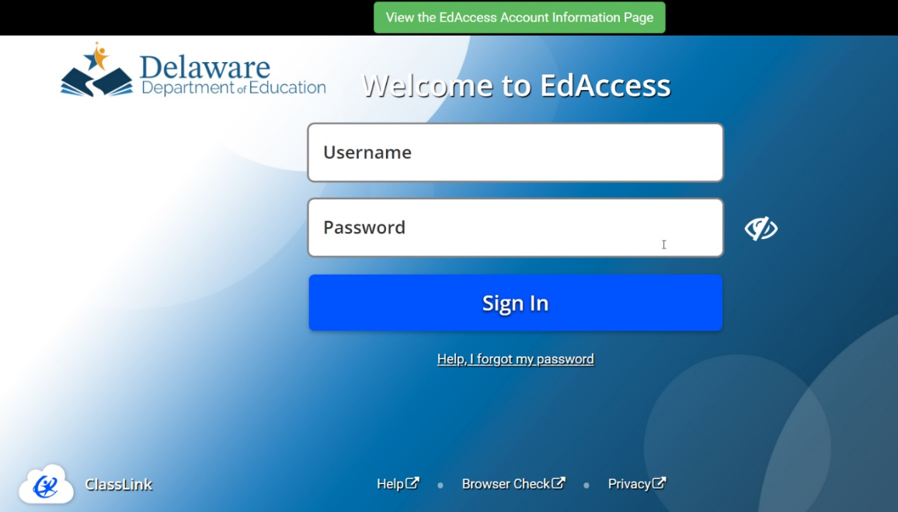
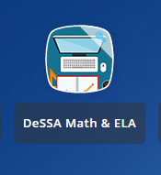
Logging into the TA Interface
The TA interface is accessed through the Delaware Department of Education’s (DDOE’s) EdAccess or LEA ClassLink application.
1. Access the DDOE EdAccess or LEA Classlink application Single Sign-On login page at launchpad.classlink.com/ddoe. Use your regular EdAccess ID and password to log in.
2. After you have successfully logged, you will see a list of authorized applications, including DeSSA Math & ELA.
Click the [DeSSA Math & ELA] button from your menu. You will be directed to the DeSSA portal.
Notes:
The TA Interface is accessed through the Delaware Department of Education’s (DDOE’s) EdAccess or LEA Classlink application.
Access the DDOE EdAccess login page at launchpad.classlink.com/ddoe. Use your regular EdAccess ID and password to log in.
After you have successfully logged in, you will see a list of authorized applications, including DeSSA Math & ELA.
Click the [DeSSA Math & ELA] button from your menu. You will be directed to the DeSSA portal.

Slide 4
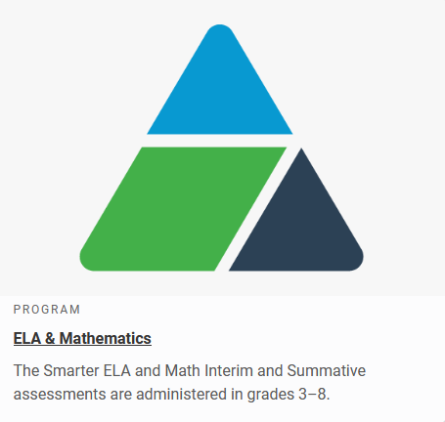
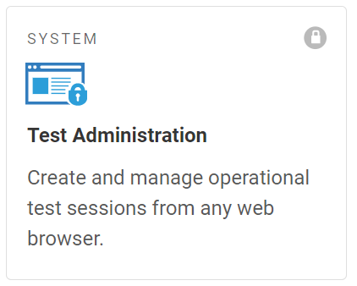
Logging in to the TA Interface
The TA Interface is accessed through the Delaware Department of Education’s (DDOE’s) EdAccess or LEA ClassLink application.
3. Click the [ELA & Mathematics] user card to access DeSSA applications.
4. Click the [Test Administration] card. If you are authorized to access this application, you will be automatically directed to the TA Interface. You will not have to log in again.
Notes:
Access the DDOE EdAccess or LEA Classlink application login page at launchpad.classlink.com/ddoe. Use your regular EdAccess ID or LEA Classlink ID and password to log in.
After you have successfully logged in to EdAccess or LEA Classlink, you will see a list of authorized applications, including DeSSA Math & ELA.
Click the [DeSSA Math & ELA] button from your menu. You will be directed to the DeSSA portal.
Click the [ELA & Mathematics] user card to access DeSSA applications.
Click the [Test Administration] button. If you are authorized to access this application, you will be automatically directed to the TA Interface.

Slide 5
Creating a Test Session
Notes:
The first step in administering any test is to create a test session.

Slide 6
TA Interface Feature Overview
Notes:
In the top right corner of the window, you will see your username with a dropdown menu and a Help button. Select your username to access the Logout button. Select the Help button to access the online Help Guide.
Below the Help button and username on the left side of the window, you will see an Operational Session ID tab, Select Tests tab, Student Lookup tab, and a Menu button.
The Operational Session ID tab will display the session ID and will show the test session table after students are approved to enter the test session and have logged in.
Select the Select Tests tab to add tests to a session.
Select the Student Lookup tab to search for student information using Quick Search and Advanced Search.
Select the Menu button to access the screensaver function and view any approved requests.

Slide 7
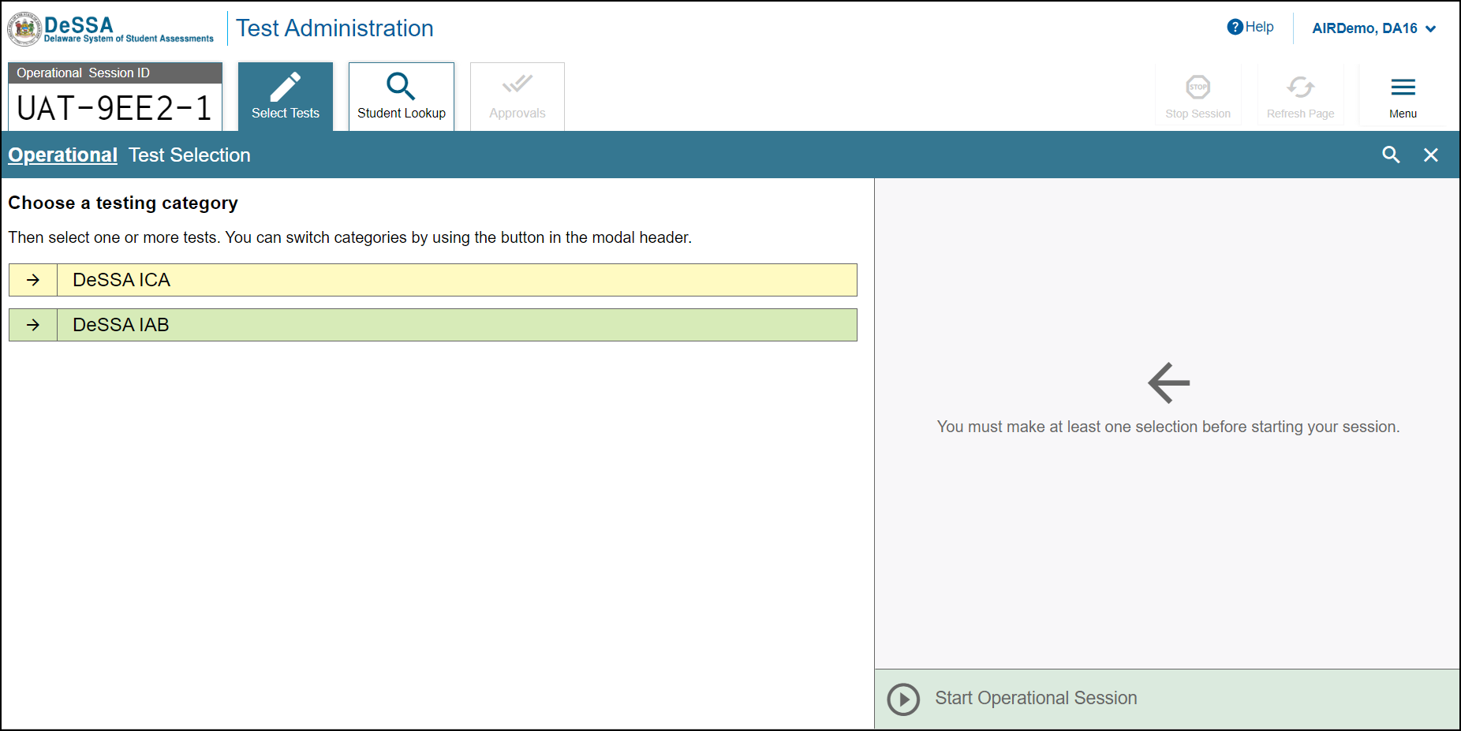
Create a Test Session: Test Categories
Expand Category
Notes:
The first step in administering any test is to create a test session. This should be done fewer than 20 minutes prior to starting the test in order to prevent the system from timing out.
After logging in, the Test Selection pop-up window appears, displaying color-coded test categories such as English Language Arts and Mathematics.
To expand a category and see all the possible tests for that category, click the arrow next to the category name.

Slide 8
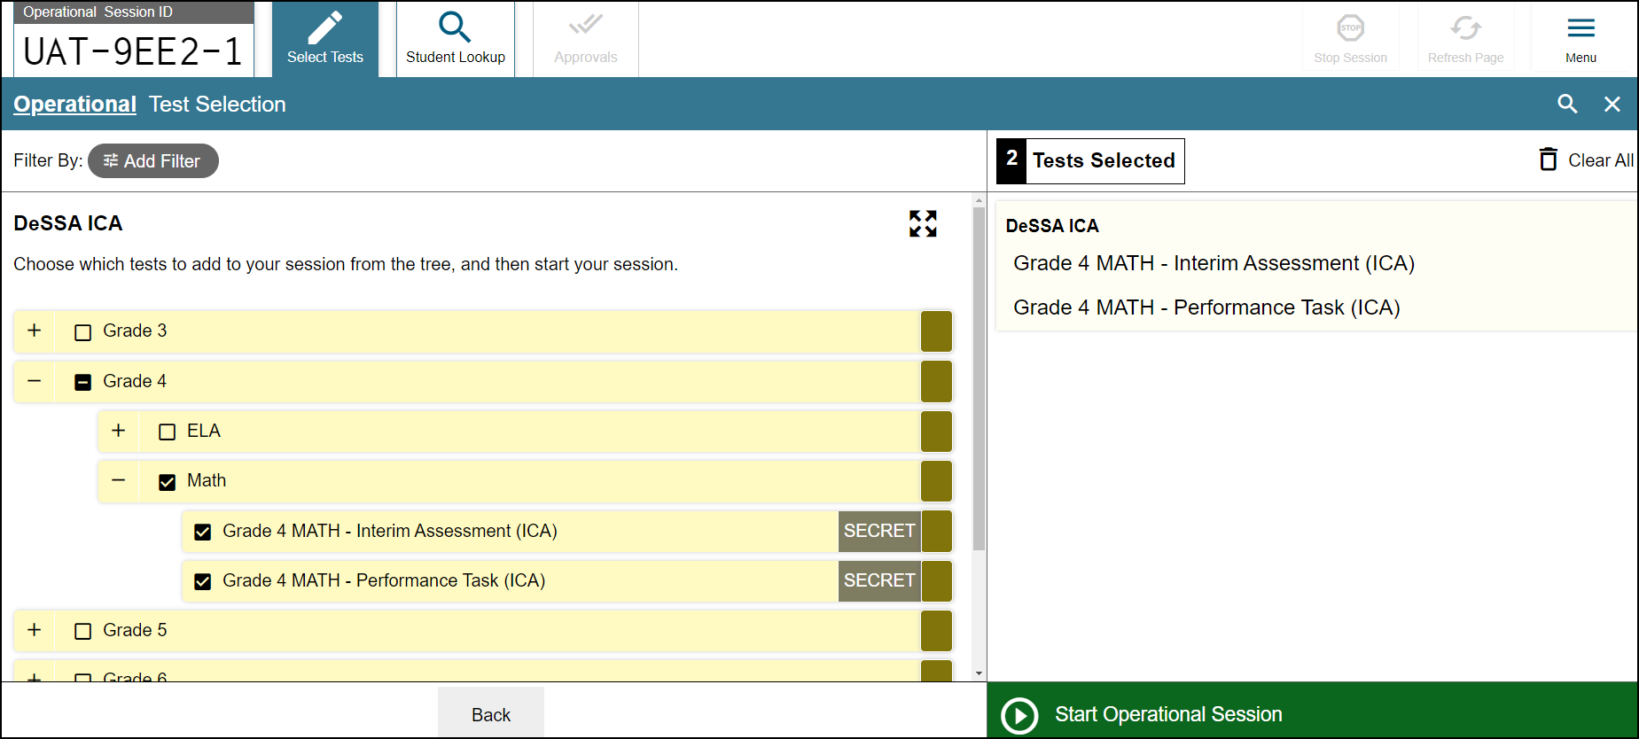
Create a Test Session: Test Selection
Notes:
Select the plus sign (+) next to a test group name to view the tests in that group. To create a test session, select one or more tests to administer, or select the checkbox for a test group to include all tests in that group. Once you select tests to add to the session, they will appear in the “Tests Selected” column on the right side of the window. If you need to remove a test that you have previously selected, uncheck the box next to that test in the left column.
To add tests from a different test category, select the back button to return to the list of test categories.

Slide 9
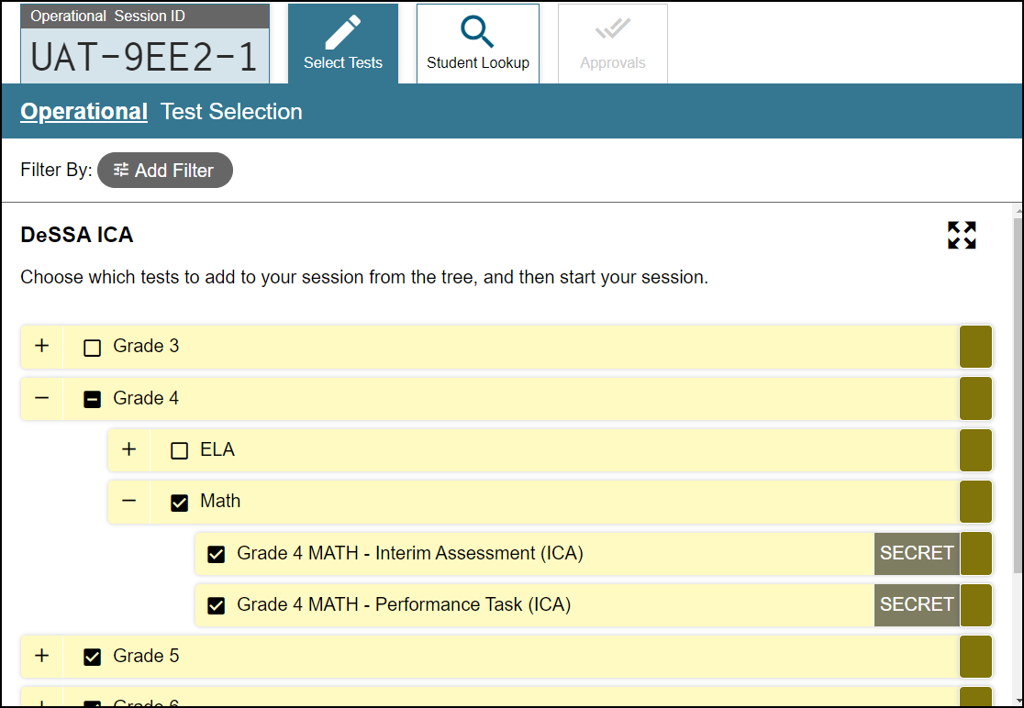
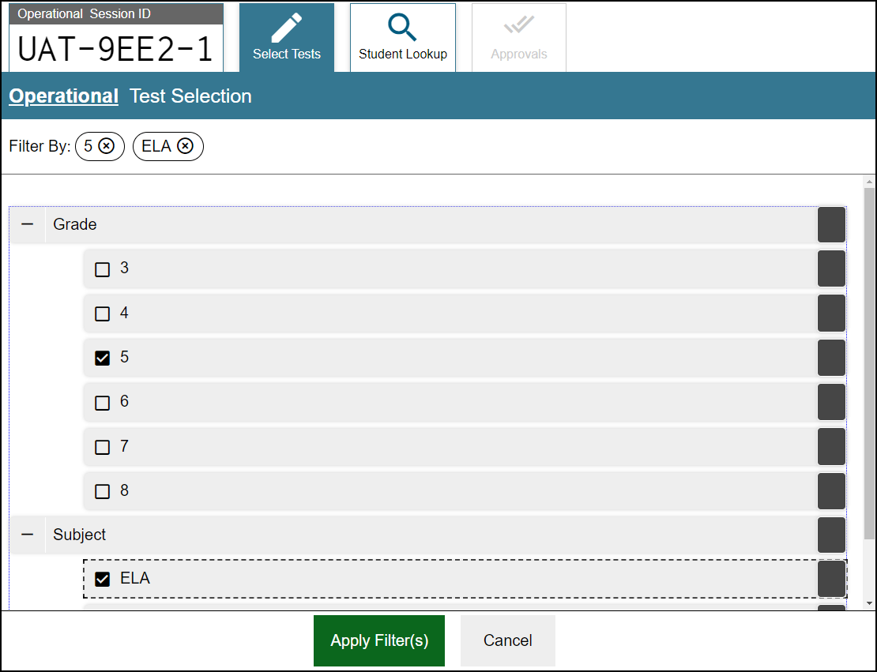
Create a Test Session: Filters
Notes:
You can also filter a list of tests by grade and subject, in order to focus on specific types of assessments. The filters function is especially useful if a large number of tests exists.
To filter a list of tests, first select the Add Filter button and the filters panel will appear. Then select the plus sign (+) button next to the grade and/or subject to expand the category and see a list of available grades and subjects. Mark the checkboxes next to the grades and/or subjects you want to filter by. Your selected filters will appear at the top of the window. If you want to remove a filter, select the “x” button next to the filter you want to remove.
Once you are finished selecting filters, select Apply Filter(s).

Slide 10
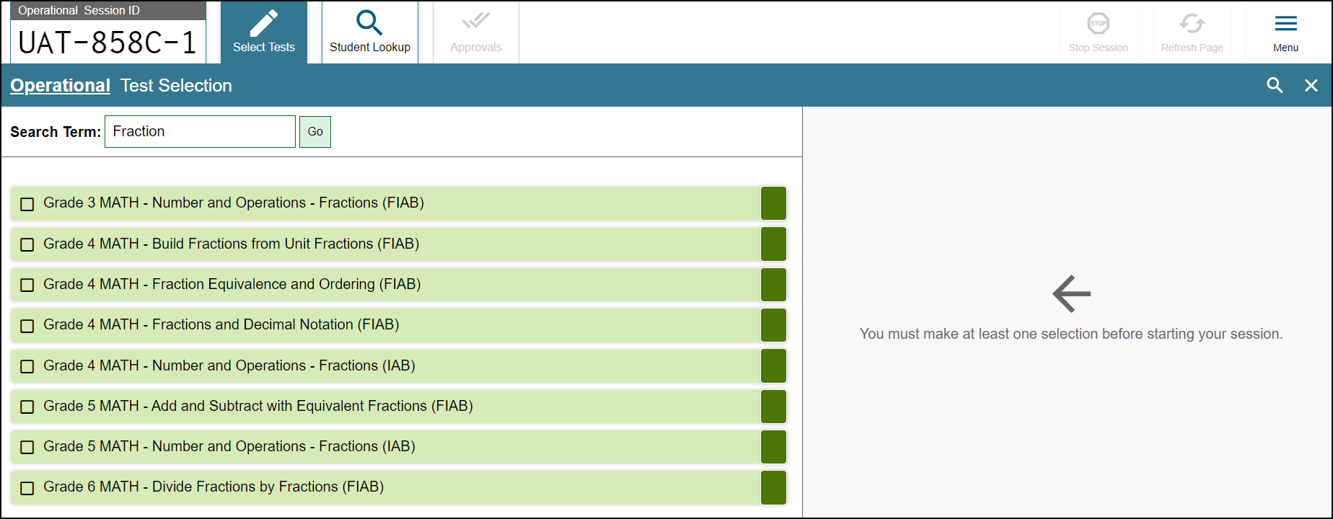
Create a Test Session: Global Search Feature
Notes:
You can also search for specific tests to add to your session by using the global search feature.
To search for tests, click the magnifying glass in the right corner of window. On the search panel that appears, enter the full or partial test label in the Search Term field and select Go. A list of tests containing your search terms will appear below. Select the test(s) you want to add to your session by marking the checkbox next to the test name. If you want to close the search window, select the Close button at the bottom of the panel.
Once you have selected the test or tests you want to add to the session, click the Start Session button.

Slide 11
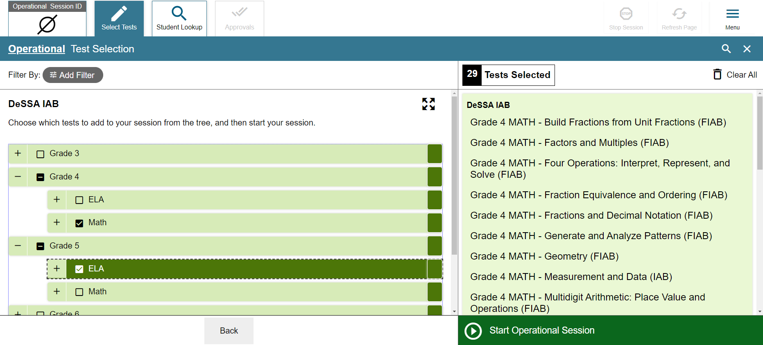
Create a Test Session: Start Session
Notes:
Once you have selected the test or tests you want to add to the session, click the Start Session button.

Slide 12
TA Interface Features After Testing Has Begun
Print Session Information
Notes:
Once a session has started and students are waiting for approval, the Operational Session ID tab displays the session ID and will show the test session table after students are approved to enter the test session and have logged in.
The Approvals tab will become active when any students are waiting for approval. In this example, one student is waiting for approval. In addition, the Stop Session button will become active.
Below the Menu button, you will see a Print icon. Select the print icon to print the test session information.

Slide 13
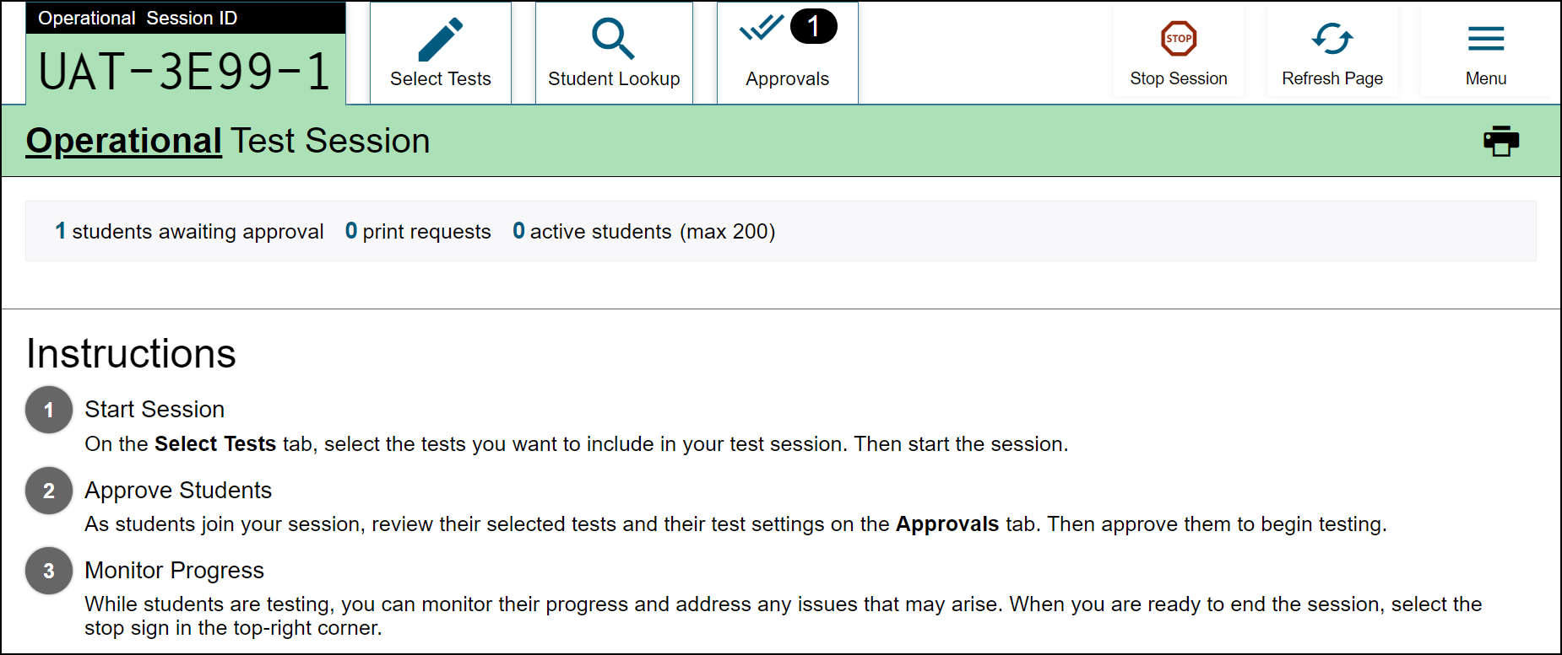
Session ID
Notes:
Once you start a session, the system will automatically generate a session ID. The session ID will show in a tab at the top of the TA Interface. This ID must be given to students for them to log in. You may display it on a whiteboard or provide it to students using a printed card or similar method. If you provide students with the information on paper, be sure to collect and destroy the papers when the session is complete.
You should also note the session ID for your own records. If you accidentally close your browser, entering the session ID will allow you to resume the session. If you do not have this information when you try to resume, you will be unable to do so.
When students start signing into the test session, the Approvals tab will become active. Once you approve students for testing, the Test Session table will show in the center of the TA Interface, displaying students’ testing progress. We will discuss more about this in later slides.

Slide 14
Screensaver Mode
Notes:
Since the student test progress tables in the TA Interface often contain sensitive student information, such as student IDs, the TA Interface contains a screensaver function to hide the data from view. The screensaver will automatically turn on if you are not active in the TA Site for five minutes.
To turn on screensaver mode, select Menu and then select Toggle Screensaver. The screensaver displays the Session ID and the timer, if applicable. It also displays notifications if students are awaiting approval, if there are pending print requests, or if students require other interventions.
The screensaver will turn off automatically if any mouse or keyboard activity is detected. It will also turn off automatically if the test session times out due to TA or student inactivity or once the allotted time expires for a timed test.

Slide 15
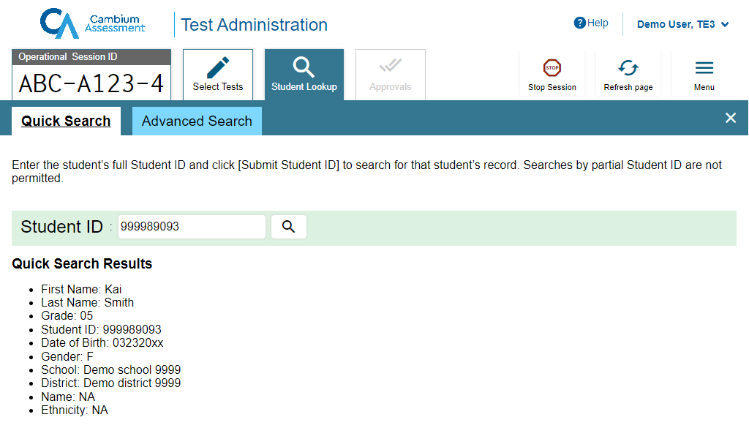
Student Lookup: Quick Search
Search
Notes:
If a student is having trouble logging in, use the Student Lookup feature to verify that the student’s login credentials are correct. You can use either the Quick Search or Advanced Search option to view the information entered for the student in TIDE.
With Quick Search, you simply enter the student’s state-assigned student ID and select the Search icon.
Results will display. If there is no match, you will see an error message.

Slide 16
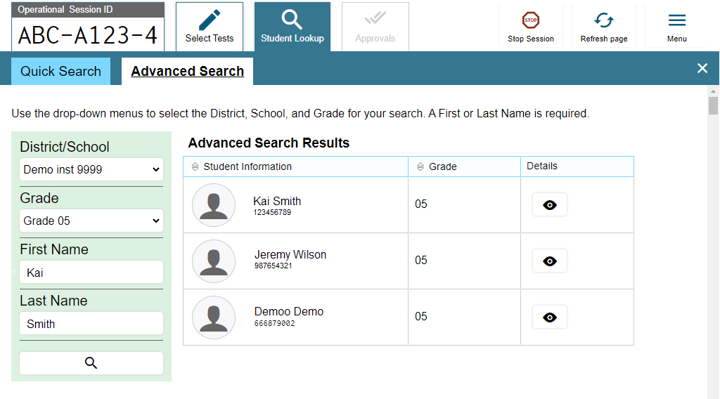
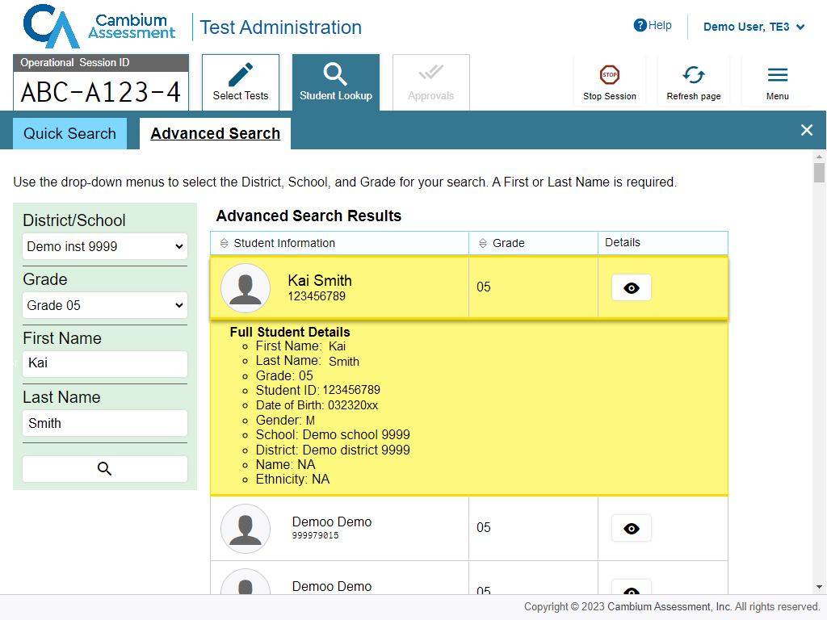
Student Lookup: Advanced Search
Search
Notes:
Advanced Search allows you to narrow your search using several filters, including District/School, Grade, First Name, and Last Name. Enter the criteria in the fields listed and select the Search icon. Results will display. If you see the student you are looking for, select the Eye button next to the student’s name. The student’s information will display below that student’s row in the table. Note that the information displayed may vary slightly from what is shown here.

Slide 17
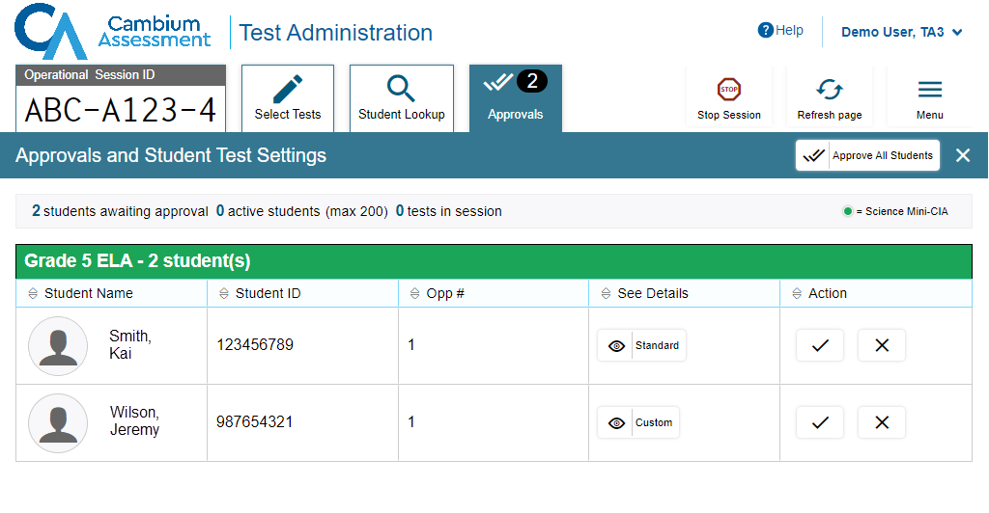
Approving Student Entry
Notes:
Once you start the test session and students log in, you must review and approve their test settings before they can access their tests. It is important that you pay close attention to the test name prior to approval to be sure that students have selected the appropriate test. To approve students for testing, select the Approvals tab. A list of students will display, organized by test name. You should review the list to make sure that all students chose the correct content area and test. You should also ensure that each student’s test settings are accurate. To do this, select the Eye icon in the See Details column. We will talk more about that in a few moments.
If no changes are needed, select Approve All Students to admit all students to the session. You will see a confirmation message appear after selecting Approve All Students.

Slide 18
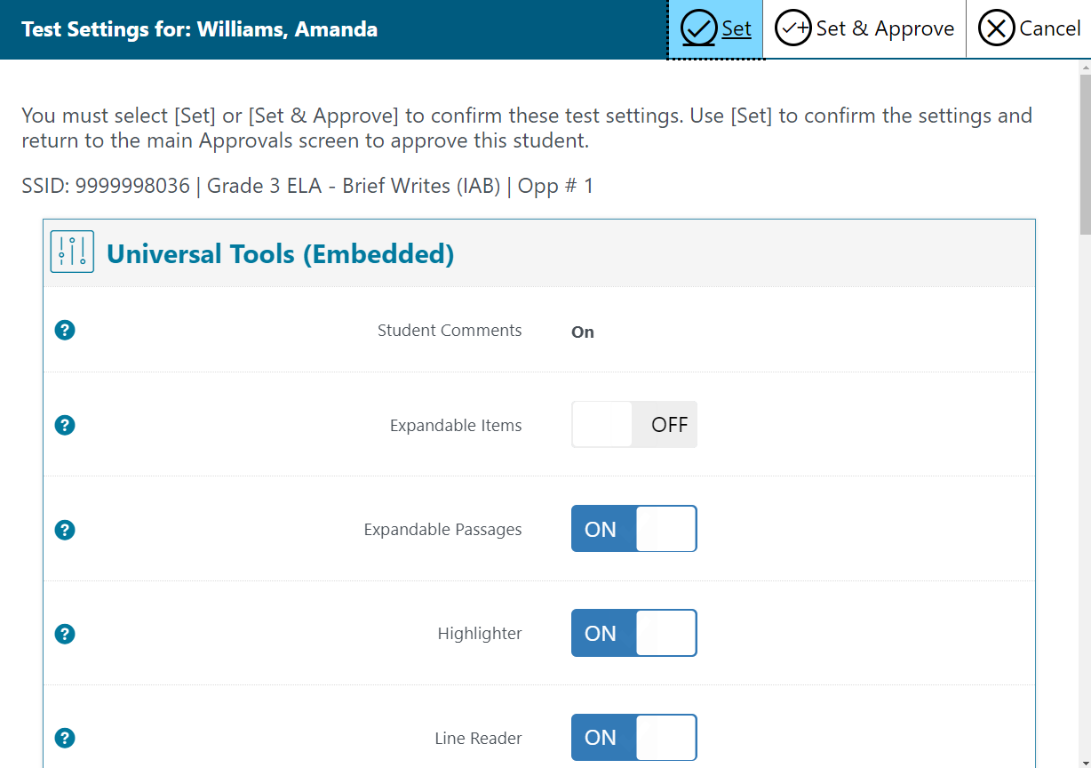
Editing Student Details: See/Edit Details
Notes:
NOTE: Student test settings should be confirmed in TIDE in advance of the scheduled test session.
If you need to change test settings for a student, select the Eye button in the See Details column. The Test Settings window will appear, displaying the student’s information at the top and various test settings organized by their area of need.
Some test settings can be changed in this window. After adjusting settings, select the Set button to change the settings without approving the student. To both change settings and approve the student for testing, select the Set & Approve button.
Some test settings can be viewed but not changed in this window. These test settings must be set by an authorized TIDE user prior to testing. See the TIDE User Guide for more information.
Note that the Test Settings window may not appear exactly as it is shown here, depending on your user role and permissions.
If the student’s test settings are incorrect, the settings must be updated in TIDE or the TA Interface before the student takes the test. Contact your School Test Coordinator or District Test Coordinator to have the settings updated. This will prevent resetting the test for the student later. Please note that the changes may not be immediate.
Note that no settings can be changed while the student is actively testing. Once a student begins testing, the language option cannot be changed without resetting the test opportunity. Updates to background color or font size will take effect only after the student logs out and then resumes testing.

Slide 19
Denying Student Entry
Deny entry to a test session in these circumstances:
The student is not supposed to enter this session.
The student’s demographic information is incorrect.
The student’s required accommodations are incorrect.
Notes:
If a student selected an incorrect test, you must deny that student entry to the test session by selecting the X button in the Action column. Although you can approve all students at the same time, students must be individually denied entry into the test session.
You should deny students entry into the session in these circumstances:
• The student is not supposed to enter this session.
• The student’s demographic information is incorrect.
• The student’s required accommodations are incorrect.
Denying the student entry into the test session will not prevent other approved students from beginning their tests.

Slide 20
Monitoring a Test Session
Notes:
Once students log in and are approved for testing, you can monitor their status from the table(s) displayed on the TA Interface.

Slide 21
Monitoring Student Progress
Notes:
Once students log in and are approved for testing, you can monitor their status from the table(s) displayed on the TA Interface. The table shows Student Information, Opportunity Number, Test Name, Progress, Test Status, Test Settings, and an Actions option.
The Progress column displays the student’s progress through the items in the test. It may display a progress bar to indicate the student’s progress through the test or display the total number of items completed thus far and the total number of items in the test.
The Test Status column indicates a student’s testing status. For a list of test statuses, please see the Test Administrator User Guide.
The Test Settings column will display either Standard or Custom. This column displays Custom when a student’s test settings are different from the default settings for that test. Click the Eye button to view a student’s test settings.
The Actions column allows you to pause a student’s test. If a student request a printout, a printer icon will appear in this column.

Slide 22
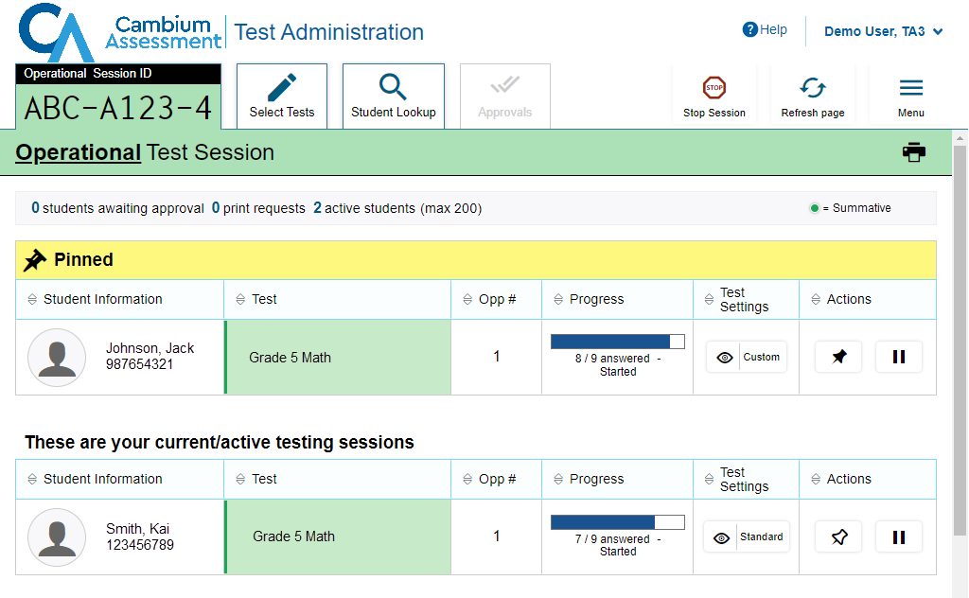
Pin Student
Unpin student
Notes:
If you want to closely follow a student, you can use the pin student function.
Select the pushpin icon in the Actions column of the student you want to monitor. The student’s row will appear in a separate table and move to the top of the test session tab. Note: More than one student can be pinned at a time.
To unpin a student, select the pushpin icon again. The student’s row will no longer appear at the top of the Test Session tab.

Slide 23
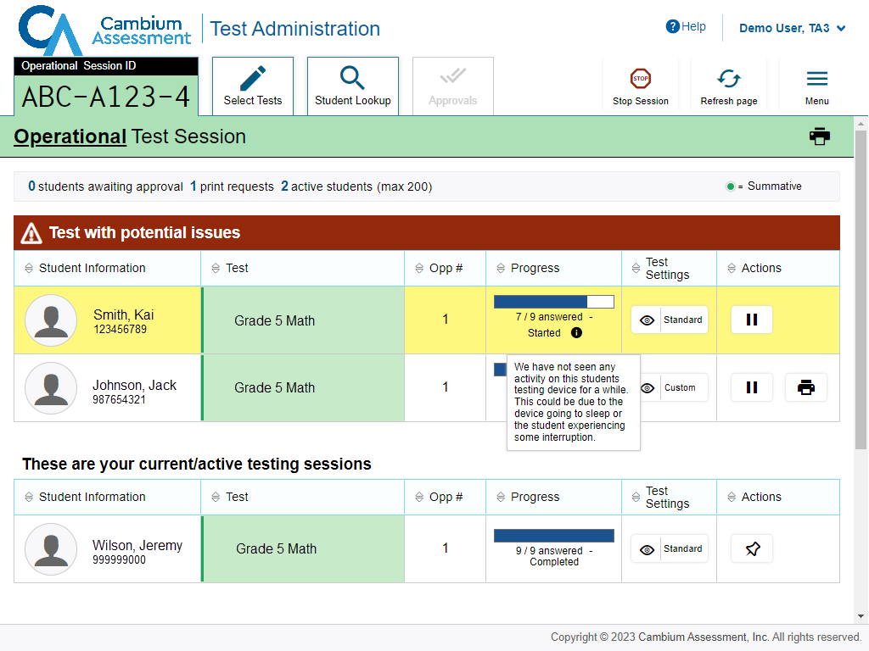
Test with Potential Issues Table
Notes:
If the Test Delivery System (TDS) detects that a student may be having technical issues or requires assistance, a “Test with potential issues” table will appear above the “Tests without issue” table. Hovering over the “i” icon will display more information about the issue.
NOTE: Students with Print on Request enabled will appear under “Tests with potential issues” when they submit a print request. Additional details about the Print on Request functionality can be found in the TA User Guide on the DeSSA portal.

Slide 24
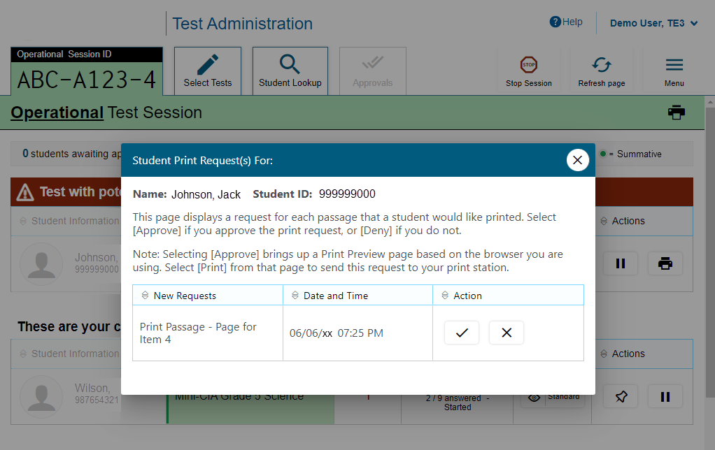
Print on Request
Notes:
The Print on Request feature is available only for students who require it. Please contact your School Test Coordinator if your student needs this accommodation, which requires state approval. It is a testing impropriety to apply this restricted resource for a student who does not have an IEP or Section 504 Plan documenting his or her need for the accommodation.
Students with this accommodation can request printouts of stimuli and/or items, depending on their settings.
• When a student sends a print request, the Printer button will appear in the Actions column of the Tests with potential issues table on the TA Interface. Select the button to view the request.
• If you select the Check button to approve the print request, a cover sheet containing the student’s name and SSID will display in a new browser window. No test content will ever display on your screen.
• If you select the X button to deny the print request, nothing will be printed.
Before approving the student’s print request, ensure that it will be sent to a printer that is monitored by staff who have been trained in test security. All printed test items, stimuli, and reading passages must be securely stored and destroyed immediately following a test session.

Slide 25
Approved Requests
Notes:
The Approved Requests option allows you to view a list of every print request you approved during the current session. To see all approved requests, select the Menu button, and then select Approved Requests.
If you wish to print this list for your own records, select Print at the top of the Approved Requests window.

Slide 26
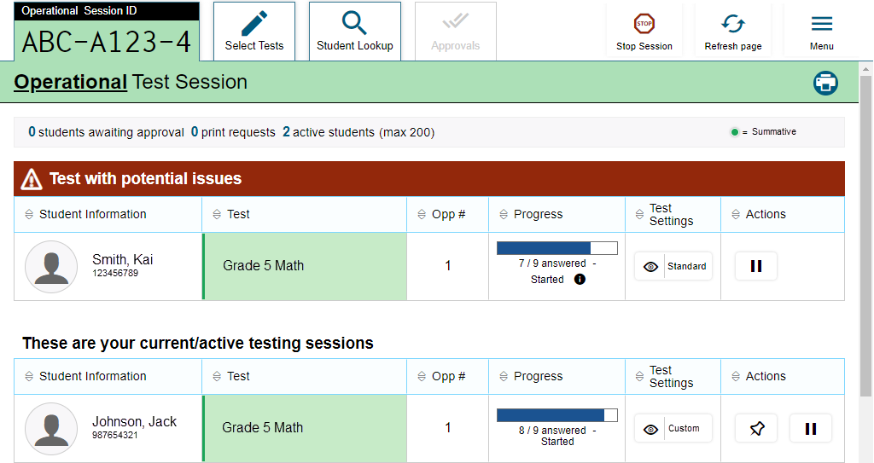
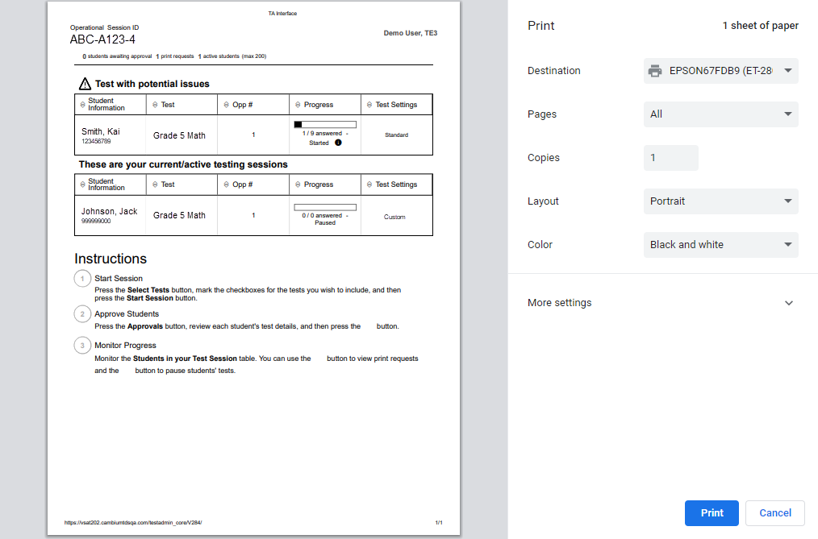
Printing Test Session Information
Notes:
If you wish to print a snapshot of the TA Interface in its current view, select the Print icon located below the Menu button. Printing a snapshot of the test session information can be useful for tracking which students did not complete their tests and may need to be scheduled for another session.
NOTE: Remember that any printouts containing personally identifiable student information must be securely stored and should be destroyed after use.

Slide 27
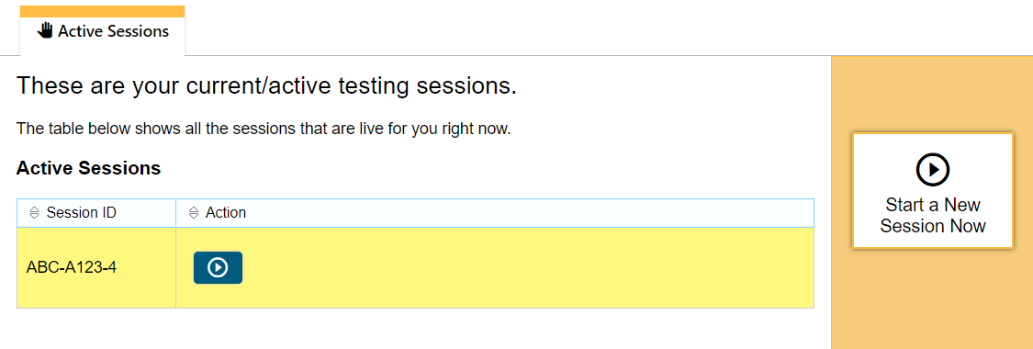
Transferring Sessions
New device or browser
Start the session
Previous device or browser
Notes:
In the event that you have problems with your computer or web browser or need to change computers during an active test session, you can transfer the session from one computer, mobile device, or browser to another without stopping the session or interrupting in-progress tests. To transfer a test session to a new device or browser, remember the following:
Do not log out of the session you are currently in or stop the test session. If you do, you will end the test session and pause all students’ tests.
Log in to the TA Interface on the new machine or in the new browser. You will see an Active Sessions table listing all active testing sessions.
Select the session you want to transfer and select the Start icon in the Actions column. The session will become active on the new browser or device.
A message will appear on the previous device or browser, and the window will close automatically. This will not stop the session or pause student tests.

Slide 28
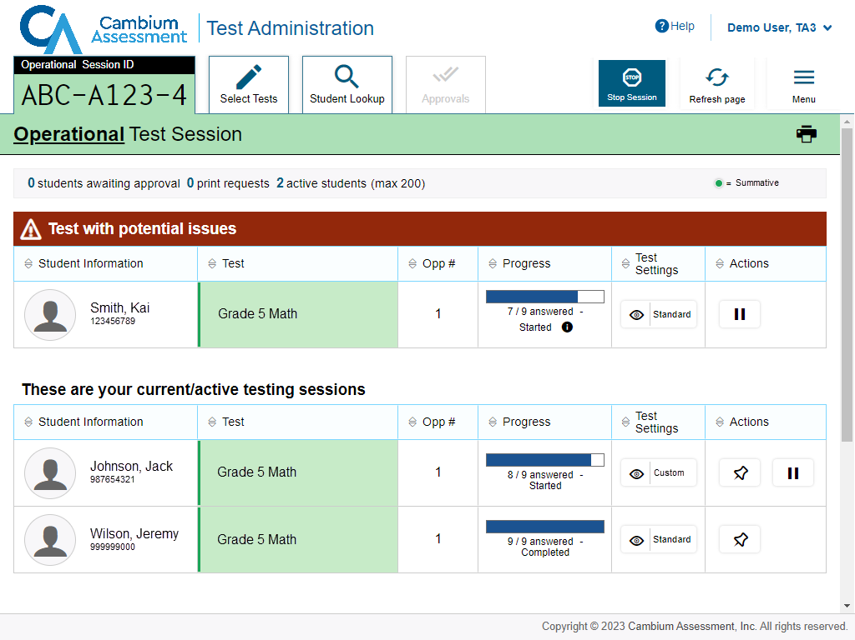
Pausing and Stopping Sessions
Stop all tests
Pause a test
Notes:
You have two options within the TA Interface to pause or stop testing once it has begun. You can pause an individual student’s test or stop the entire session, which will stop all students from testing.
To pause an individual student’s test, select the Pause button in the Actions column for that student. When prompted, select OK to confirm that you want to pause the test. This option would be appropriate if a student becomes ill, for example. In the event of an emergency that requires all students to stop testing, you can pause all students’ tests by stopping the session.
If you stop the session, all in-progress tests will be paused. If a session stops, it cannot be resumed. You will have to create a new test session and give the new session ID to students so that they can resume testing. To stop the entire test session for all students, do the following:
• Select the Stop Session button next to the session ID. A pop-up message will appear requesting verification to end the session and log students out.
• When prompted, select OK to continue.
If you forget to log out before leaving the testing area, the session will close automatically after 20 minutes of inactivity on both the TA and student computers. You would then need to create a new session and provide the new session ID to students in order to resume testing.

Slide 29
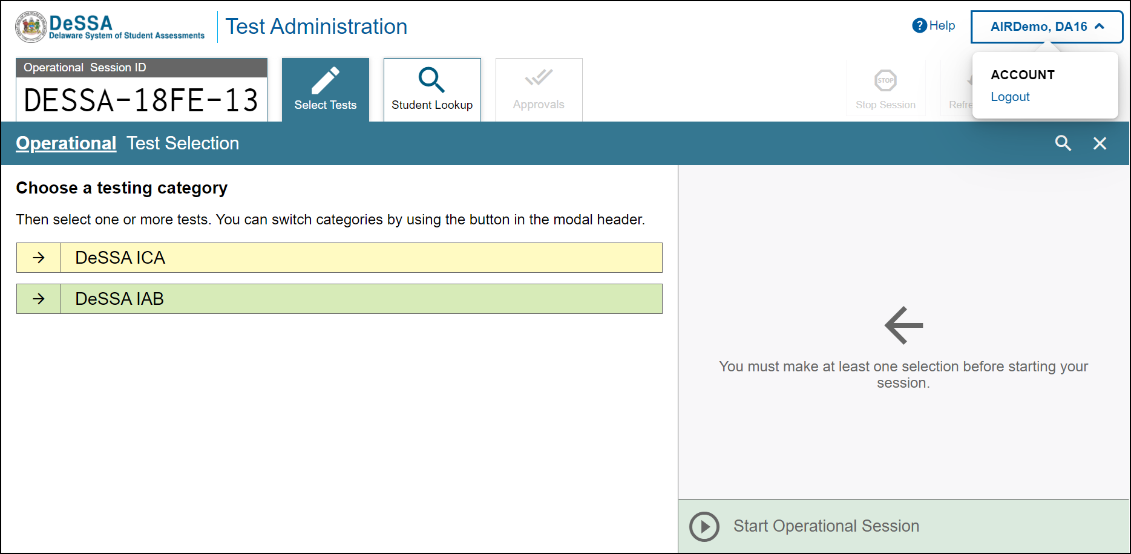
Logging Out of the TA Interface
Notes:
To log out of the TA Interface, select the Logout button in the upper-right corner of the page. It is preferable for you to log out only after stopping your active test session, as logging out will cause all in-progress tests to be paused. A confirmation message will appear, asking you to confirm that you want to exit the website and pause all students’ in-progress tests. This scenario also occurs when you navigate to another website from the TA Interface.
However, regardless of when or how you log out or navigate away from the TA Interface, student data will NOT be lost. If you need to access another application, we encourage you to open it in a separate browser window.
When all students have completed testing, refer to your Test Administration Manual for instructions on destroying any printed testing materials and reporting testing improprieties or irregularities.

Slide 30
Troubleshooting
Description | What to Do
What should I do if a test session ends? | Log in and start a new session. Provide the students with a new session ID.
What should I do if a student gets logged out of a test while a session is still active? | If a student’s test session is interrupted, the student should log back in and rejoin the session.
What should I do if forbidden applications are running? | The Secure Browser will not allow the student to begin testing if forbidden applications are running. You will see messages advising you which applications must be closed before testing can begin.
What should I do if a student’s test freezes? | Force-quit the Secure Browser and log back in. For instructions, refer to the Test Administration Manual.
Notes:
This table presents some of the common issues that you or your students may encounter during a test session. Please take a moment to review this information. For more detailed information please refer to your Test Administration Manual.

Slide 31
Thank You!
Further Information
https://de.portal.cambiumast.com/
DeSSA Help Desk:
E-mail Support: DeSSAHelpDesk@cambiumassessment.com
Support Toll-Free Number: 877.560.8331
Hours: 6:30 a.m. to 6:30 p.m. ET- Mondays–Fridays (except holidays)
DOE Contact:
Phone number: (302) 857-3391
https://helpdesk.doe.k12.de.us/
Notes:
Thank you for taking the time to view this training module. If you have general questions or need further information, please visit your DE portal or consult your help desk for assistance.

