Slide 1
Test Information Distribution Engine (TIDE)
Training Module
2023–2024
Copyright © Cambium Assessment, Inc. All rights reserved.
Notes:
Welcome to the online training module for the Test Information Distribution Engine, also known as TIDE. This training module includes many examples of TIDE’s features. The TIDE User Guide on the Delaware assessment portal: https://de.portal.cambiumast.com/ has additional information about features in TIDE.

Slide 2
Objectives
Preparing for Testing
Activating your new TIDE account and logging in to TIDE
Navigating the TIDE interface
Understanding account permissions
Managing user accounts
Managing student information and test settings
Managing test windows
Administering Tests
Managing appeals
Monitoring test progress
After Testing
Managing Family Portal access codes
Notes:
This presentation will address numerous topics in TIDE, including tasks that typically take place while preparing for testing, during test administration, and after testing has concluded.
At its core, TIDE is a registration system for users who will access CAI systems and students who will take CAI tests. Users of all CAI systems must be added to TIDE before they can access any CAI system. Students must be added to TIDE before they can test in TDS. Classes must be added in TIDE so Reporting can display scores at the classroom, school, district, and state level. During testing, TIDE users can print test tickets, manage invalidation requests, and monitor test progress.

Slide 3
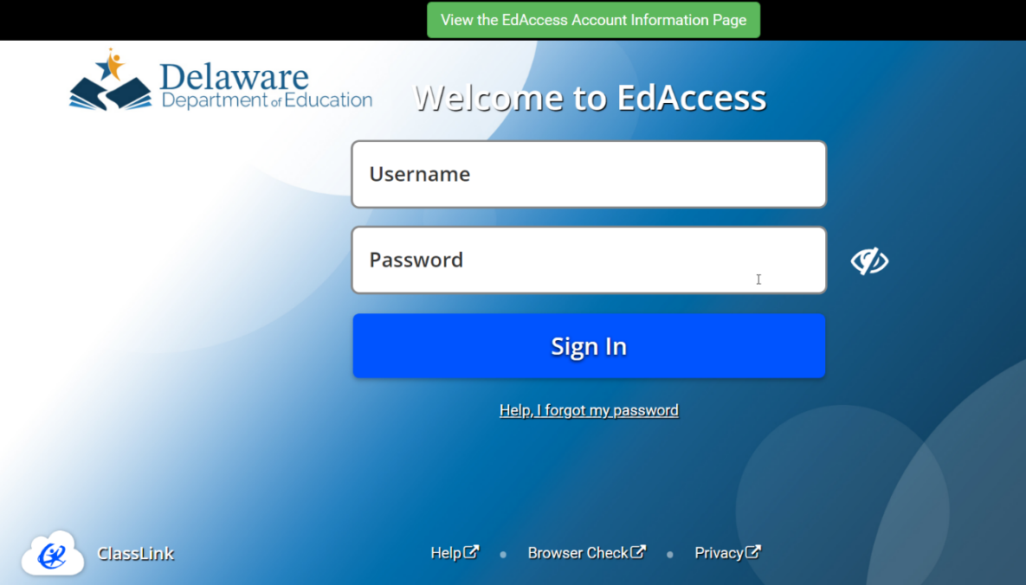
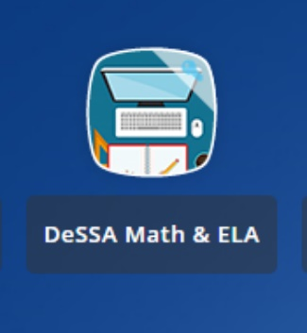
Accessing your TIDE Account
TIDE is accessed through the Delaware Department of Education’s (DDOE’s) EdAccess or LEA Classlink application.
1. Access the DDOE EdAccess or LEA Classlink Single Sign-On (SSO) login page launchpad.classlink.com/ddoe. Use your regular EdAccess ID and password to log in.
2. After you have successfully logged in, you will see a list of authorized applications, including DeSSA Math & ELA.
Click the [DeSSA Math & ELA] button from your menu. You will be directed to the DeSSA portal.
Notes:
TIDE is accessed through the Delaware Department of Education’s (DDOE’s) EdAccess application or LEA Classlink Single Sign-On login page.
Access the DDOE EdAccess or LEA Classlink Single Sign-On login page login page at launchpad.classlink.com/ddoe. Use your regular EdAccess or LEA Classlink ID and password to log in.
After you have successfully logged in, you will see a list of authorized applications, including DeSSA Math & ELA.
Click the [DeSSA Math & ELA] button from your menu. You will be directed to the DeSSA portal.

Slide 4
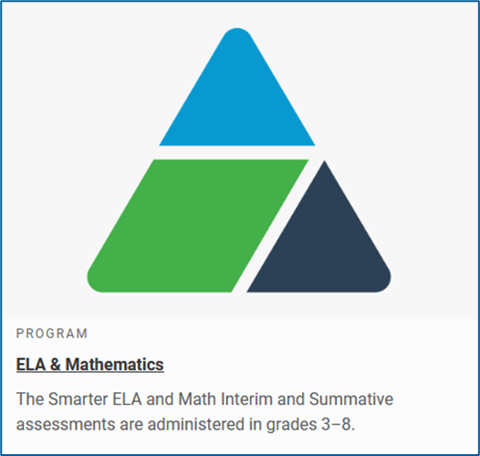
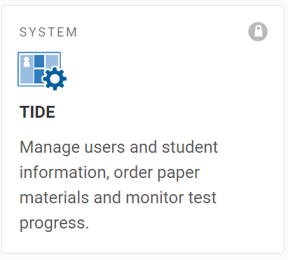
Accessing your TIDE Account, continued
3. Click the [ELA & Mathematics] portal card or ELA and Mathematics topic in the top navigation to access DeSSA applications.
4. Click the [TIDE] button. If you are authorized to access this application, you will be automatically directed to the TIDE home page. You will not have to log in again.
Notes:
Access the DDOE EdAccess or LEA Classlink login page at launchpad.classlink.com/ddoe. Use your regular EdAccess or LEA Classlink ID and password to log in.
After you have successfully logged, you will see a list of authorized applications, including DeSSA Math & ELA.
Click the [DeSSA Math & ELA] button from your menu. You will be directed to the DeSSA portal.
Click the [ELA & Mathematics] user card to access DeSSA applications.
Click the [TIDE] button. If you are authorized to access this application, you will be automatically directed to the TIDE home page. You will not have to log in again.
The Dashboard for your user role appears. Depending on your user role, TIDE may prompt you to select a role, client, state, district, or school to complete the login.

Slide 5
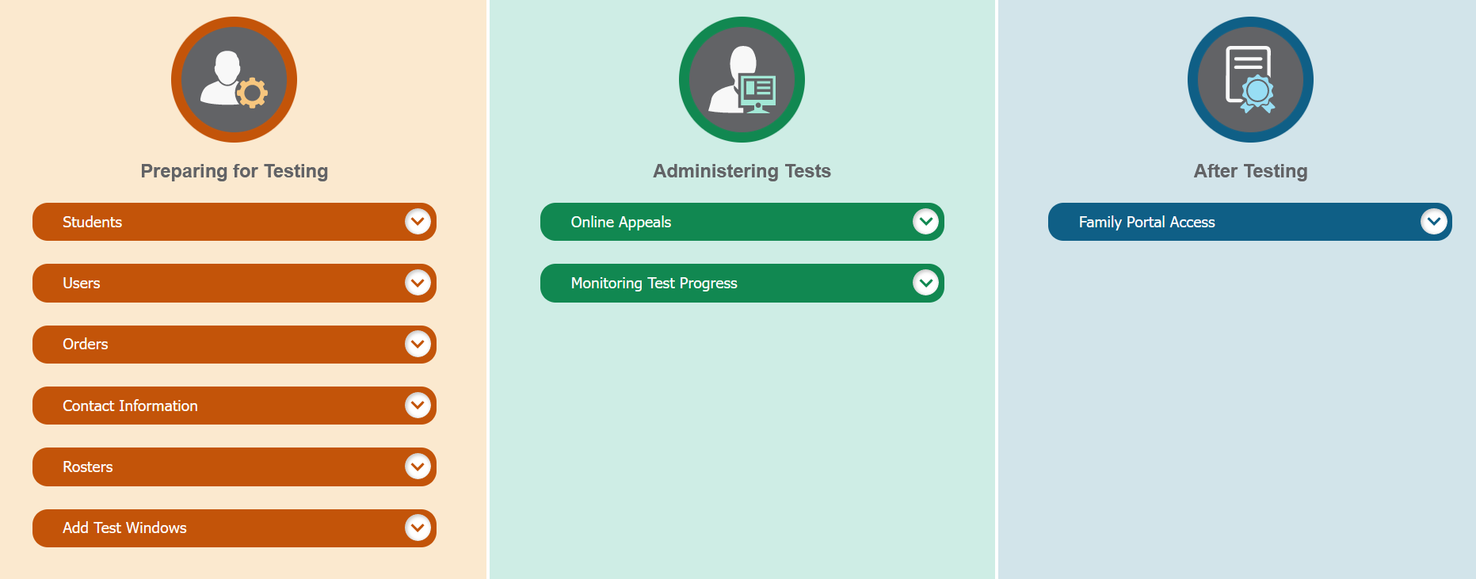
TIDE Home Page
Notes:
The TIDE home page appears after you log in. The home page is designed to reflect the stages of the testing process as directly and simply as possible. Each TIDE’s section lists menus for the tasks available in that section. For example, the Users menu contains options for adding users; viewing, editing, or exporting users; and uploading users. To expand a task menu and view its set of related tasks, click the down arrow on the end of that menu. To perform a task, click the name of that task listed in the menu.

Slide 6
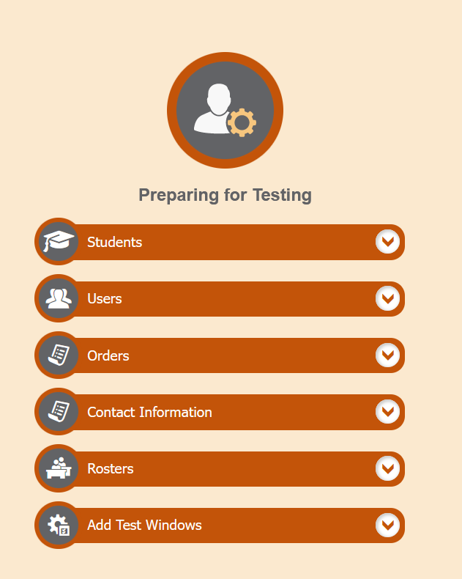
TIDE Tasks: Preparing for Testing
Notes:
Tasks in the Preparing for Testing section are typically performed before testing begins. This category also includes tasks for placing orders for paper testing materials and for setting up test windows.
TIDE can group students into rosters. A roster is a collection of students sharing a similar characteristic who are assigned to a specific teacher. Rosters typically represent classrooms, but they can also be used to group students with special needs or students participating in particular activities or programs. Once scores are calculated, users can visualize how a roster of students performed as a group.

Slide 7
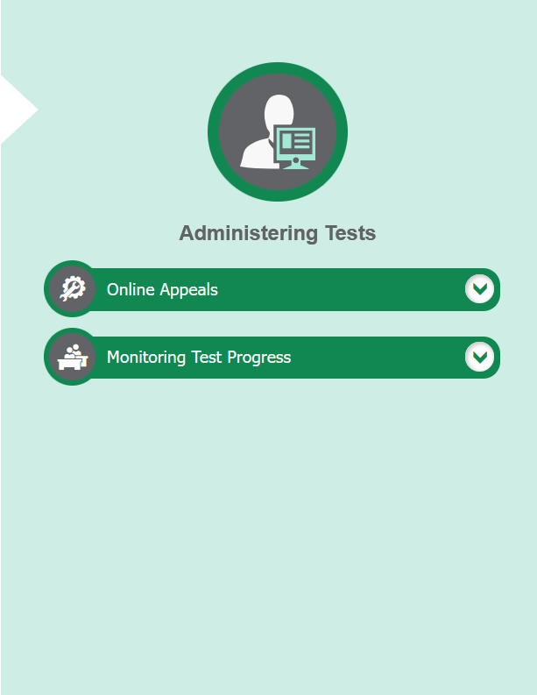
TIDE Tasks: Administering Tests
Notes:
Tasks in the Administering Tests section are typically performed during the test window.
Test administrators may use TIDE to invalidate a test, reset a test, or reopen a test. These tasks are limited to the district and school test coordinators.
In this section, you may also monitor test progress ang generate participation reports. .

Slide 8
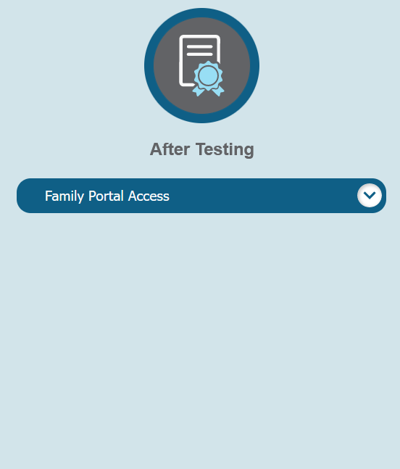
TIDE Tasks: After Testing
Notes:
In the After Testing section, users with the DA and SA role will be able manage the Family Portal access codes.

Slide 9
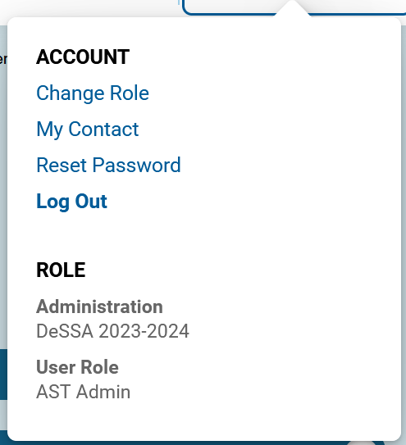
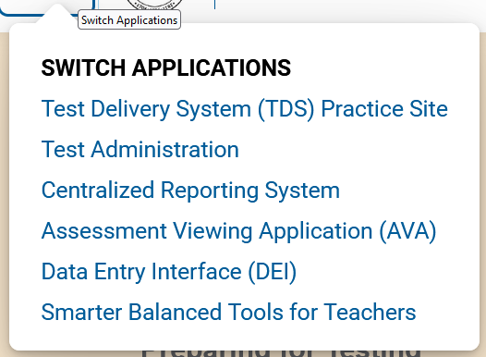
TIDE Banner
Notes:
A banner appears at the top of each TIDE page showing the current test administration and your current user role. On the left, there is a drop-down list for accessing other Cambium Assessment applications. You will also find a General Resources drop-down list, a Help button that displays the TIDE User Guide, the Secure File Center button, a Manage Account drop-down list where you may set up your account details, and a Log Out button.
The district and school information is also displayed along with the user role and test administration.

Slide 10
TIDE Banner: General Resources
Notes:
To download Hand-Scoring resources needed for the Smarter Balanced interims, click the General Resources drop-down list in the banner.
Please note than Hand-Scoring resources are only available for the ELA and math interim assessments.

Slide 11
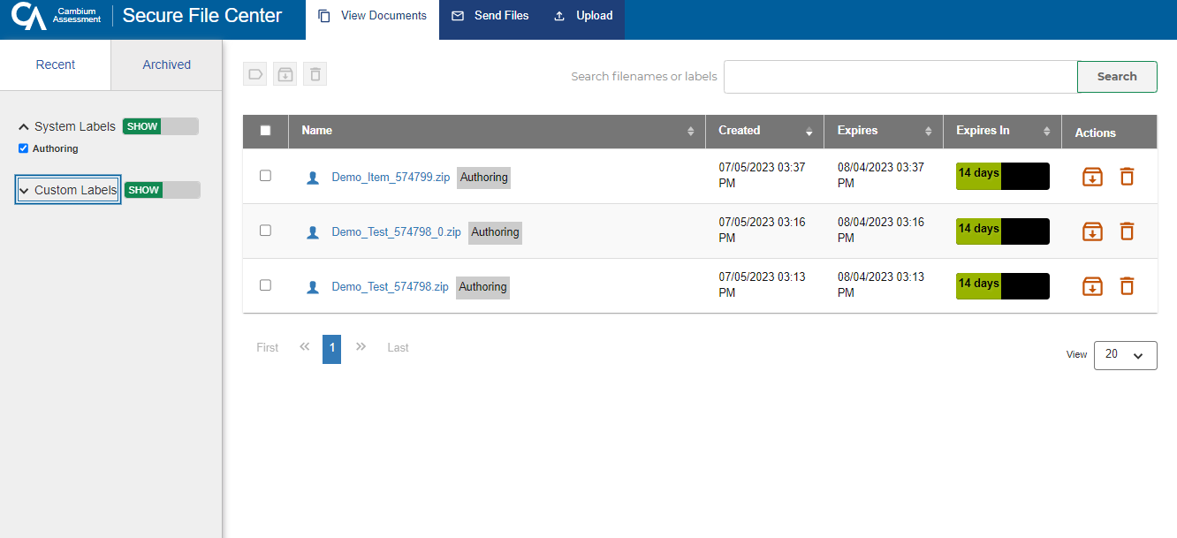
Secure File Center: View Documents
Notes:
To access secure documents and files you have previously exported in TIDE and other Cambium Assessment systems, click the Secure File Center button in the banner. Note that files are displayed in the order that they are generated, uploaded, or archived. The Secure File Center displays the name of the file, creation and expiration dates, days until expiration, and an actions column. To show system and custom labels, click Show on the corresponding toggle bar and mark checkboxes for the label(s) you wish to display. To hide labels, click Hide on the appropriate toggle bar.
By default, exported files are available for 30 days.
For more information on the Secure File Center and its features, refer to the TIDE User Guide.

Slide 12
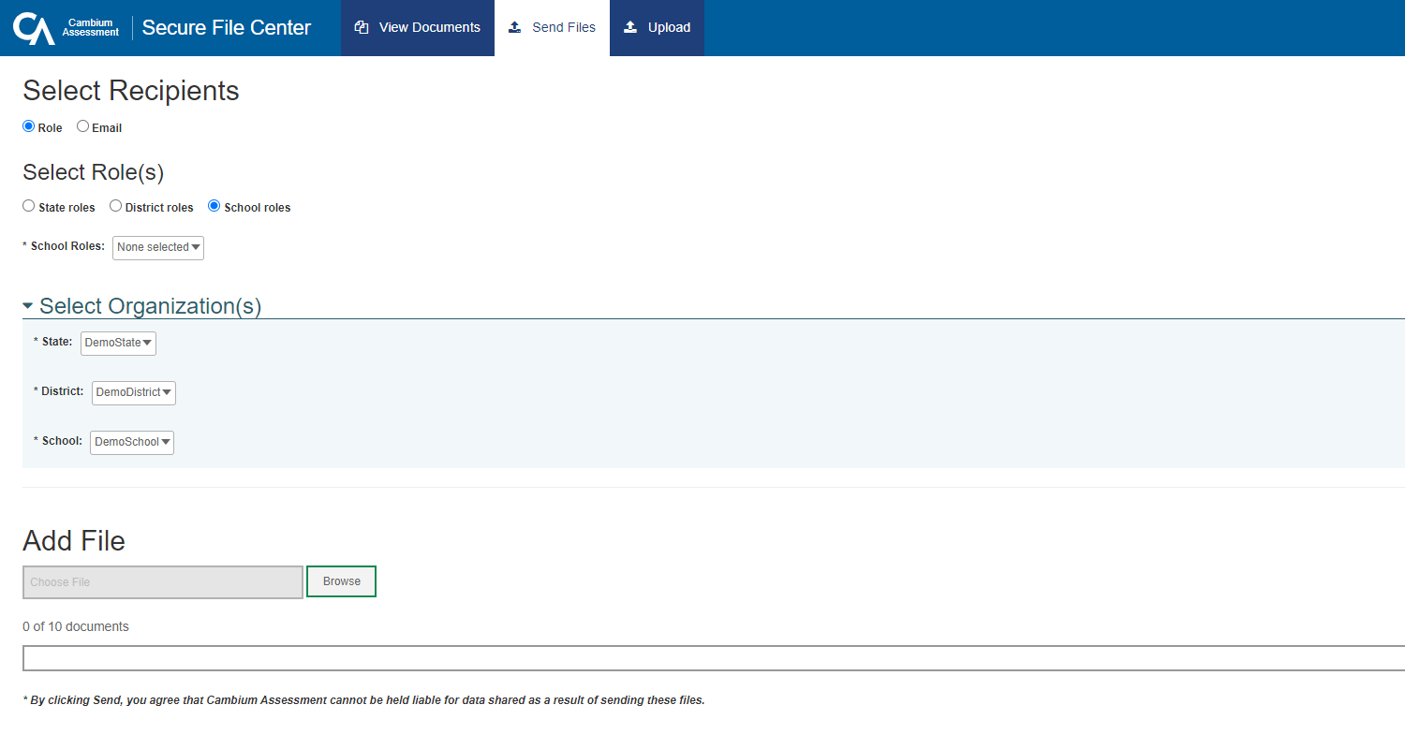
Secure File Center: Sending Files
Notes:
You can send a file or files from TIDE to individual recipients by email address or to groups of recipients by user role.
To send files, click the Secure File Center button from the TIDE banner. Next, click the Send Files tab at the top of the window.
To send files by role, select the role group to which you want to send a file or files. A drop-down list appears.
Next, select the role or roles to which you want to send a file or files. You can choose Select all to send a file or files to all roles in the selected role group.
From the Select Organization(s) drop-down lists, select organizations that will receive the file or files you will send.
To send files by email, enter the email address of the recipient to whom you wish to send a file or files.
After selecting recipients, click Browse under the Add File field to select a file or files to send. A file browser appears.
From the file browser, select up to 10 files to send.
Click Send.

Slide 13
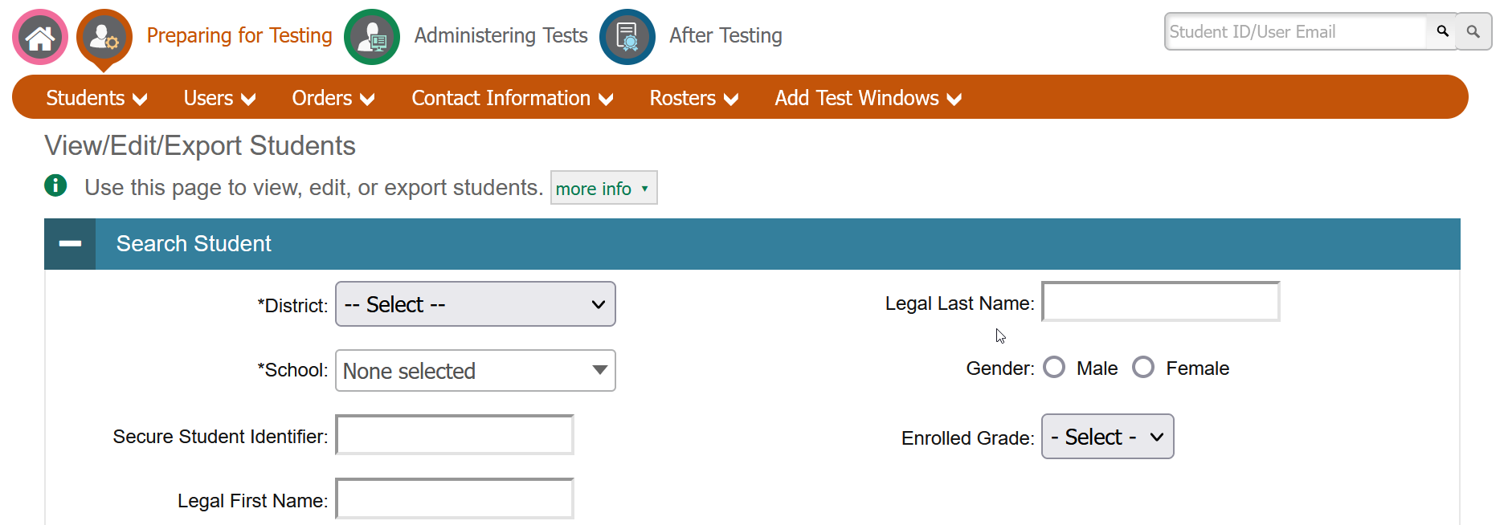
Navigation Toolbars
Notes:
When you enter any task page, a navigation toolbar appears at the top of the page. This toolbar allows you to access each task and action that was available on the dashboard. To view the task menus for a particular TIDE category, click the icon for that category above the toolbar.
Some pages in TIDE are divided into multiple panels. Each panel contains a group of related settings and fields that you can edit. You can click the minus sign in the upper-left corner of a panel to collapse it or click the plus sign in a collapsed panel to expand it. Additionally, a floating Go to section toolbar appears on the left side of each page with multiple panels. This toolbar includes a numbered button for each panel in the form. You can hover over a button to display the label of the associated panel and click the button to jump to that panel.

Slide 14
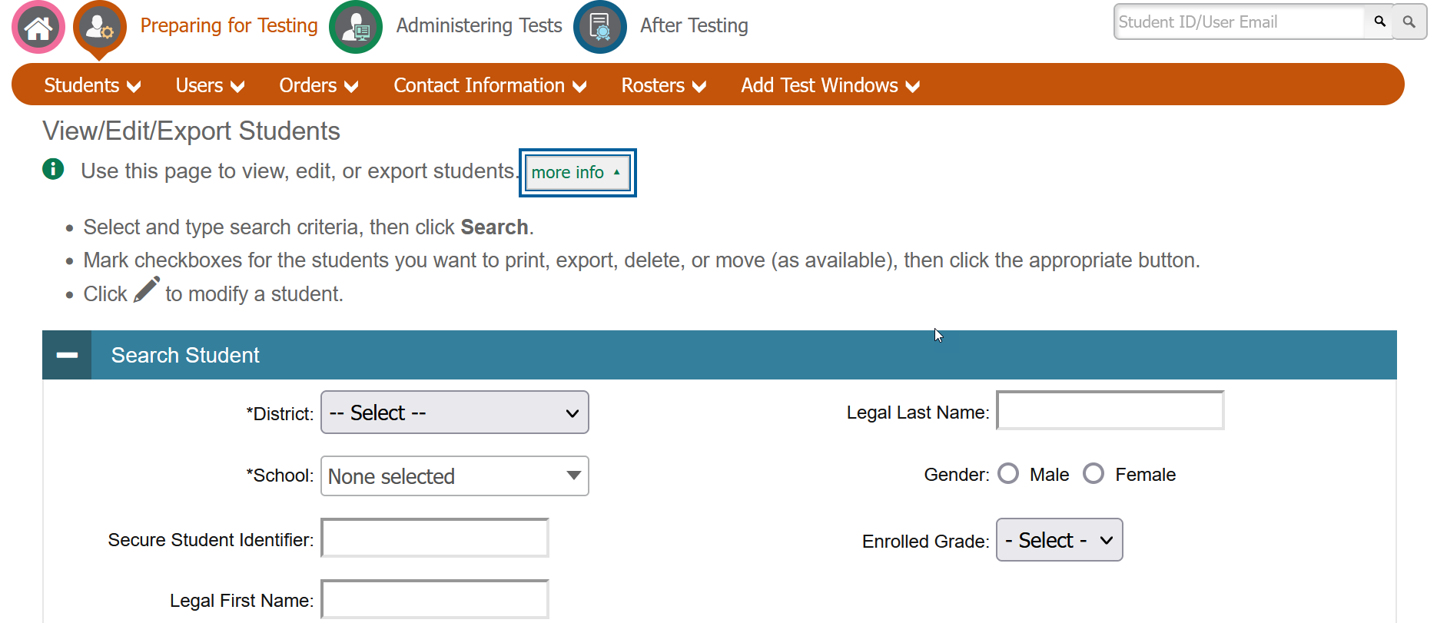
Help Text
Notes:
Most pages in TIDE have help text that describes the page and how to use it. To show or hide help text on a page, click the gray more info link under the page title.
To read more-detailed information about the page that you are currently viewing, click the Help button in the banner.

Slide 15
Quick Search
Notes:
To quickly search for a user or student to view or edit, enter the user’s email address or student’s SSID in the search box. Then, click the magnifying glass to the right of the search box.
If you are searching for a user to view or edit, the View/Edit User form will appear. If you are searching for a student to view or edit, the View/Edit Student form will appear.
When you are finished viewing/editing a student or user, click the Save button.

Slide 16
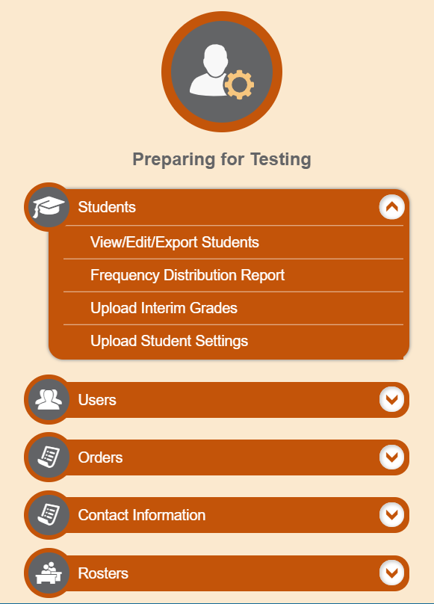
Students
Notes:
TIDE also manages student information and keeps track of which assessments students are eligible to take. The Students task menu allows you to view, edit, or export student; upload interim grades; and generate frequency distribution reports, and upload student settings. We have shown you how to perform most of the tasks in the Students Task Menu. As you plan for testing it is helpful to use the Frequency Distribution Report to double check student information and test settings.
NOTE: The TIDE tasks available vary by user role with State and District level roles with access to the most features.

Slide 17
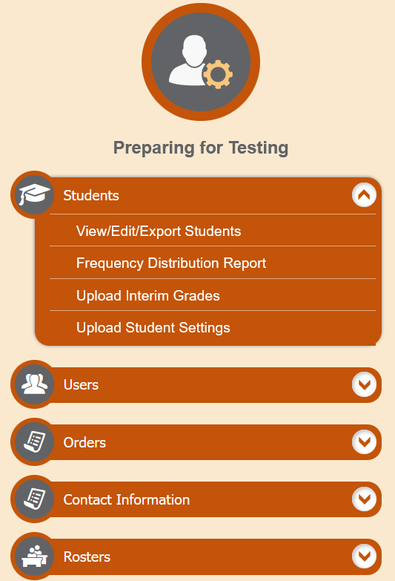
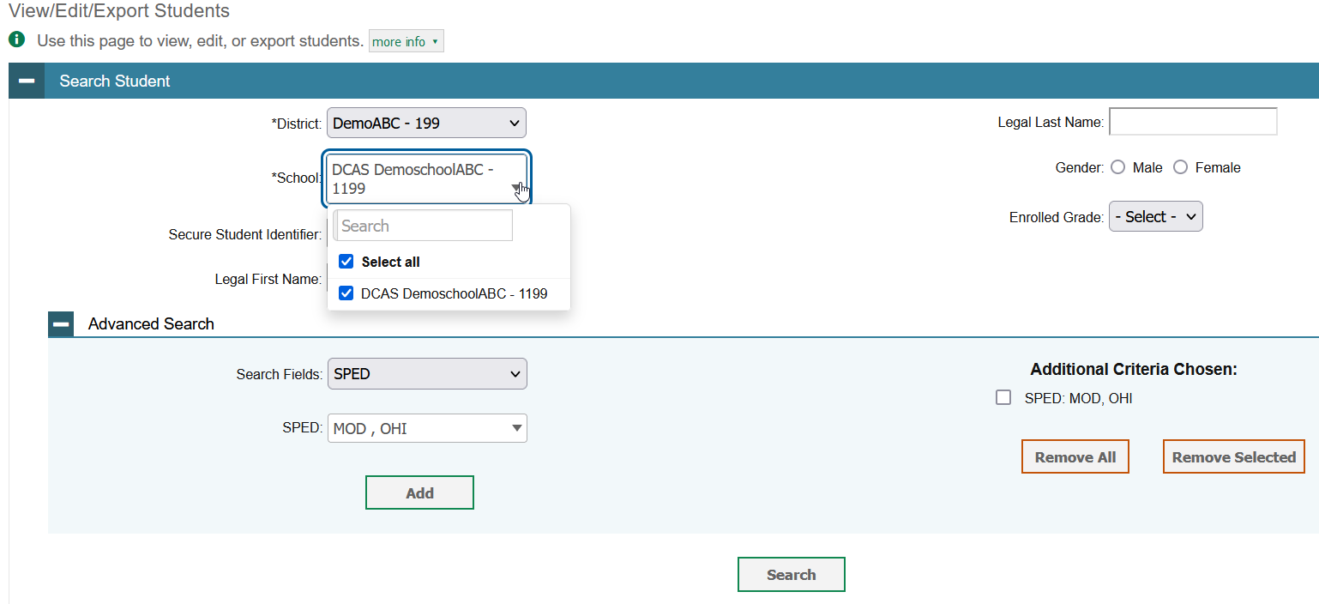
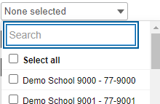
Modify Students One at a Time
Notes:
The View/Edit/Export Students page includes a form for setting selection criteria to retrieve students. Required criteria, such as the district and school in this example, are marked with asterisks. In the School drop-down list, users can begin typing in the Search field to filter results. You can enter part of or your complete school name or school ID in the search field.
Other criteria are optional, such as the secure student identifier and the student’s first or last name.
You can further refine your criteria by entering additional demographic information or test settings in the Additional Search panel.
The students you can retrieve on this page are limited by your role’s scope. For example, if you are a district-level user, you can retrieve only students enrolled within your district. If you are a school-level user, you can only retrieve students enrolled within your school.
Click Search to continue.

Slide 18
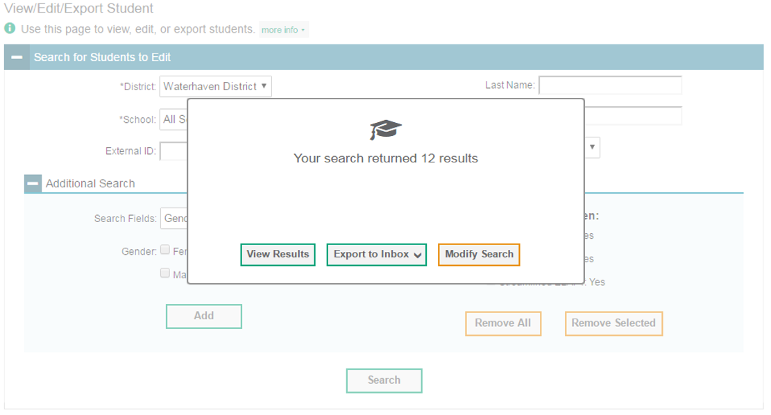
Modify Students One at a Time, continued
Notes:
After you click Search, you will see a message asking whether you would like to view the results of your search, export the list of students to your Inbox, or modify your search criteria and try again. If you choose to export the results to your Inbox, you will receive an email when the file is ready for you to download.

Slide 19
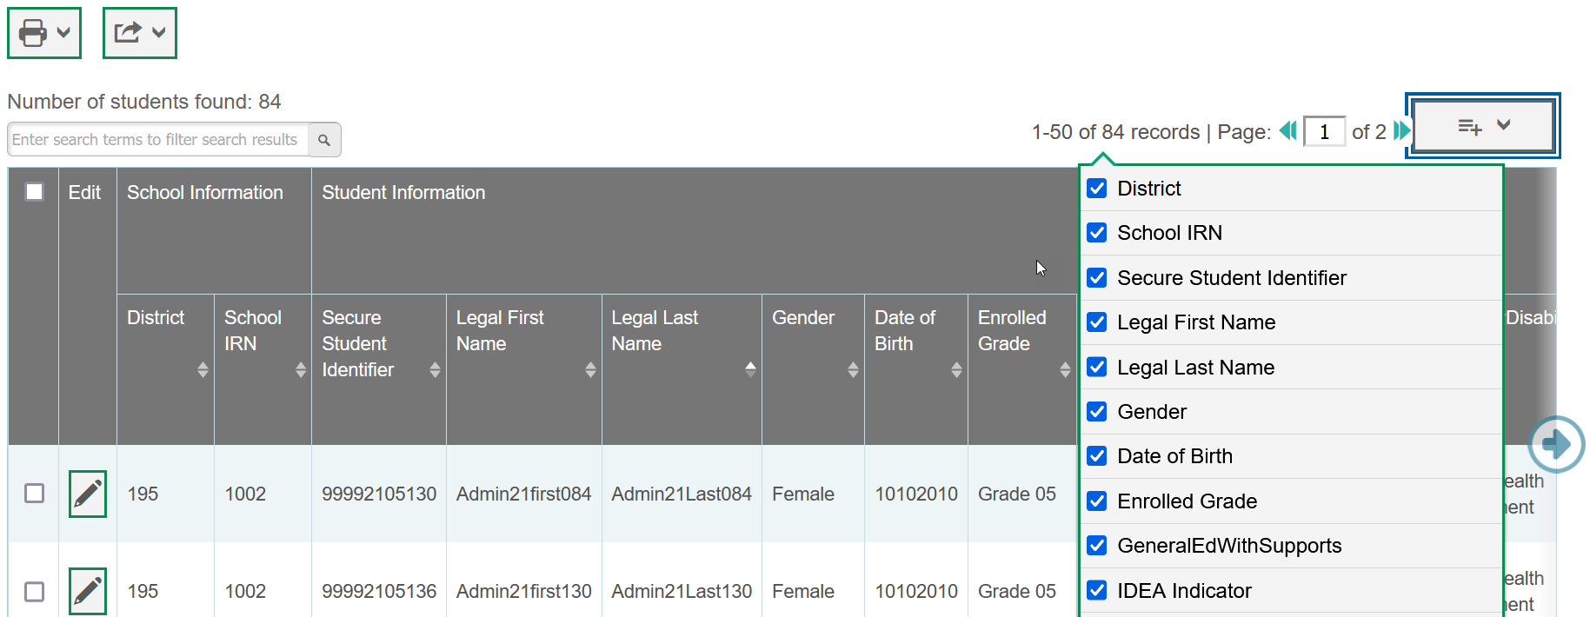
Modify Students One at a Time, continued
Notes:
When you click View Results, TIDE will display all the students satisfying the search criteria. Because not all columns can fit on the screen at once, click the blue arrow on the right side of the screen to scroll right and display more information. To add or delete columns to display, click the drop-down menu at the upper-right corner of the results. You can edit a student’s information, including test settings and accommodations and student test participation data, by clicking the green pencil icon.
Print students from TIDE by selecting the desired students and clicking the Print button above the search results.
To export the results, mark the checkboxes next to the results you wish to export and click the green export button above the search results. A pop-up window will appear with the option to export to the Inbox in either Excel or CSV format.
To make the search form reappear and search for additional students, click the plus sign in the Search Students panel, which appears as a blue bar.
For more-detailed information on managing students, see your TIDE User Guide.

Slide 20
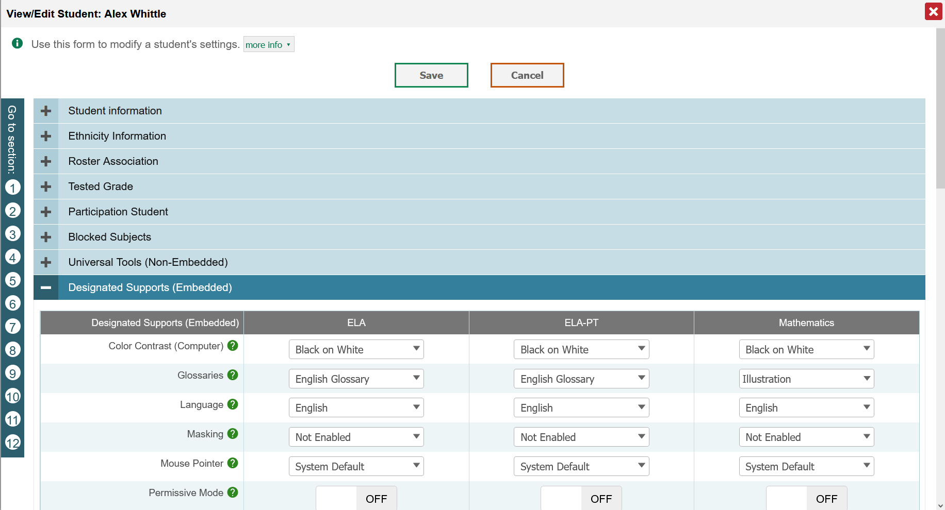
Modify Students One at a Time, continued
Notes:
When you click on the green pencil icon for the student whose account you want to view in the list of retrieve students. The Edit Student form appears.
In the Student Information and Ethnicity Information panels, you can view student information, but you cannot edit this information in TIDE. Student demographic can only be updated in eSchoolplus.
Only DA’s and DAM have access to edit student test setting.
From the Tested Grade panel, you can view and edit the student’s Interim Testing Grade.
From the Participation Student panel, view the student’s test participation report, if available.
In the Blocked Subjects panel, mark or clear checkboxes as required to modify the student’s eligible tests.
In the available test settings and tools panels, modify the student’s test settings. The test settings are grouped into categories, such as Universal Tools (Non-Embedded), Designated Supports (Embedded), Designated Supports (Non-Embedded), Accommodations (Embedded), Accommodations (Non-Embedded), and Special Request. The panels display a column for each of the student’s tests. You can select different settings for each test, if necessary, by toggling on or off or selecting options from the drop- down menu.
Click Save.
In the affirmation dialog box, click Continue to return to the list of student records.
In the dialog box, click Continue to return to the list of student records.
For more-detailed information on managing students, see your TIDE User Guide.
NOTE: Student demographic information can only be edited in eSchool. The student demographic information in TIDE will mirror the student demographic information in eSchool.

Slide 21
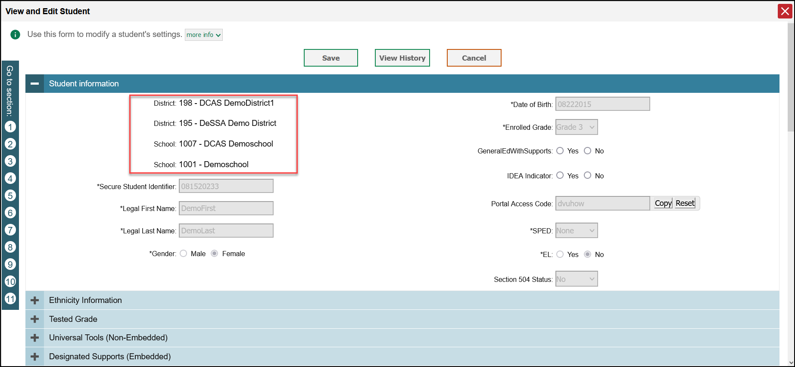
Dual Enrolled Students
Notes:
When students, such as those attending a Service School, are enrolled in eSchool under more than one institution, both associations will appear in TIDE under Student Information. Both institutions will have access to the student information and data within the Cambium Assessment systems. More information about Dual Enrolled students can be found in the TIDE User Guide on the DeSSA portal.

Slide 22
Frequency Distribution Reports
Notes:
A frequency distribution report pulls demographic and enrollment information based on the selected criteria.
To generate a report from the Frequency Distribution Report page, select a district and school from the drop-down lists (if available). Mark checkboxes in the Select Demographics panel to filter the report for additional demographics and accommodations, as desired.
Click Generate Report to display a frequency distribution report using the selected criteria.

Slide 23
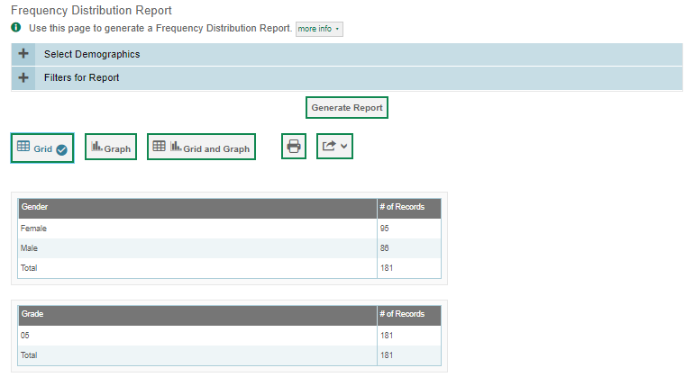
Frequency Distribution Reports, continued
Notes:
TIDE will display the frequency distribution report in grid format. This example shows a report by gender and grade.
To display the report in tabular format, click Grid.
To display the report in graphical format, click Graph.
To display the report in both tabular and graphical format, click Grid and Graph.
To download the report as a PDF file, click the print icon and then save the file to your computer. To export the report in Excel format, click the export button located next to the print button, and choose “Export to Excel” from the drop-down menu.

Slide 24
Upload Student Settings
Notes:
TIDE keeps track of student test settings, such as font size and text-to-speech. The Upload Student Settings upload test settings and tools.

Slide 25
Upload Student Settings
Notes:
A second way to edit test settings and tools in TIDE is to use the Upload Test Settings page to compose an upload file in Excel or CSV format and then upload that file.
An upload screen will appear where you can download a template file. Once you have downloaded and filled out the template file, return to the upload screen, select Browse, and upload your file to TIDE. Then select Next.

Slide 26
Upload Student Settings, continued
Notes:
When you select Next, the upload preview screen will appear. Verify that the information is correct, then select Next.

Slide 27
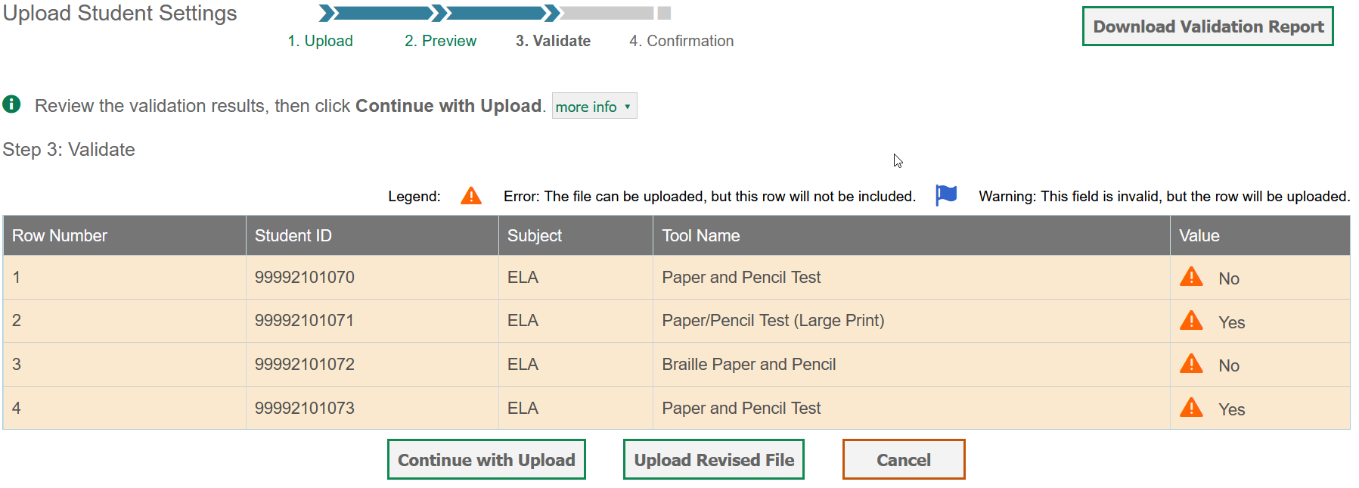
Upload Student Settings, continued
Notes:
TIDE will validate the file and display any errors or warnings according to the legend on the page. Click the orange error icons and blue warning icons in the validation results to view the reason that a field is invalid. If a record contains an error, that record will not be included in the upload. If a record contains a warning, that record will be uploaded, but the field with the warning will be invalid.
To complete the upload, click Continue with Upload.
To upload a different file, click Upload Revised File.
To cancel the upload, click Cancel.
If your file contains a large number of records, TIDE will process it offline and send you a confirmation email when complete. While TIDE is validating the file, do not click Cancel, as TIDE may have already started processing some of the records.
To view a PDF file listing the validation results for the upload file, click Download Validation Report in the upper-right corner.
When the upload is complete, a confirmation page will appear with a message that summarizes how many records were uploaded and how many were excluded.

Slide 28
Upload Student Settings, continued
4
Notes:
When the upload is complete, a Confirmation page will appear with a message that summarizes how many records were uploaded and how many were excluded. Click Upload New Files to upload additional files.
You may use the upload records process with other tasks too such as uploading interim grades .

Slide 29
Rosters
Notes:
The Rosters task menu allows you to add rosters; view, edit, or export rosters; and upload rosters from external files.
Once test scores are calculated, roster information is used to generate reports of how students in the roster performed as a group.

Slide 30
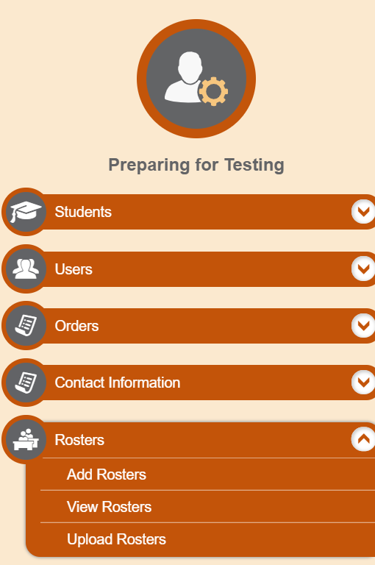
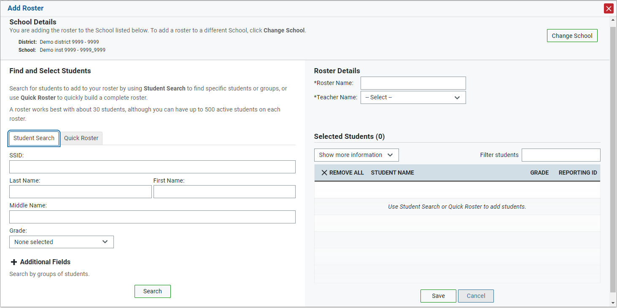
Add Rosters One at a Time
Notes:
The Add Roster page contains two panels, a Find and Select Students panel and a Roster Details panel.
To search for students, complete the student search fields in the Find and Select Students panel. The fields marked with an asterisk are mandatory. You can further refine your search by selecting criteria under the Additional Fields section.
Refine the list of available students by completing the fields in the Add Students to the Roster panel. Then, click Search.

Slide 31
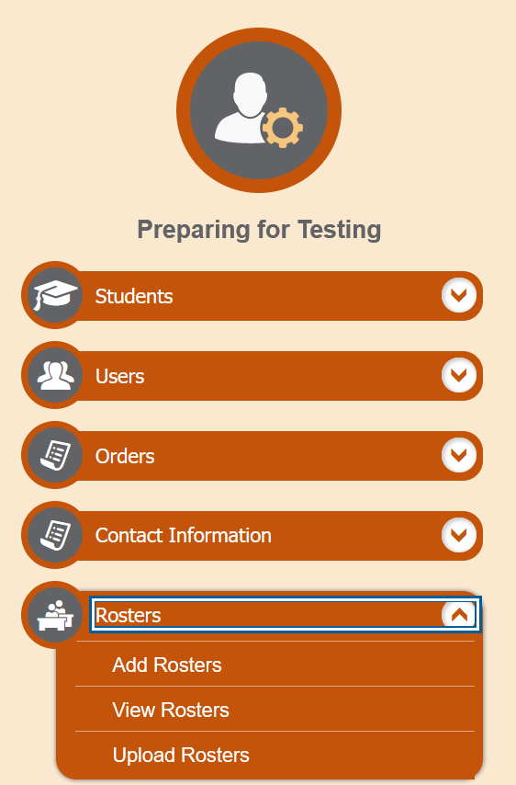
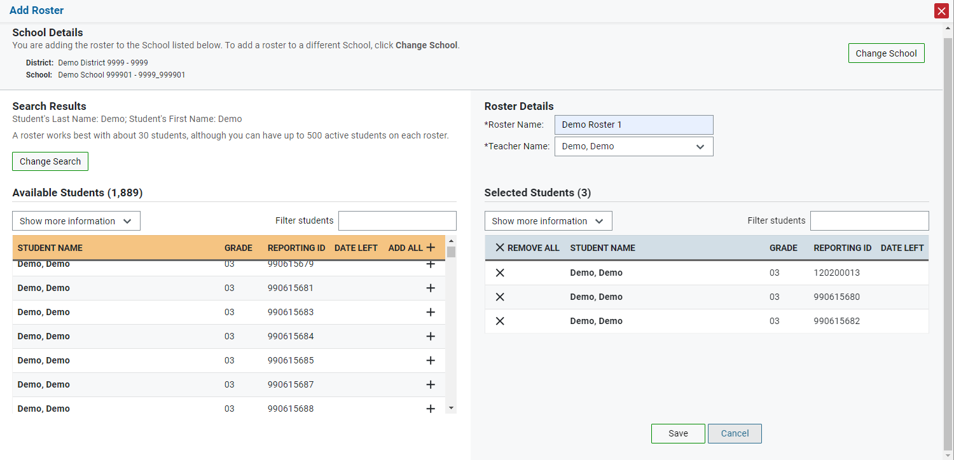
Add Rosters One at a Time, continued
Notes:
The students listed in the Search Results panel are available to be added to the roster.
First, in the Roster Details panel, enter a name for the roster and select the teacher who should be associated with the roster.
Next, add students to the new roster. To add a single student to the roster, click the plus sign next to a student in the left column. You can add all available students to the roster by clicking Add All.
Students will display under Selected Students as they are added to the roster.
To remove a single student from the roster, click the X next to a student in the right column. Remove all students from the roster by clicking Remove All. click Save to save the roster.

Slide 32
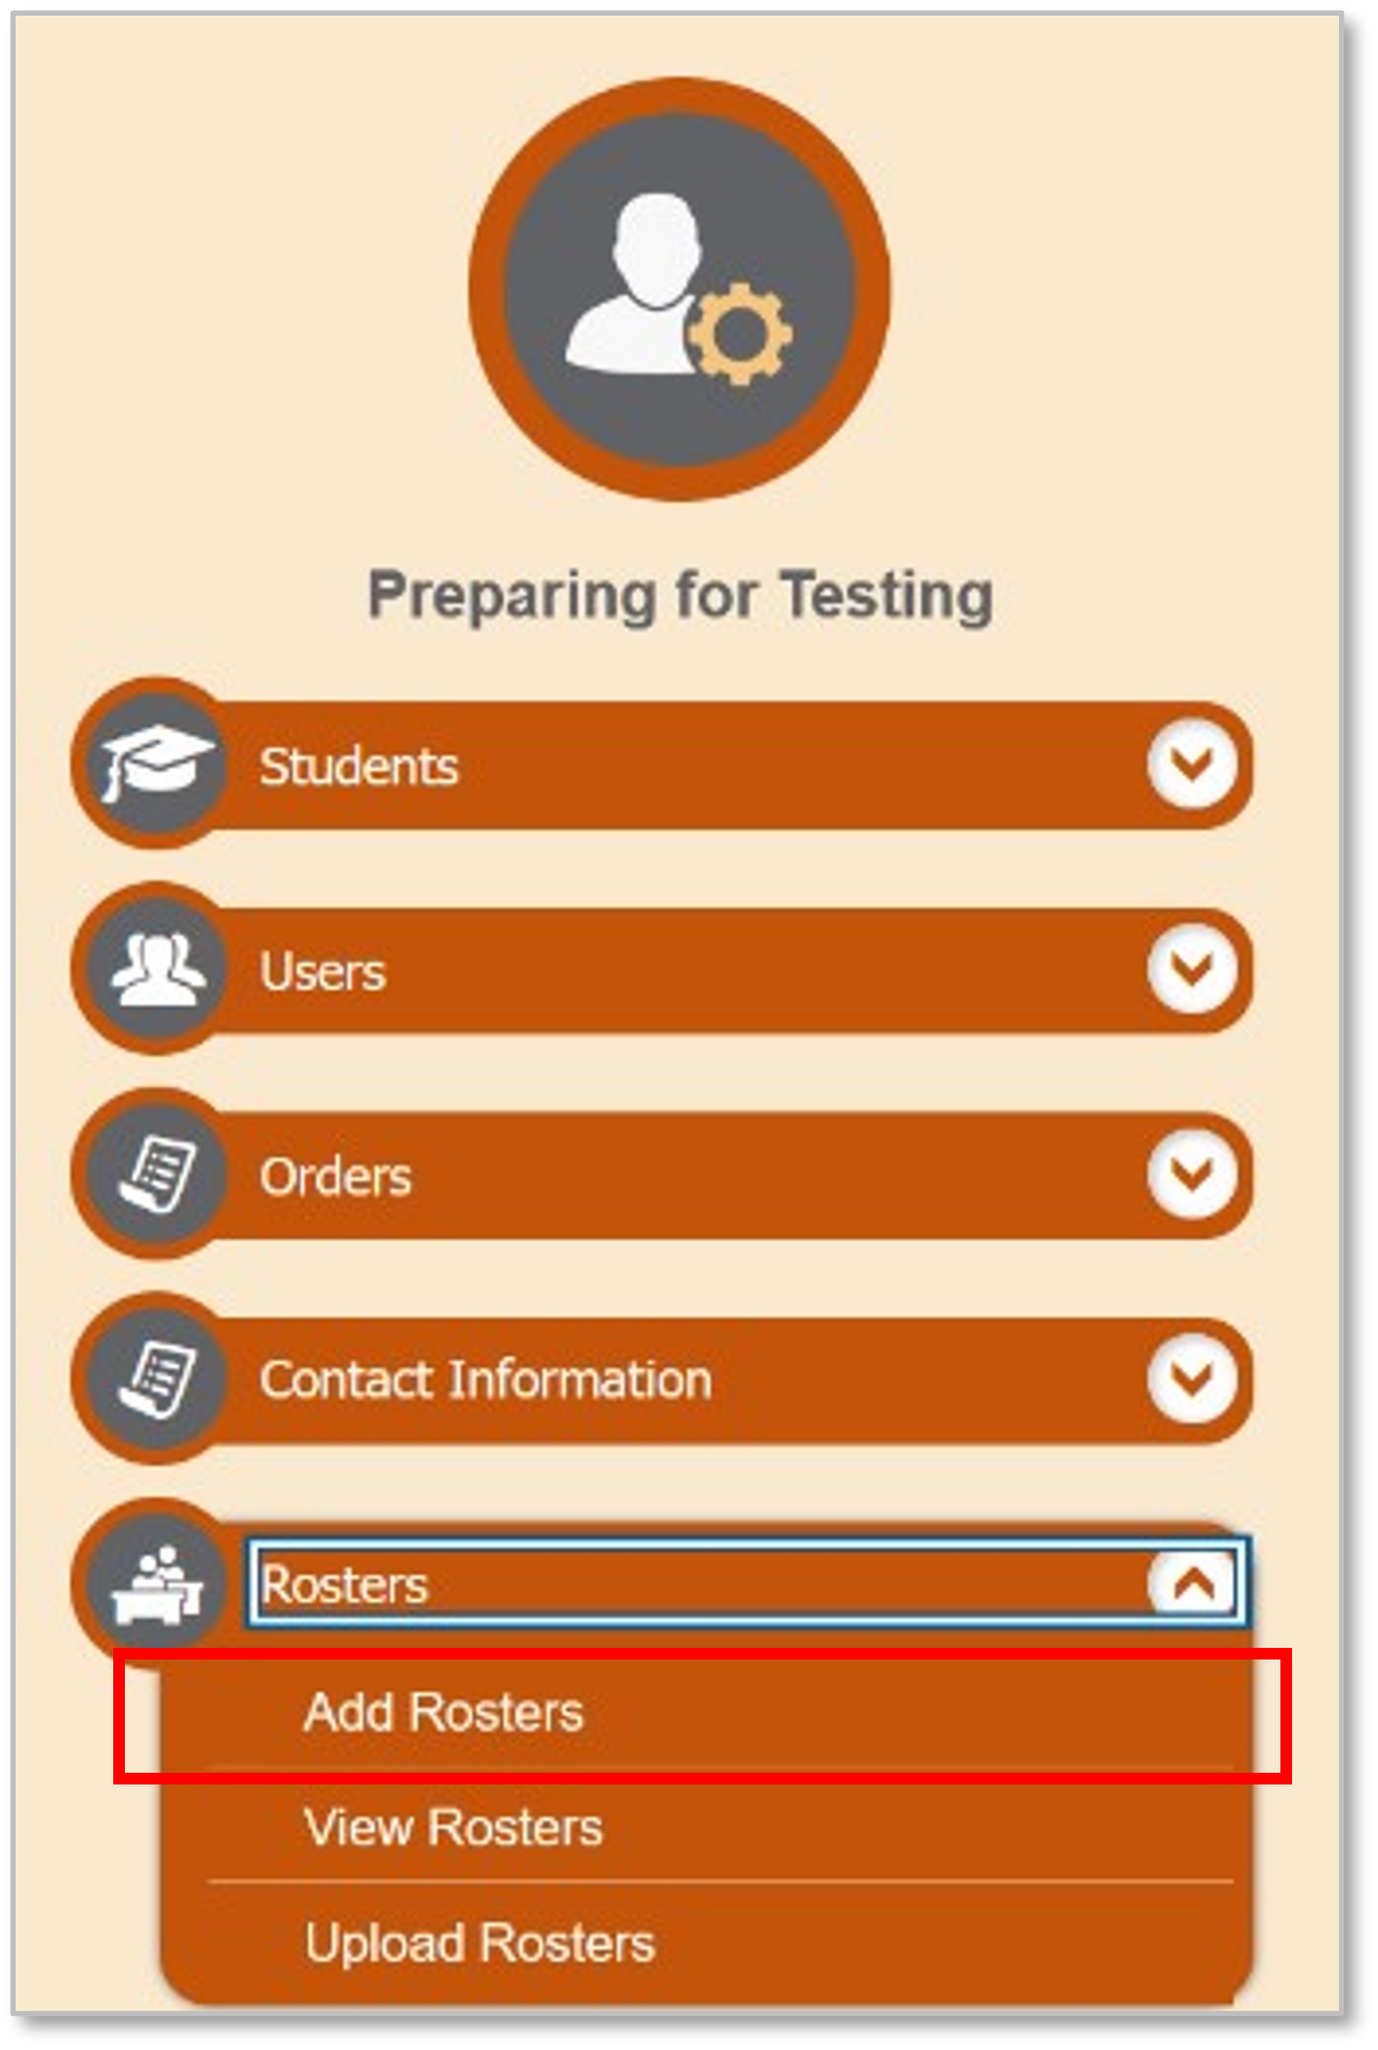
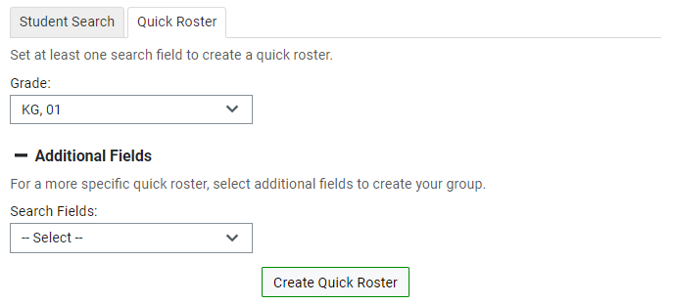
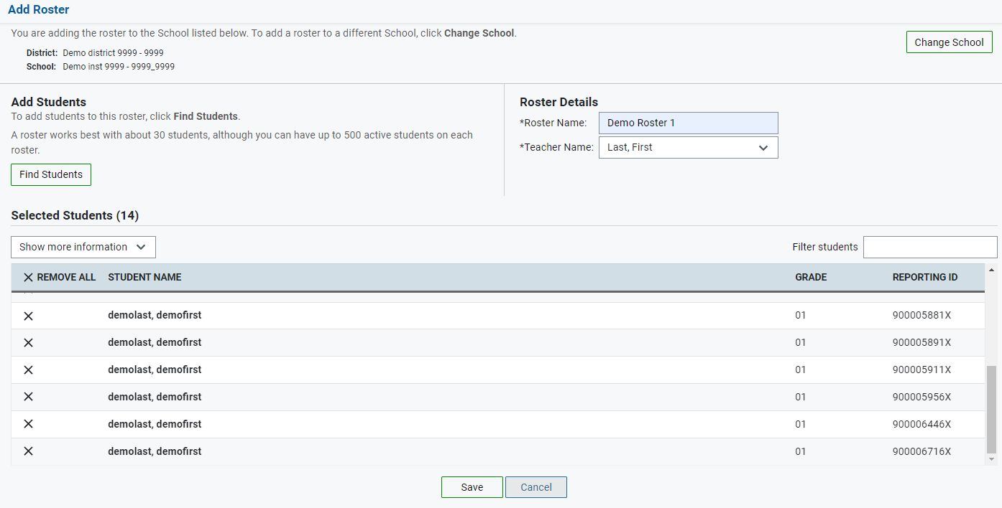
Add Rosters One at a Time, continued
Notes:
The Quick Roster tab can be utilized to create a complete roster from a group of students. To search for students, complete the fields in the Quick Roster panel. You can further refine your search by selecting criteria under the Additional Fields section. click Create Quick Roster.
All students who meet the criteria in your search are automatically added to the roster. You can manually remove students by clicking the X next to individual students or click Remove All from the top of the grid. click Save to create your roster.

Slide 33
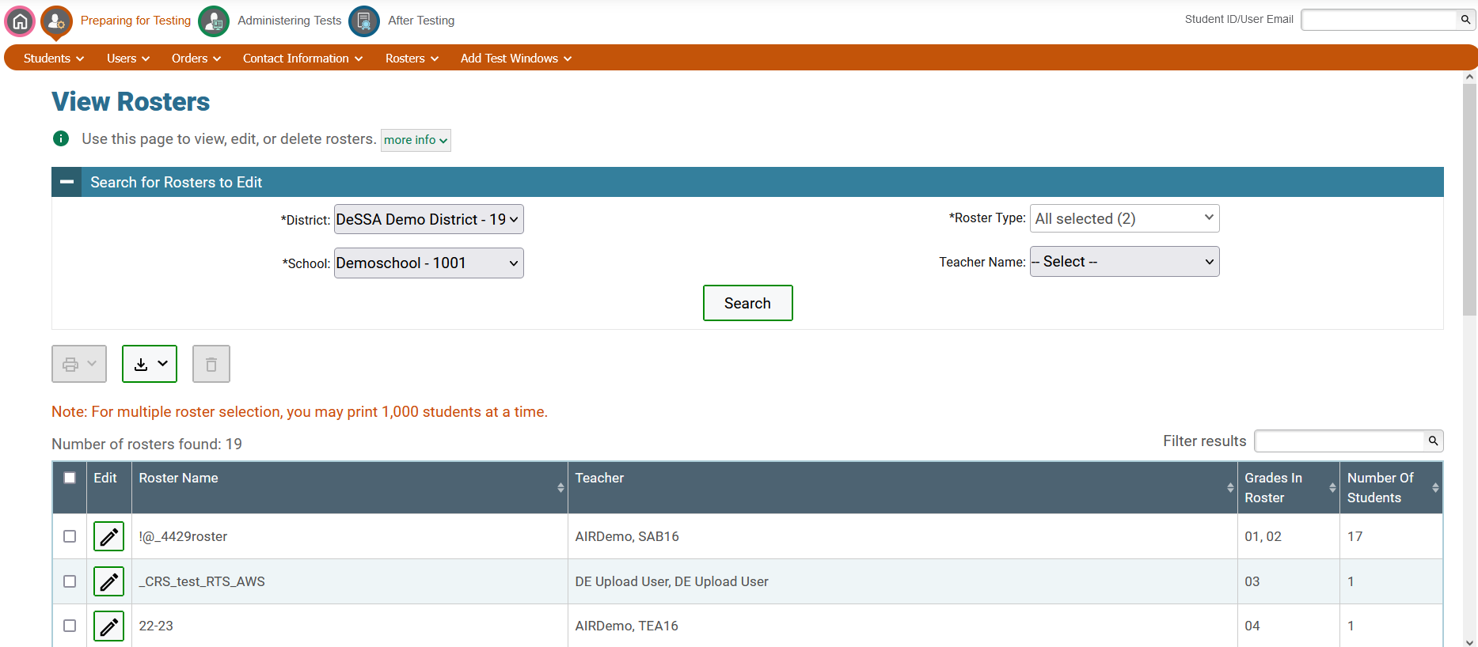
View Rosters
Notes:
The View Roster page includes a form for setting selection criteria to retrieve rosters. In this example, the district, school, and roster type criteria are required. Your particular version of TIDE may have other fields by which you can retrieve rosters. Click Search to display a list of rosters matching your criteria.
Print, export, or delete rosters from TIDE by selecting the desired rosters and clicking the Print, Export, or Delete buttons above the search results.
Click the pencil icon next to a roster to view or edit its details. The Edit Roster form will appear. This form is similar to the form used to add rosters, and you may edit the roster name, teacher name, and students to display in the roster in the same way that you would for a new roster.

Slide 34
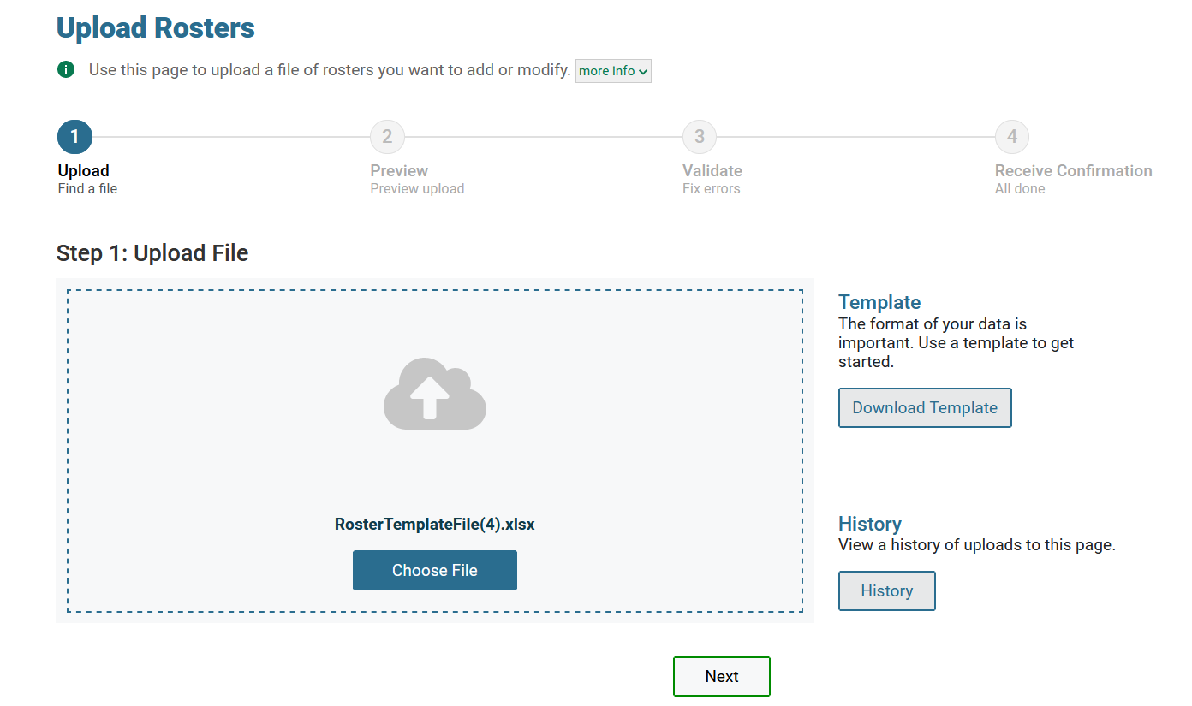
Upload Rosters
Notes:
A second way to add new rosters into TIDE is to use the Upload Roster page to compose an upload file in Excel or CSV format and then upload that file.
This task is performed by downloading a template file, entering information into the template, saving, and clicking the Choose File button to locate the file and upload it into TIDE.
Users can also delete a student from a roster via an upload file. For specific instructions on deleting students from a roster via an upload file, see your TIDE User Guide.

Slide 35
Upload, continued
Notes:
When you click Next, the preview upload screen will appear. Verify that the information is correct, then click Next. To cancel the upload, click Cancel.

Slide 36
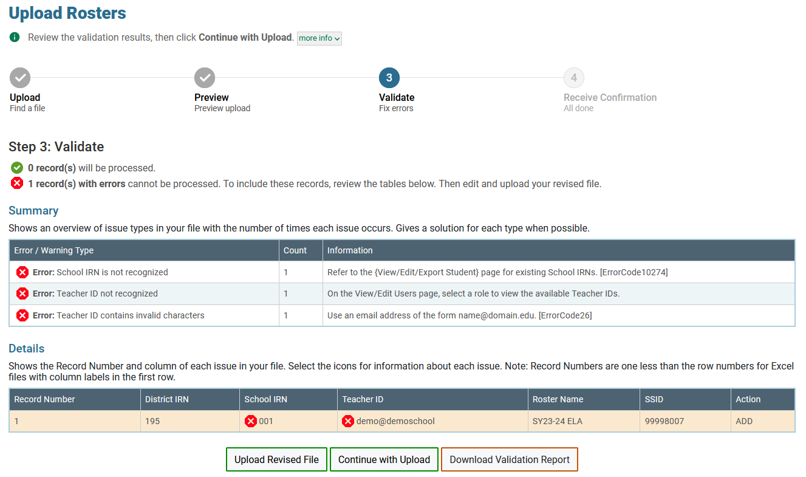
Upload Rosters, continued
Notes:
TIDE will validate the file and display any errors or warnings according to the legend on the page. Click the error icons and warning icons in the validation results to view the reason that a field is invalid. If a record contains an error, that record will not be included in the upload. If a record contains a warning, that record will be uploaded, but the field with the warning will be invalid.
To upload a different file, click Upload Revised File.
To complete the upload, click Continue with Upload.
To view a PDF file listing the validation results for the upload file, click.
Download Validation Report
If your file contains a large number of records, TIDE will process the file offline and send you a confirmation email when complete. While TIDE is validating the file, do not click Cancel, as TIDE may have already started processing some of the records.
When the upload is complete, a confirmation page will appear with a message that summarizes how many records were uploaded and how many were excluded.

Slide 37
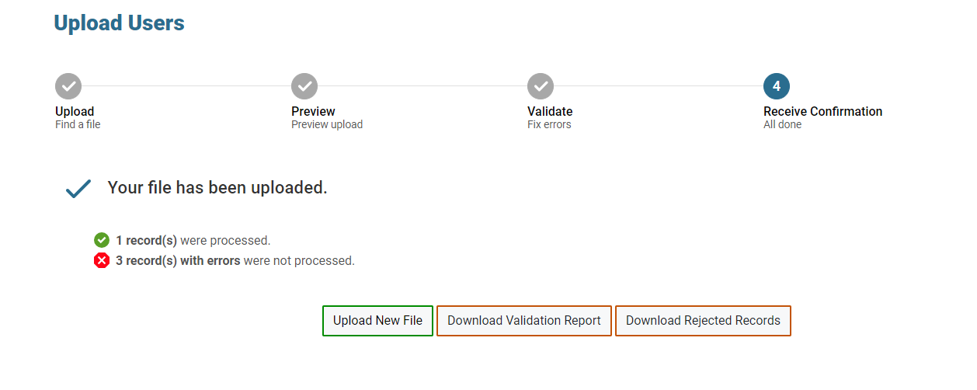
Upload Rosters, continued
Notes:
When the upload is complete, a Confirmation page will appear with a message that summarizes how many records were uploaded and how many were excluded. Click Upload New File to upload additional files. The Validation Report and any rejected records can be downloaded by selecting the appropriate button at the bottom of the confirmation screen.
You may use the upload records process with other tasks too, such as uploading interim grades. Your test menu options vary by state.

Slide 38
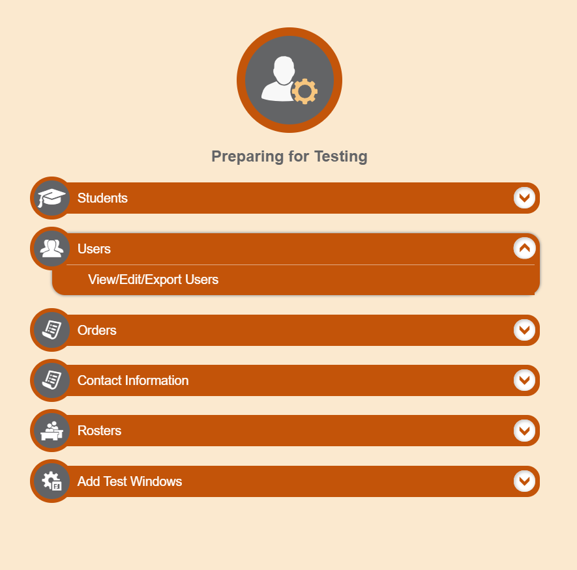
Users
Notes:
Before testing begins, and throughout the school year, TIDE is used to manage user accounts for TIDE itself, the TA Interface, the Centralized Reporting System (CRS), and other Cambium Assessment systems. The Users task menu allows you to add users; view, edit, or export users; and upload users from an external file.
NOTE: Only District level users and School Test Coordinators have permission to edit user roles.

Slide 39
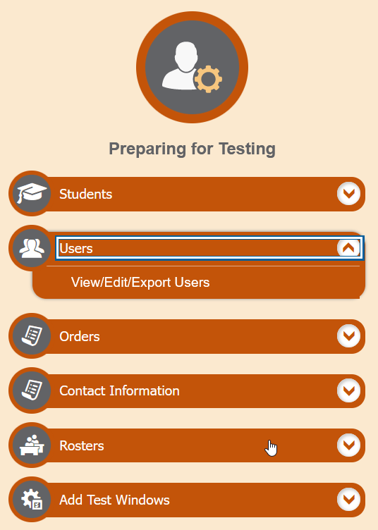
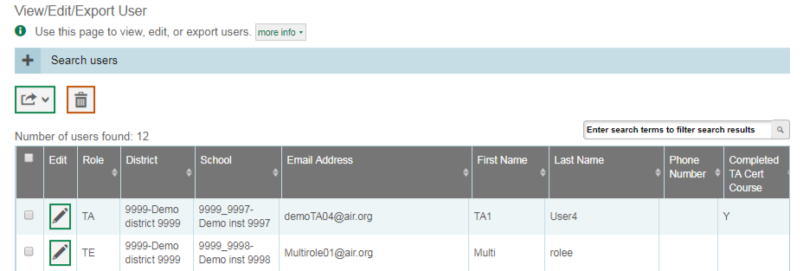
Modify Users One at a Time
Notes:
The View/Edit/Export Users page includes a form for setting selection criteria to retrieve users. In this example, the required criteria are the user’s role, state, and district. Other criteria are optional, such as the first or last name. Your particular version of TIDE may have other fields by which you can retrieve users. Click Search to continue. The search panel will automatically collapse, and your search results will appear below.
After you click Search, TIDE will display all the users satisfying the search criteria. If your user role permits, you can edit a user’s role by clicking the green pencil icon. Another page will appear for you to edit and save the role.
To export user information, mark the checkboxes next to the users you wish to export and click the green export button above the search results. A pop-up window will appear with the option to export to the Inbox in either Excel or CSV format.
To delete a user’s role from TIDE, click the orange trash can button next to the user’s role.
To make the search form reappear and search for additional users, click the plus sign in the Search users panel, which appears as a blue bar.
For more-detailed information on managing users, see your TIDE User Guide.

Slide 40
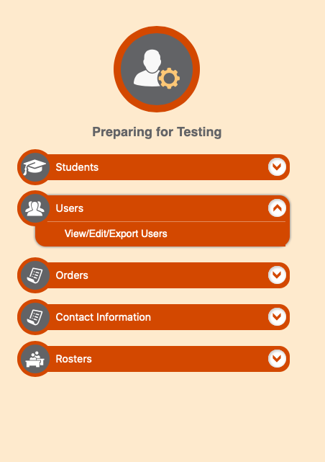
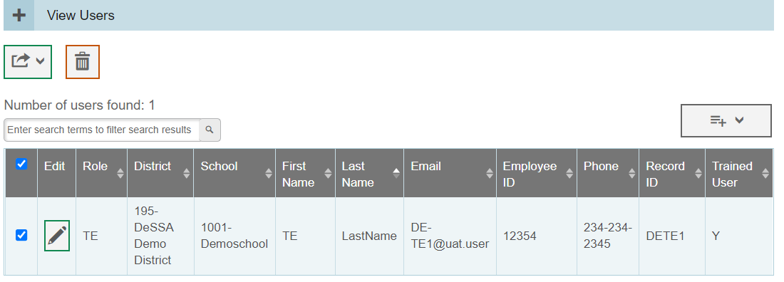
View/Edit/Export User Results
Notes:
After you click Search, TIDE will display all the users satisfying the search criteria. If your user role permits, you can edit a user’s information by clicking the green pencil icon. Another page will appear for you to edit and save information.
To export user information, mark the checkboxes next to the users you wish to export and click the green export button above the search results. A pop-up window will appear with the option to export to the Inbox in either Excel or CSV format.
To delete users from TIDE, mark the checkboxes next to the users you wish to delete and click the orange trash can button above the search results.
To make the search form reappear and search for additional users, click the plus sign in the Search users panel, which appears as a blue bar.
For more-detailed information on managing users, see your TIDE User Guide.

Slide 41
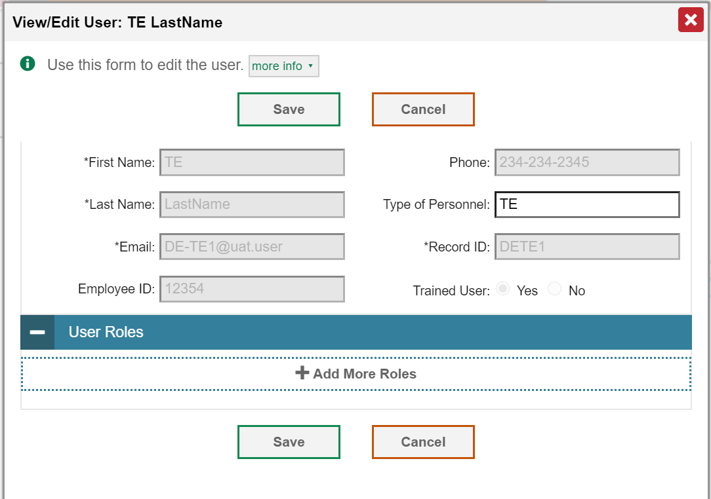
View/Edit/Export User Results- Add More Roles
Notes:
After you click Add More Roles, a drop-down menu will appear and you can select the user role you want to assign this user. You must delete the current user role before adding a new role, unless you are adding the same role for a different school.
Once the user role has been assigned, click Save.
Please note that only DTCs and ISO can add user roles in TIDE. For more-detailed information on managing users, see your TIDE User Guide.

Slide 42
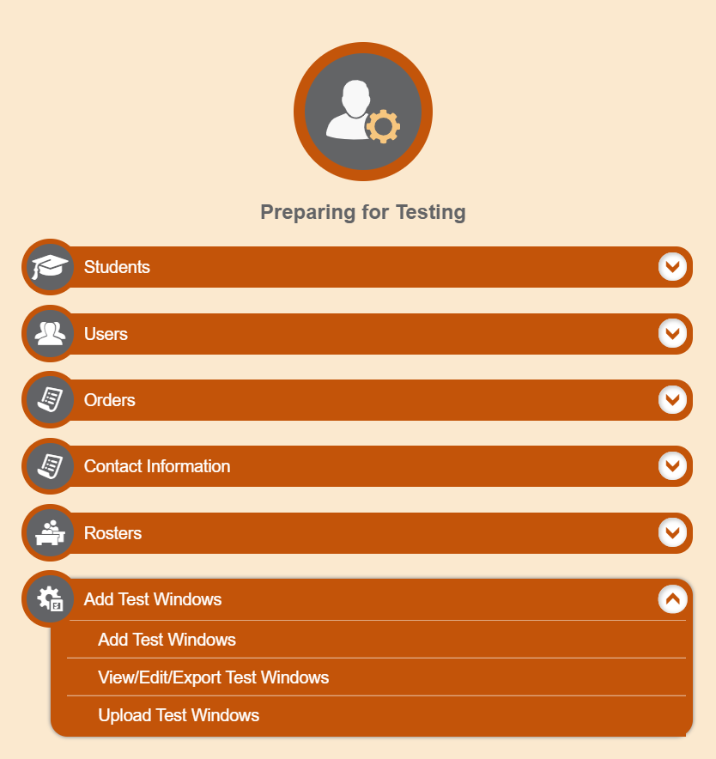
Test Windows
Notes:
The Test Windows task menu allows you to add customized test windows; view, edit, or export test windows; and upload test windows from an external file.

Slide 43
Test Windows Example
District 1
School A
School B
State
District 2
School C
School D
School E
April 1–5
April 8–12
April 15–19
Notes:
Prior to the beginning of a school year, the DDOE establishes the test windows for each test administration. Individual districts or schools can create customized test windows that permit testing within a narrower time period. Districts may want to use this feature to manage testing schedules.
In this example, a state has two districts: District 1 and District 2. The state sets a default test window of April 1–5 for a particular test. The schools in District 1 (School A and School B) offer the tests during that time. District 2 has some disruptions in the academic year, so it changes its test window to April 8–12 for the same test; therefore, its subsidiary schools (School C and School D) also offer the test during that time. School E, also part of District 2, encounters extenuating circumstances and moves its test window a week further, to April 15–19.

Slide 44
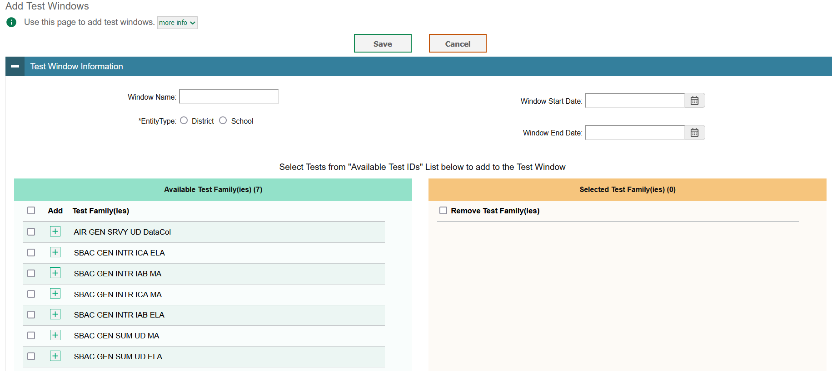
Add Test Windows
Notes:
You can manually create a customized test window on the Add Test Windows page.
Begin by entering a name for the test window in the Window Name field. Next, select an entity type for which you want to add a test window: District or School. From the State, District, and School drop-down lists (as available), make selections for the district, state, and school. Then, enter the test window’s start and end dates.

Slide 45
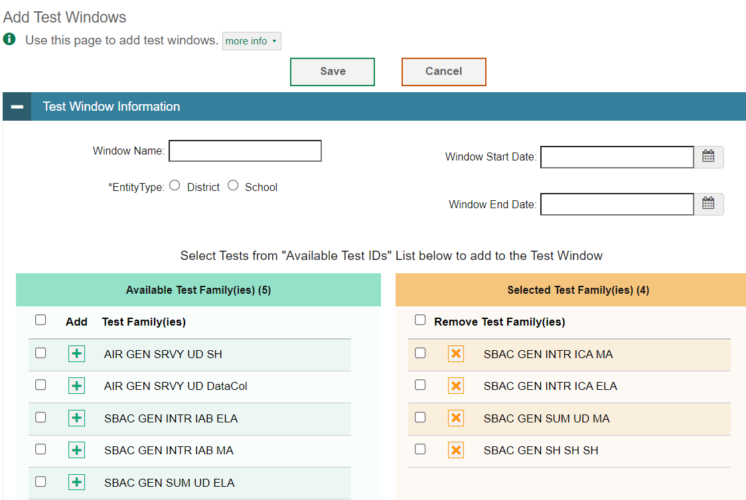
Add Test Windows, continued
Notes:
Next, add tests in the Add/Remove Tests section. To add a single test to the window, click the green plus sign next to a test in the left column. You can add multiple tests to the window by marking checkboxes next to the tests you want to add and then clicking Add Selected. Add all available tests to the window by clicking Add All.
To remove a single test from the window, click the orange X next to a test in the right column. You can remove multiple tests from the window by marking checkboxes next to the tests you want to remove and then clicking Remove Selected. Remove all tests from the window by clicking Remove All.
Click Save to save the new test window. The new test window will take effect immediately in the TA Interface.

Slide 46
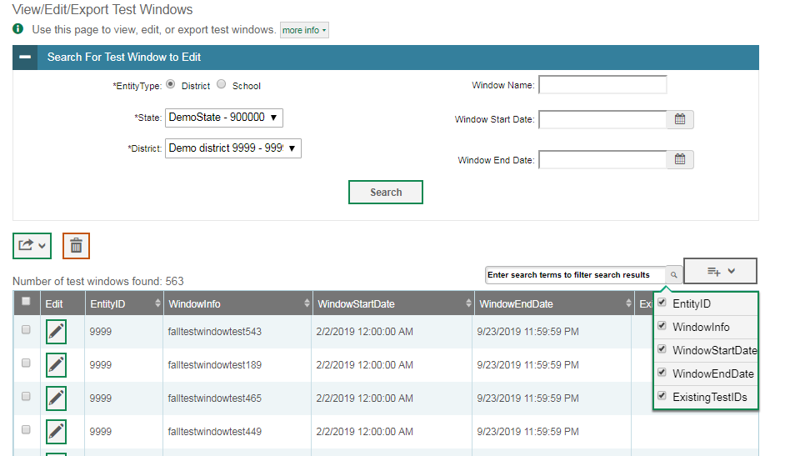
View/Edit/Export Test Windows
Notes:
The View/Edit/Export Test Windows page includes a form for setting selection criteria to retrieve test windows. Select the district and/or school associated with the test window you wish to retrieve and enter additional criteria as desired. Click Search to display a list of test windows matching your criteria. The search panel will automatically collapse, and your search results will appear below. To show or hide table columns, click the drop-down menu in the upper-right corner above the results table. Check the boxes next to the columns you want to appear in your table.
Click the pencil icon next to a test window to view or edit its details. The Edit Test Window form will appear. This form is similar to the form used to add test windows. You may edit the test window label, start and end dates, and tests in the same way that you would for a new test window.
To export the results, mark the checkboxes next to the results you wish to export and click the green export button above the search results. A pop-up window will appear with the option to export to the Inbox in either Excel or CSV format.
Delete test windows from TIDE by selecting the desired windows and clicking the trash can icon.

Slide 47
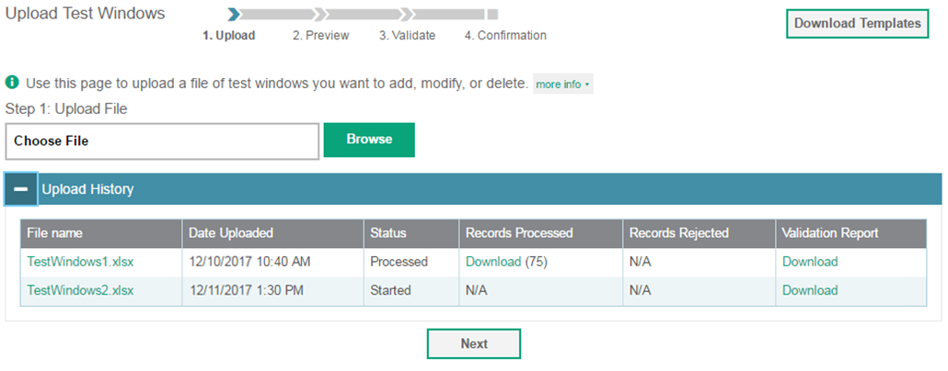
Upload Test Windows
Notes:
A second way to add new test windows to TIDE is to use the Upload Test Windows page to compose an upload file in Excel or CSV format and then upload that file. This task is performed by following the same steps used for uploading new records such as users and students.

Slide 48
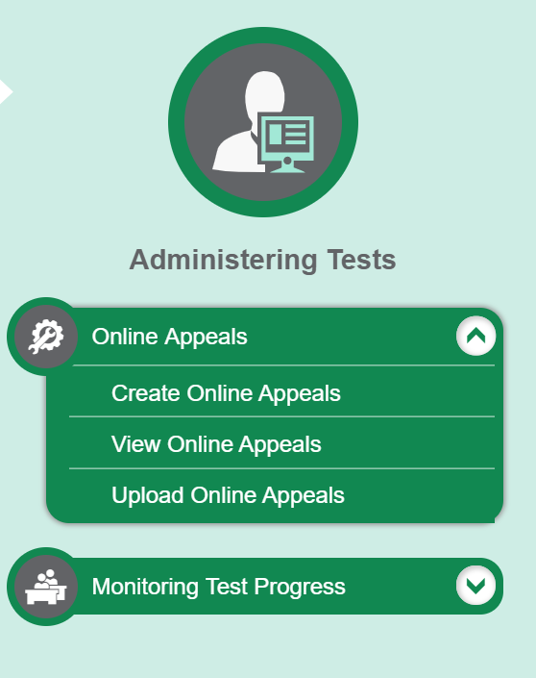
Appeals
Notes:
In the Administering Tests section of the TIDE dashboard, the Appeals task menu allows you to view pending appeals; create new appeals; view; and upload appeals.
In the normal flow of a test opportunity, a student takes the test in the test delivery system (TDS) and then submits it. Next TDS forwards the test for scoring, and the Online Reporting System reports the test scores.
Appeals are a way of interrupting this normal flow. Reasons for appeals can vary. For example, a student may need to retake a test or have another test opportunity. A test administrator may need to invalidate a test because of a hardware malfunction or an impropriety.
For information on particular terminology, policies, and procedures, please consult the Test Administration Manual.

Slide 49
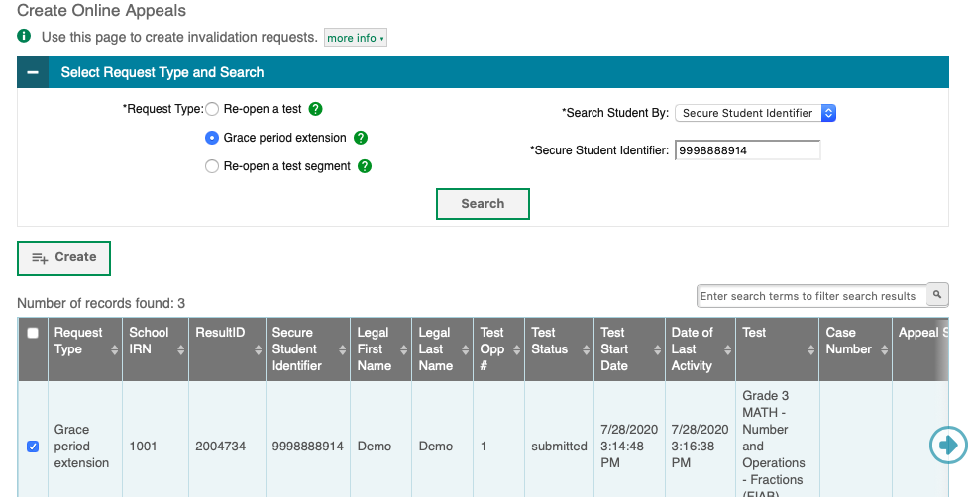
Create Appeals
Notes:
The Create Appeals page is where you can create an appeal for a test.
The following appeals are available to DTCS: re-open a test, grace period extension, and re-open a test segment.
The first step is to select the type of appeal you want to create. The TIDE User Guide lists the available appeal types and explains the implications of each.
Next, search for the test result for which you wish to create an appeal. From the drop-down lists and in the text field, enter your search criteria and click Search. TIDE will display the search results below.
Mark the checkbox next to each test result for which you wish to create an appeal and click Create. A pop-up window will ask you to enter a reason for the appeal. To create the appeal, enter a reason and click Submit.

Slide 50
Status of Appeals
Appeal Status | Description of Status
Error Occurred | An error occurred while the appeal was being processed.
Item Information Sent | Information regarding a Report Problem with Item appeal was sent to the designated recipients.
Pending Approval | Appeal is pending approval.
Processed | Appeal was successfully processed and the test opportunity has been updated.
Rejected | Another user rejected the appeal.
Rejected by System | TDS was unable to process the appeal.
Requires Resubmission | Appeal must be resubmitted.
Retracted | Originator retracted the appeal.
Submitted for Processing | Appeal was submitted to the TDS for processing.
Notes:
After an appeal is created, its status can change throughout its life cycle. This table describes the possible statuses an appeal can have.

Slide 51
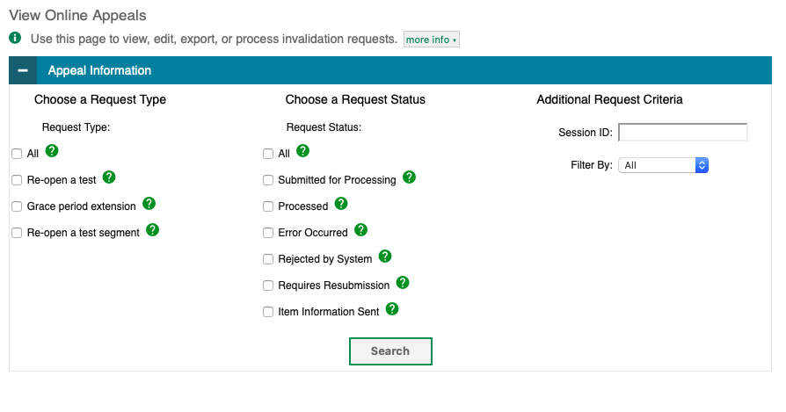
View Appeals
Notes:
You can review submitted appeals from the View/Approve/Export Appeals page. Select an appeal type and status and enter additional search criteria as desired. Click Search to display appeals matching your criteria.
To quickly display all pending appeals, click Pending Appeals in the task menu. This shortcut lets you skip the selection of search criteria.

Slide 52
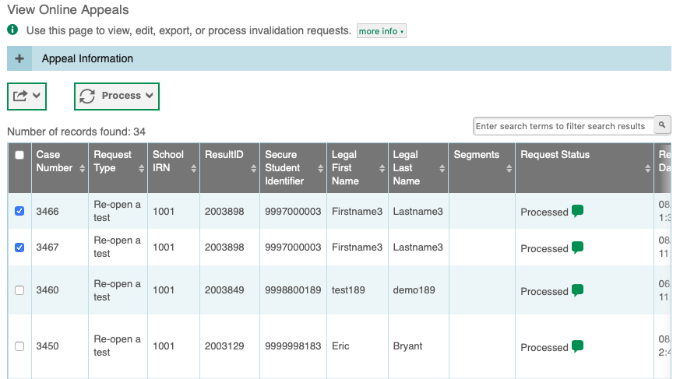
View/Export Appeals Results
Notes:
When you click Search, the search panel will automatically collapse, and your search results will appear below.
To view the approval and processing status of an appeal, click the green comment icon in the Request Status column.
To approve, reject, retract, or resubmit an appeal, mark the checkbox next to it, click Process, and then select the action you wish to perform.
To export the results, mark the checkboxes next to the results you wish to export and click the green export button above the search results. A pop-up window will appear with the option to export to the Inbox in either Excel or CSV format.
Approving an appeal will update the test opportunities and results accordingly. Rejecting an appeal will continue the processing of test results as if the appeal had never been submitted.

Slide 53
Upload Appeals
Notes:
A second way to create new appeals in TIDE is to use the Upload Appeals page to compose an upload file in Excel or CSV format and then upload that file. This task is performed by following the same steps used to upload new users and students.

Slide 54
Monitoring Test Progress
Notes:
The tasks available in the Monitoring Test Progress task menu allow you to generate various reports that provide information about a test administration's progress.
Several types of participation reports are available:
The Plan and Manage Testing report details all of a student’s test opportunities and the status of those test opportunities.
The Test Completion Rates report summarizes the number and percentage of students who have started or completed a test.
The Participation Search by SSID report shows test participation for specified students.

Slide 55
Plan and Manage Testing
Notes:
The Plan and Manage Testing reports detail all of a student’s test opportunities and the status of each test opportunity. Because the report lists testing opportunities, a student can appear more than once on the report.
To generate a report from the Plan and Manage Testing page, select a test instrument and administration under the Choose What panel.
Next, in the Search Students panel, select a district, school, and teacher if applicable. The fields marked with an asterisk are mandatory. You can refine your search by adding additional criteria under the Advanced Search section.
Finally, in the Get Specific panel, choose one of the filter options available and select parameters for that option.
Click Generate Report to view your Plan and Manage Testing report, or click Export Report to open the report in Excel.

Slide 56
Plan and Manage Testing- Search Student
Notes:
To generate a report from the Plan and Manage Testing page, first in the Search Students panel, select a district, school, and teacher if applicable. You can search specific SSID, gender, and enrolled grade. The fields marked with an asterisk are mandatory. You can refine your search by adding additional criteria under the Advanced Search section.

Slide 57
Plan and Manage Testing- Choose What
Notes:
Next, select a test instrument, test name, and administration under Choose What.

Slide 58
Plan and Manage Testing- Get Specific
Notes:
Finally, in the Get Specific panel, choose one of the filter options available and select parameters for that option.
Click Generate Report to view your Plan and Manage Testing report, or click Export Report to open the report in Excel.

Slide 59
Plan and Manage Testing Examples
Which students have not yet tested?
Which students need to test in the next five days?
Which students have paused tests?
Did all students in a test session submit their tests?
Notes:
This slide illustrates some common questions that can be answered using the options available in the Get Specific panel.
To find students who have not yet tested, select the first radio button and search for students who have not completed their test opportunity in the selected administration.
To find students whose test opportunities are expiring, select the second radio button and specify the number of days or range of days you want to search.
To find students who have paused tests, select the third radio button and search for students on their first test opportunity in the selected administration with a status of paused.
To find out if all students in a test session submitted their tests, select the fourth radio button and search for students by test session ID between the dates when the test session took place.

Slide 60
Plan and Manage Testing Results
Notes:
Clicking Generate Report will display the report and collapse the Report Criteria panel. Because not all columns can fit on the screen at once, click the blue arrow on the right side of the screen to scroll right and display more information.

Slide 61
Participation Search By SSID
Notes:
The Participation Search By SSID page allows you to generate participation reports for specified students. Enter a single SSID or multiple SSIDs separated by commas in the Student ID(s) box. You can also upload a single-row Excel file containing student ID numbers. Click Generate Report to view the results.

Slide 62
Test Completion Rates
Notes:
The Test Completion Rates report summarizes the number and percentage of students who have started or completed a test.
To download a report from the Test Completion Rates page, choose the type of report you wish to export from the Report Types drop-down list. Select a district and school from the corresponding drop-down lists, if available. Finally, select a test name and administration. Note that fields marked with an asterisk are mandatory.
To download the report as an Excel spreadsheet, click Export Report.

Slide 63
Test Session Status Report
Notes:
The Test Session Status Report details active and inactive test sessions happening in their district and/or school. These reports show how many students in each school are testing and how many have started, paused, and completed their test. School-level Test Session Status reports also include additional information such as proctor name, test name, and test session start time.
From the Test Session Status Report page, select a district and school from the drop-down lists. Then click Generate Report. A detailed report page will appear.
Note that if multiple schools were selected, a Summary Report page will first appear. From this page, select a school name to view a detailed report for that school.

Slide 64
Contact Your Help Desk
You can contact the Help Desk for assistance with any technical issues you encounter.
When contacting the Help Desk, please be ready to provide the following information:
Any error messages that are appearing (including codes)
Your operating system and browser information
Your network configuration information
Your contact information for follow-up by telephone or email
Any other relevant information, such as test names or content areas, student IDs, session IDs, and search criteria
For test administration or policy issues, please contact your District Test Coordinator.
Notes:
You can find the TIDE User Guide and other helpful resources on the Delaware assessment portal. However, if you still require assistance with troubleshooting a technical issue, you may also contact your Help Desk. When contacting your Help Desk, please be ready to provide the following information:
Any error messages that are appearing (including codes)
Your operating system and browser information
Your network configuration information
Your contact information for follow-up by telephone or email
Any other relevant information, such as test names or content areas, student IDs, session IDs, and search criteria
For questions about test administration or policy issues, please contact your District Test Coordinator.

Slide 65
Thank You!
Further Information
https://de.portal.cambiumast.com/
DeSSA Help Desk:
E-mail Support: DeSSAHelpDesk@cambiumassessment.com
Support Toll-Free Number: 877.560.8331
Hours: 6:30 a.m. to 6:30 p.m. ET- Mondays–Fridays (except holidays)
DOE Contact:
Phone number: (302) 857-3391
https://helpdesk.doe.k12.de.us/
Notes:
Thank you for taking the time to view this training module. For additional information, refer to your TIDE User Guide located on the DE portal or contact the DE Help Desk.

